Slide 1
January 28, 2013
PPWB Hydrology Workshop
2011 Flood Experience
Saskatchewan and Qu’Appelle River Systems

Slide 2
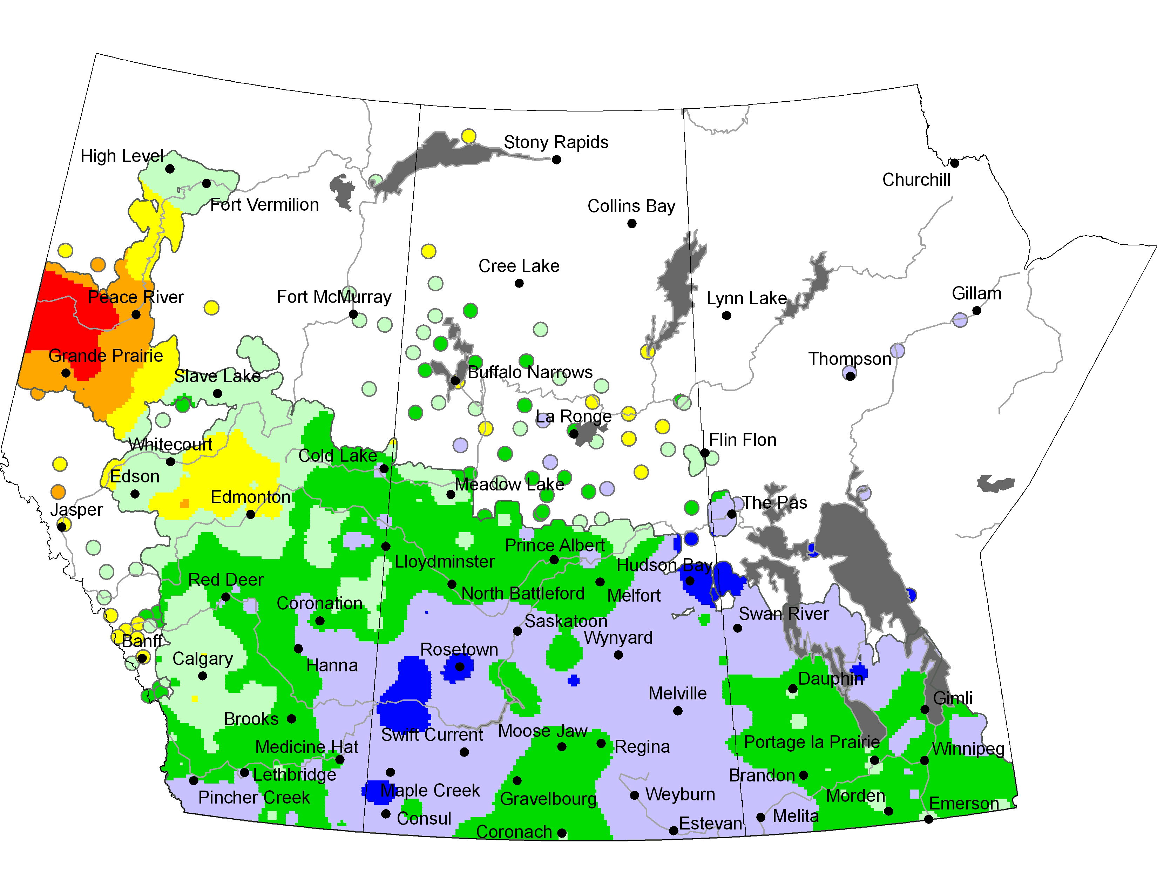
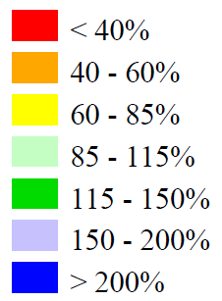
Summer Precipitation - June 9 – Sept 6, 2010

Slide 3
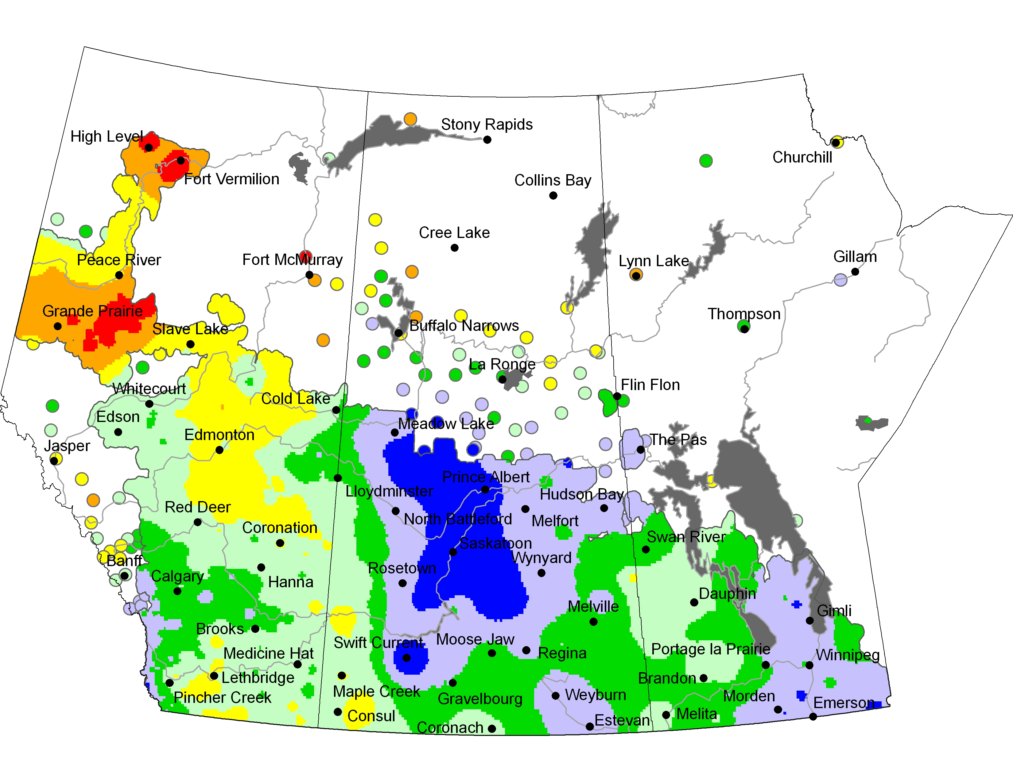
2010 Fall Precipitation - Sept 4-Oct 31 2010

Slide 4
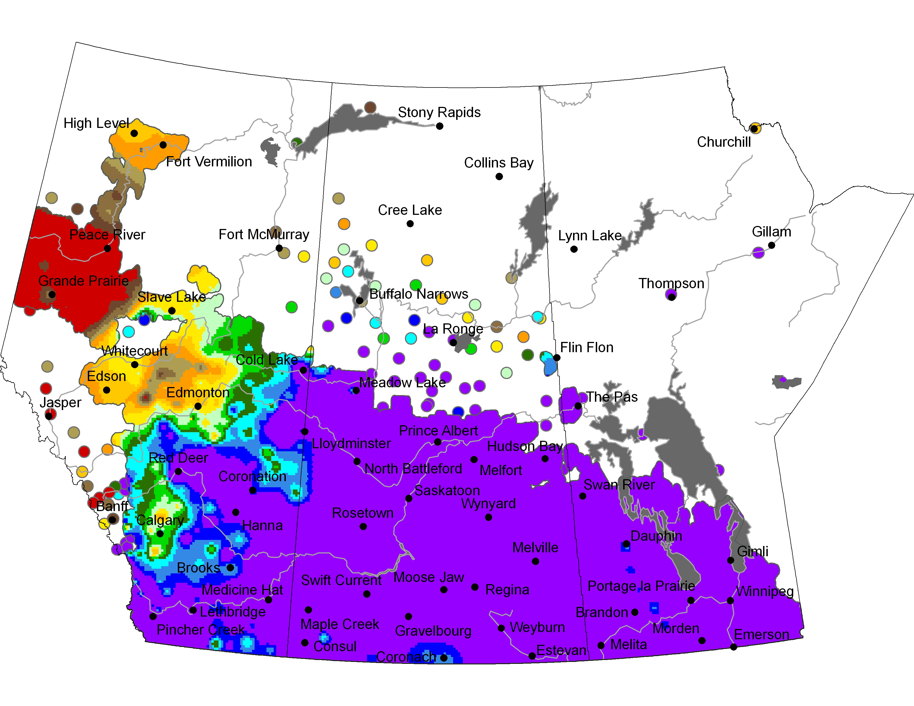
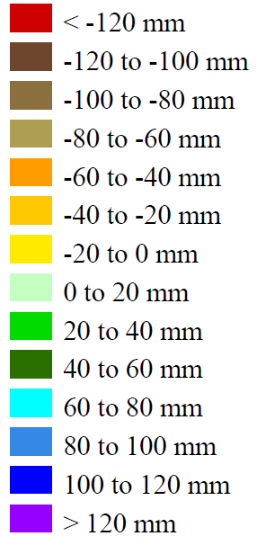
Departure from Normal - Apr 1 – Oct 31 2010
Over 120 mm Above Normal Over Most of the Prairies

Slide 5
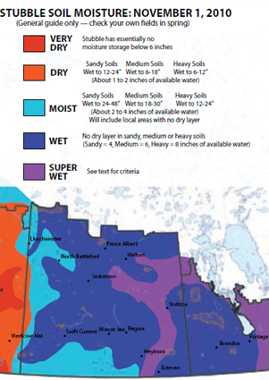
Fall 2010 Soil Moisture Conditions

Slide 6
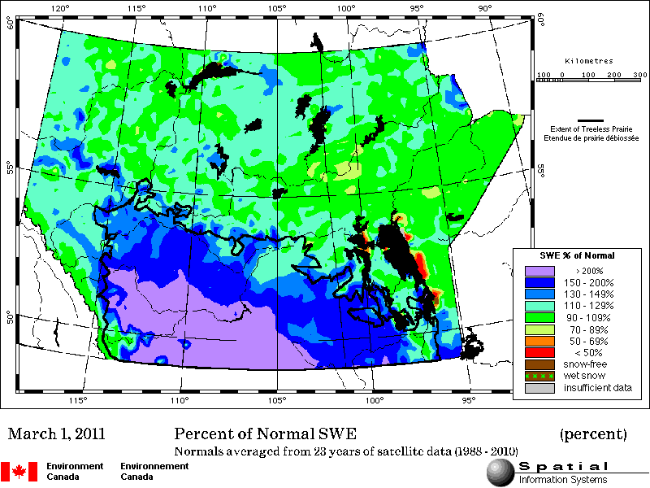
March 1, 2011 Snow Water Equivalent

Slide 7
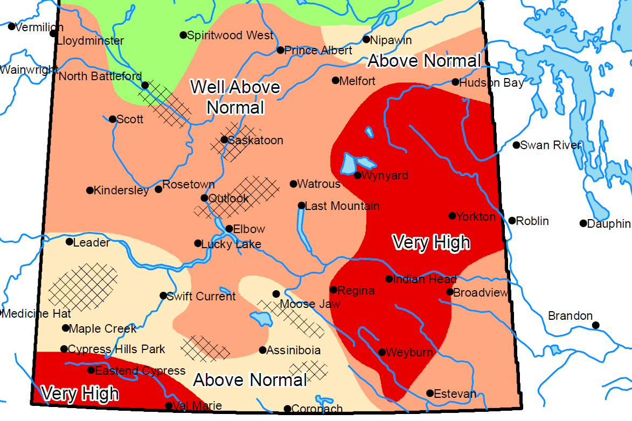
April 1, 2011 Spring Runoff Potential Map

Slide 8
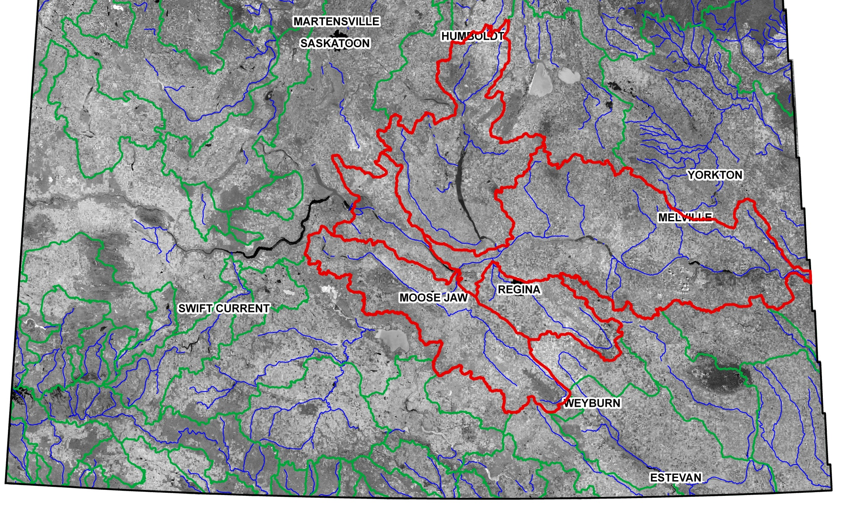
Qu’Appelle River Basin

Slide 9
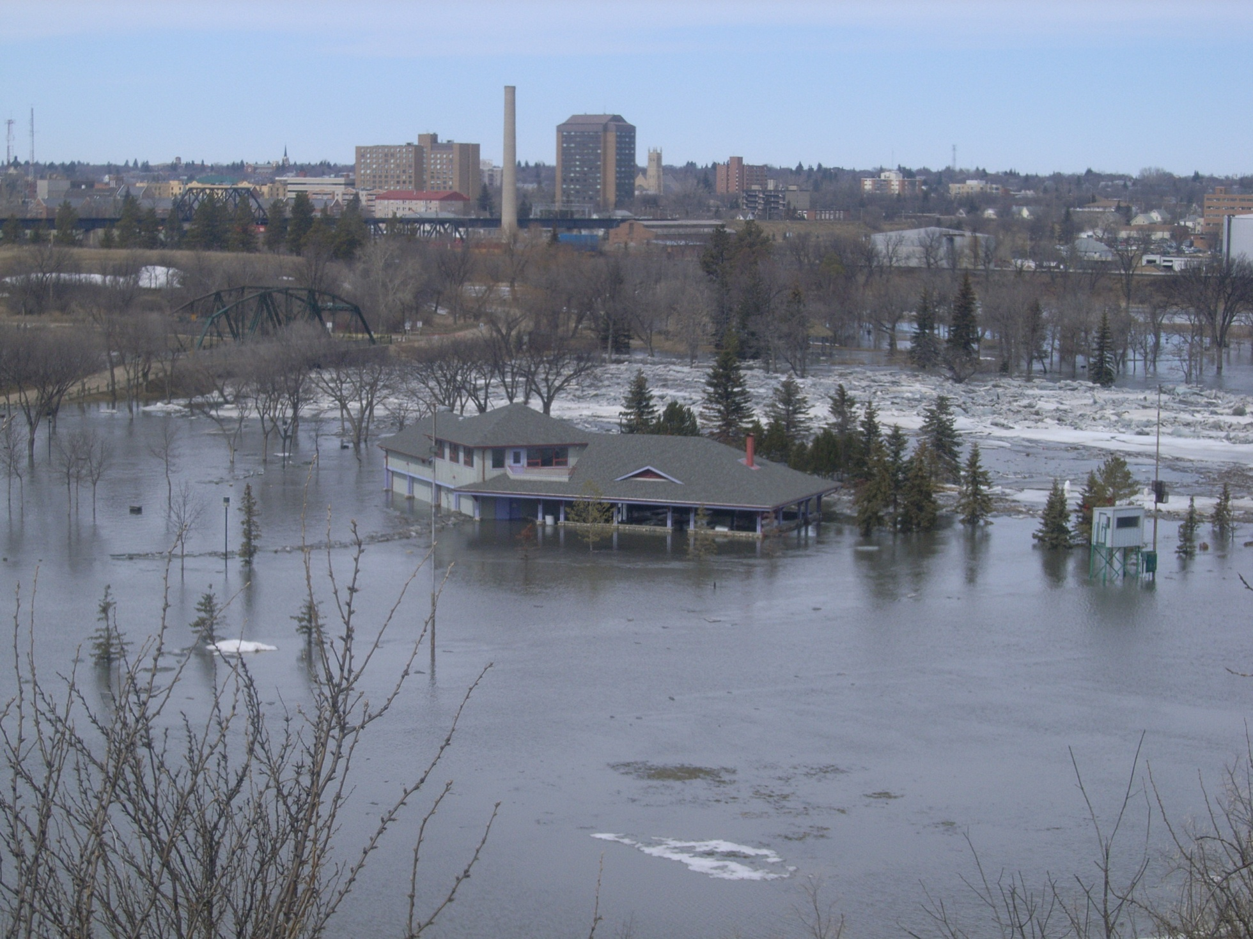
Moose Jaw River at Moose Jaw
Moose Jaw Wakamow Valley Ice Jam Flood on April 8, 2011

Slide 10
Moose Jaw River below Moose Jaw
 | Peak Discharge | Snowmelt Volume
1974 | 368 m³/s | 291,000 dam³
2011 | 197 m³/s | 313,000 dam³
1:25 185 m³/s
1:50 240
1:100 300
1:200 370
1:500 480

Slide 11
Cumulative Rainfall at Indian Head vs Normal
104 mm in 4 Days!

Slide 12
Wascana Creek near Lumsden
 | Peak Discharge | Snowmelt Volume
1974 | 153 m³/s | 165,000 dam³
2011 | 91 m³/s | 213,000 dam³
1:10 | 66 m³/s
1:25 | 97
1:50 | 120
1:100 | 150

Slide 13
Last Mountain Lake

Slide 14
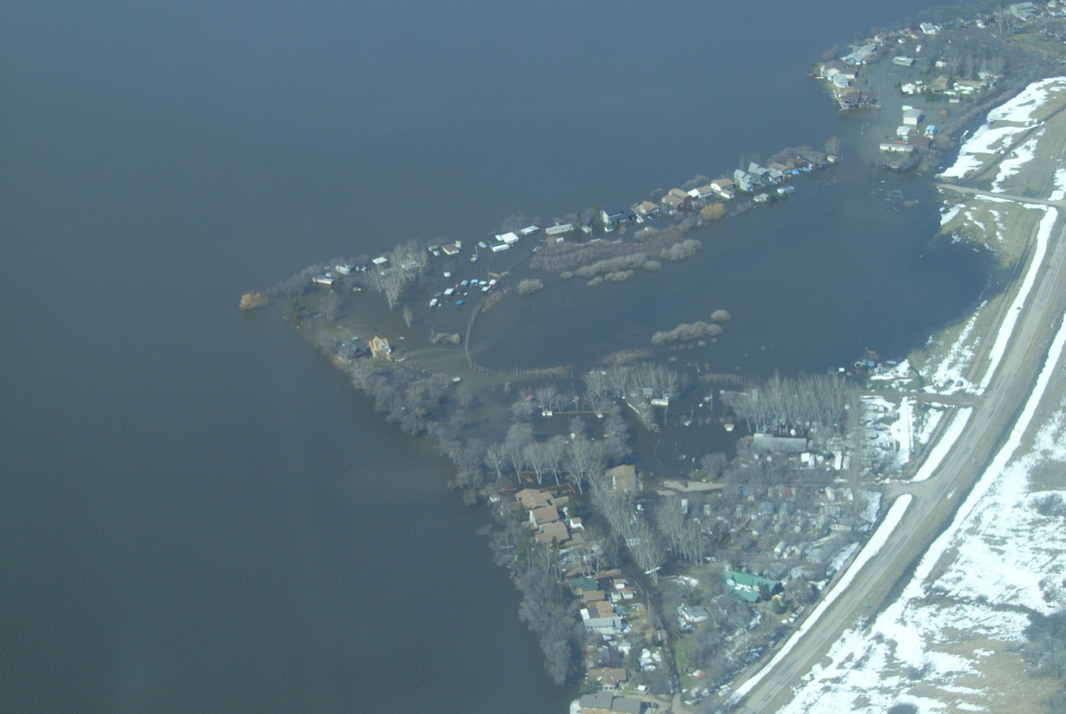
All Lakes on the Lower Qu’Appelle at 1:100 to 1:200 Year Levels
Twin Exner Bay Crooked Lake (453.77 m, peaked at 454.02 m in June) – May 3, 2011

Slide 15
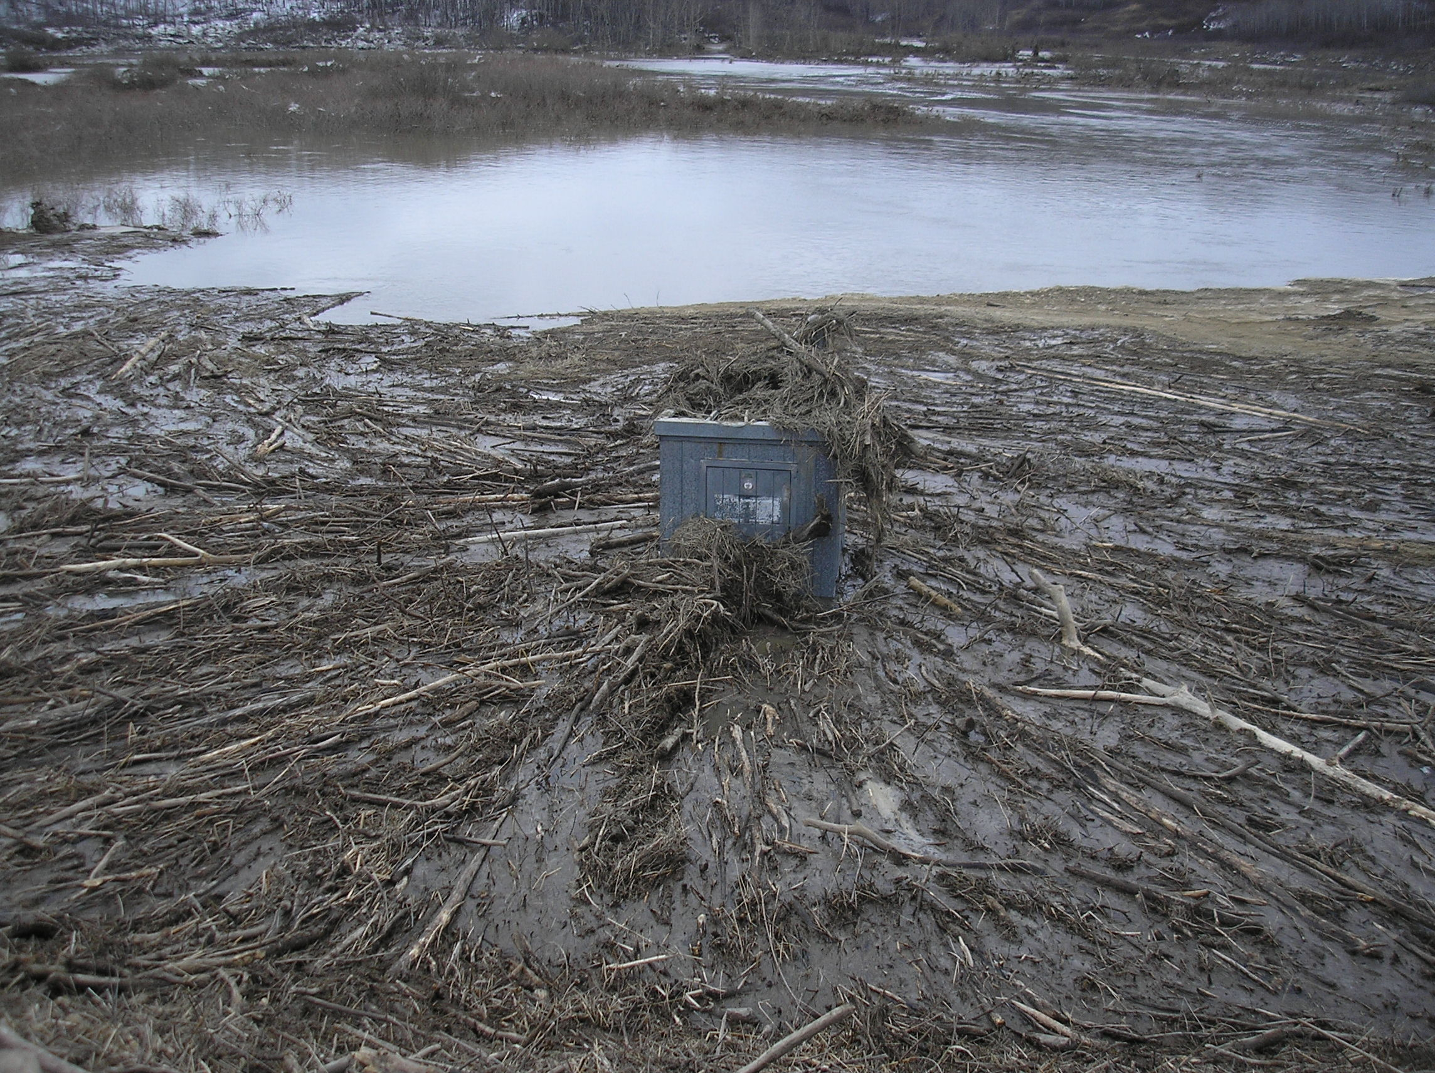
Ekapo Creek near Marieval
April 15, 2011 – Courtesy WSC

Slide 16
Cutarm Creek near Spy Hill
1:10 | 15 m³/s
1:25 | 22
1:50 | 28
1:100 | 35
1:200 | 44

Slide 17
Qu’Appelle at MB Border (Welby)

Slide 18
Qu’Appelle at MB Border (Welby)
1:10 | 120 m³/s
1:25 | 180
1:50 | 240
1:100 | 320
1:200 | 410

Slide 19
Lessons Learned/ Reiterated
Very few big floods in gauge records and every flood is different.
Snowmelt runoff peaks are highly dependent on the melt rate……..1:100 year volumes but 1:20 to 1:50 year peaks on tributaries.
Important to stress the significance of maintaining flood protection works until conditions in the basin improve, not just the lake or river.
Staff complements are not designed for widespread and/or prolonged flood events. Fatigue must be monitored.
Preparations is key.
Remember to collect data to document the event and decision making process.

Slide 20
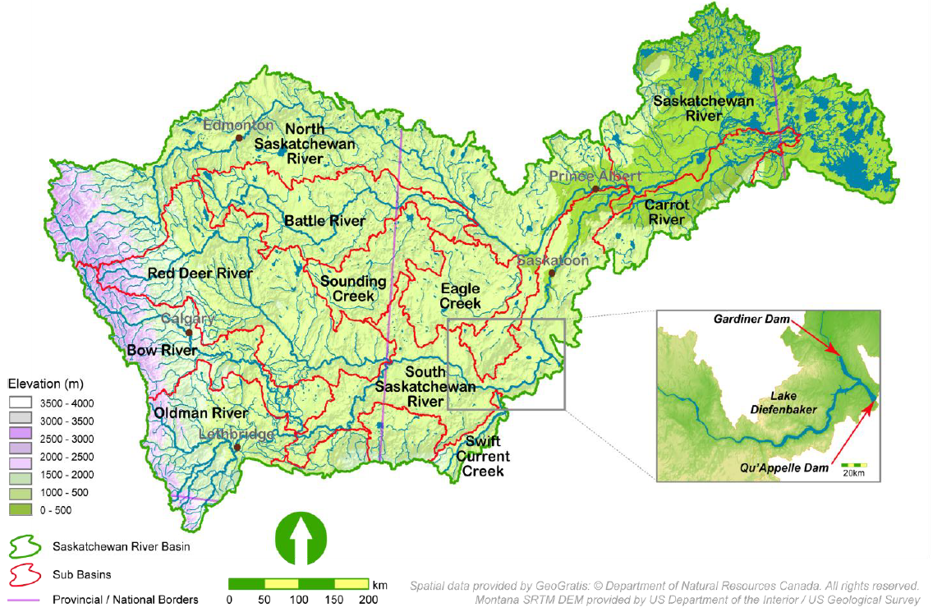
Saskatchewan River System

Slide 21
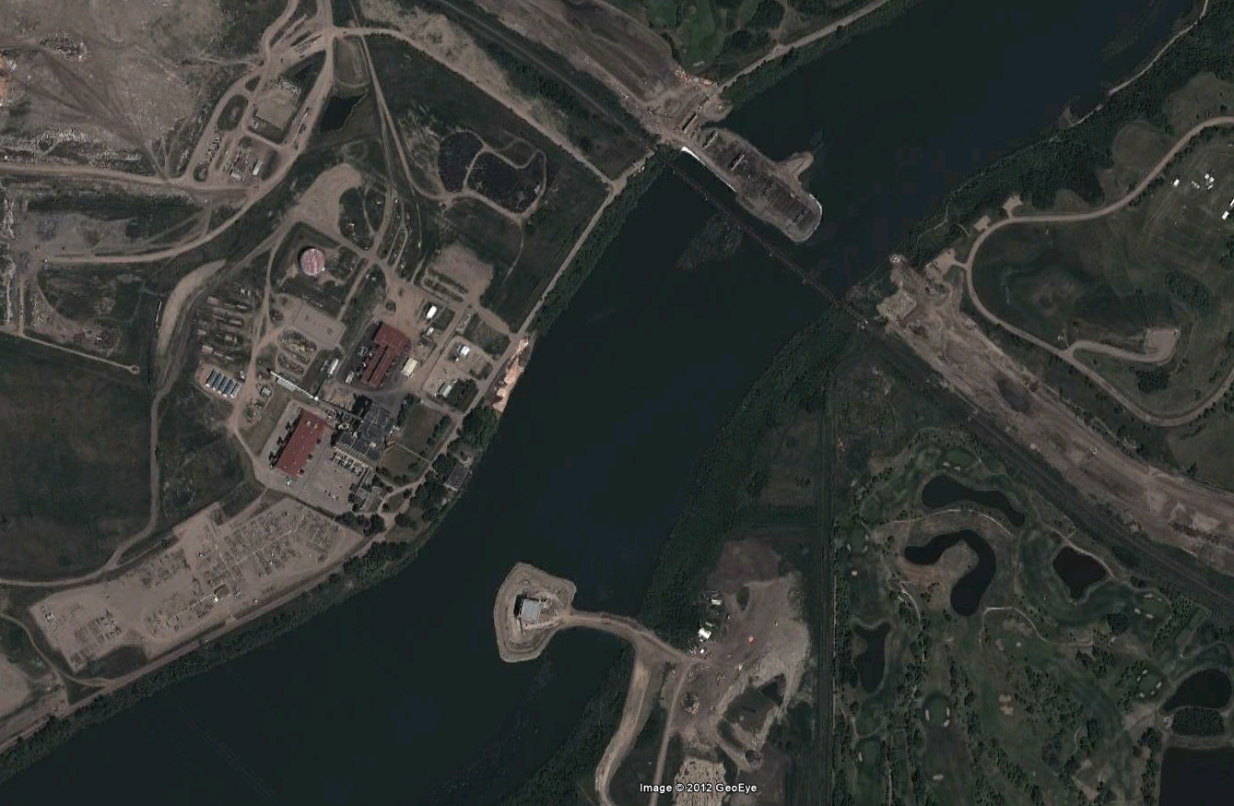
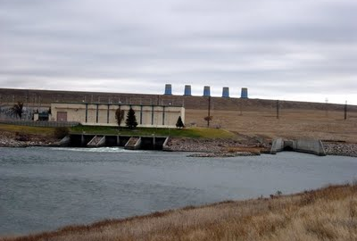
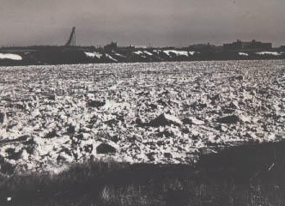
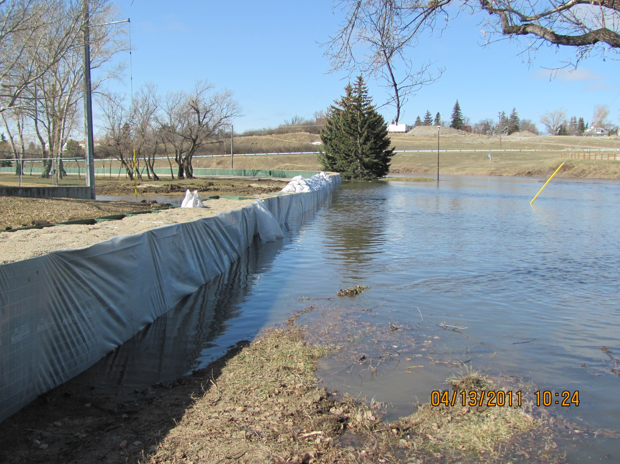
Events Leading Up to Mountain Runoff
Coffer Dams in Saskatoon
Shutdowns at Coteau Creek Power Plant
Ice Concerns
Significant Prairie Melt

Slide 22
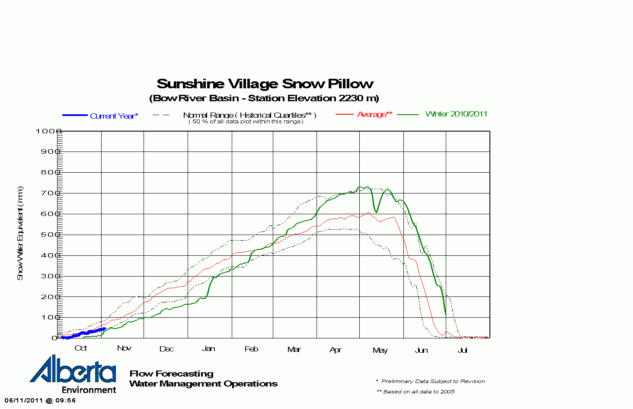
Upper Quartile Snow Pack in Mountains

Slide 23
Diefenbaker Lake Levels

Slide 24
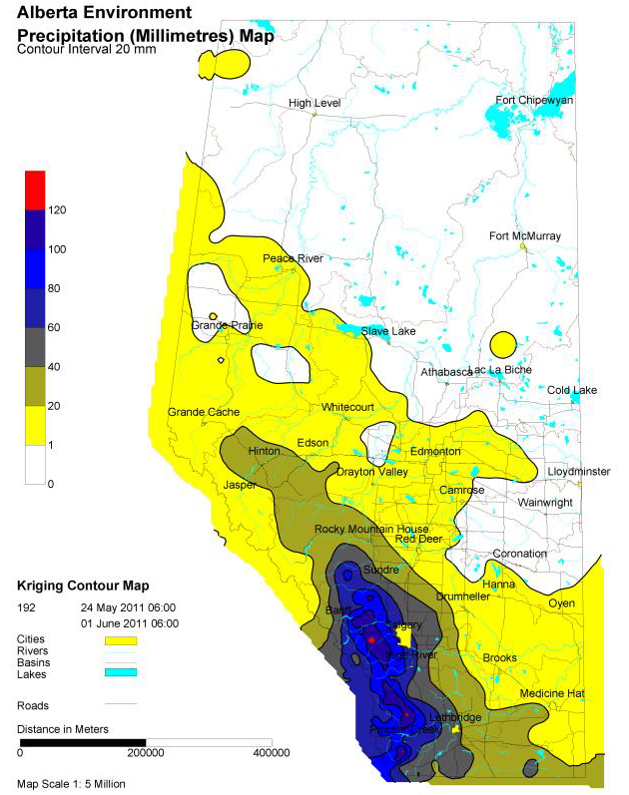
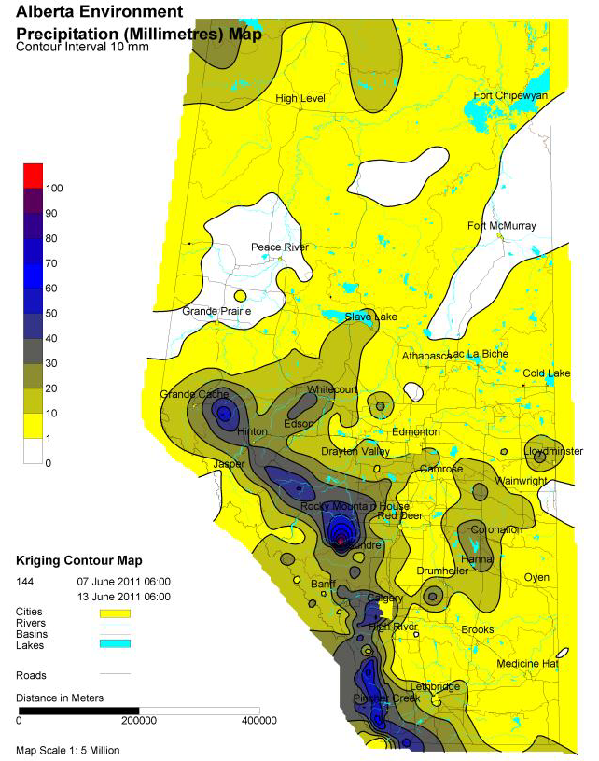
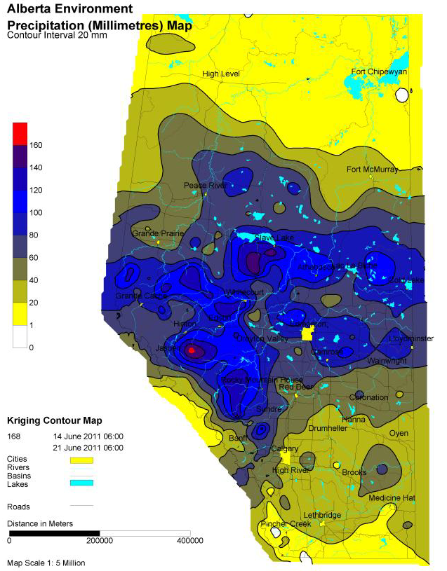
Rainfall Events
May 24 - Jun 1, 60-120 mm on SSR Headwaters
Jun 7-13, 20-80 mm on SSR Headwaters, Up to 160 mm on NSR Headwaters
Jun 14-24, 60-160 mm on NSR Headwaters

Slide 25
Diefenbaker Lake Levels

Slide 26
Diefenbaker Flows and Levels
1:10 year Peak Inflow

Slide 27
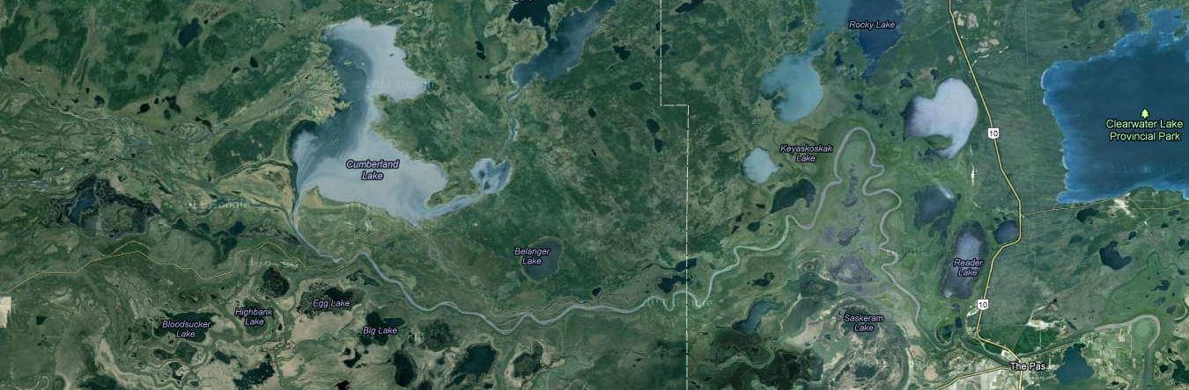
Cumberland Lake & Flows at The Pas
Saskatchewan was interested in where Cumberland Lake was going to peak at for the coordination of flood protection efforts.
Manitoba was very concerned with what the peak flow on the Saskatchewan River at The Pas for similar purposes.
Saskatchewan provided recorded and forecasts outflows from Tobin Lake to Manitoba as well as recorded levels on Cumberland Lake
Manitoba (Bob Harrison) constructed a simple routing model for Cumberland Lake and provided results back to Saskatchewan.

Slide 28
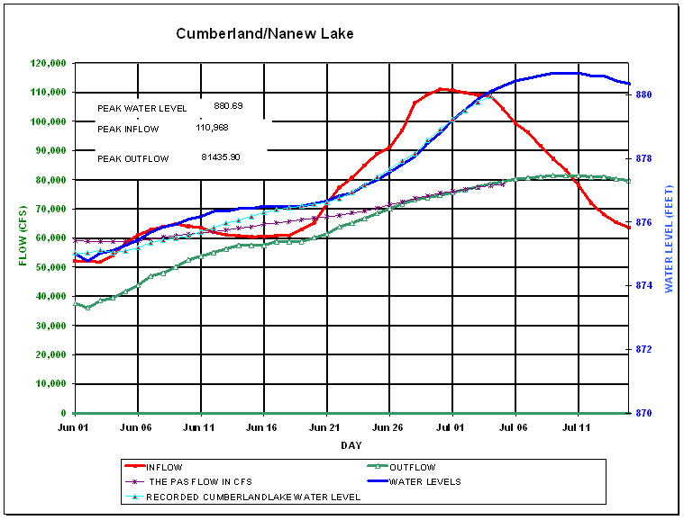
Cumberland Lake & Flows at The Pas
Actual Peaks 880.48 ft and 80,870 cfs

Slide 29
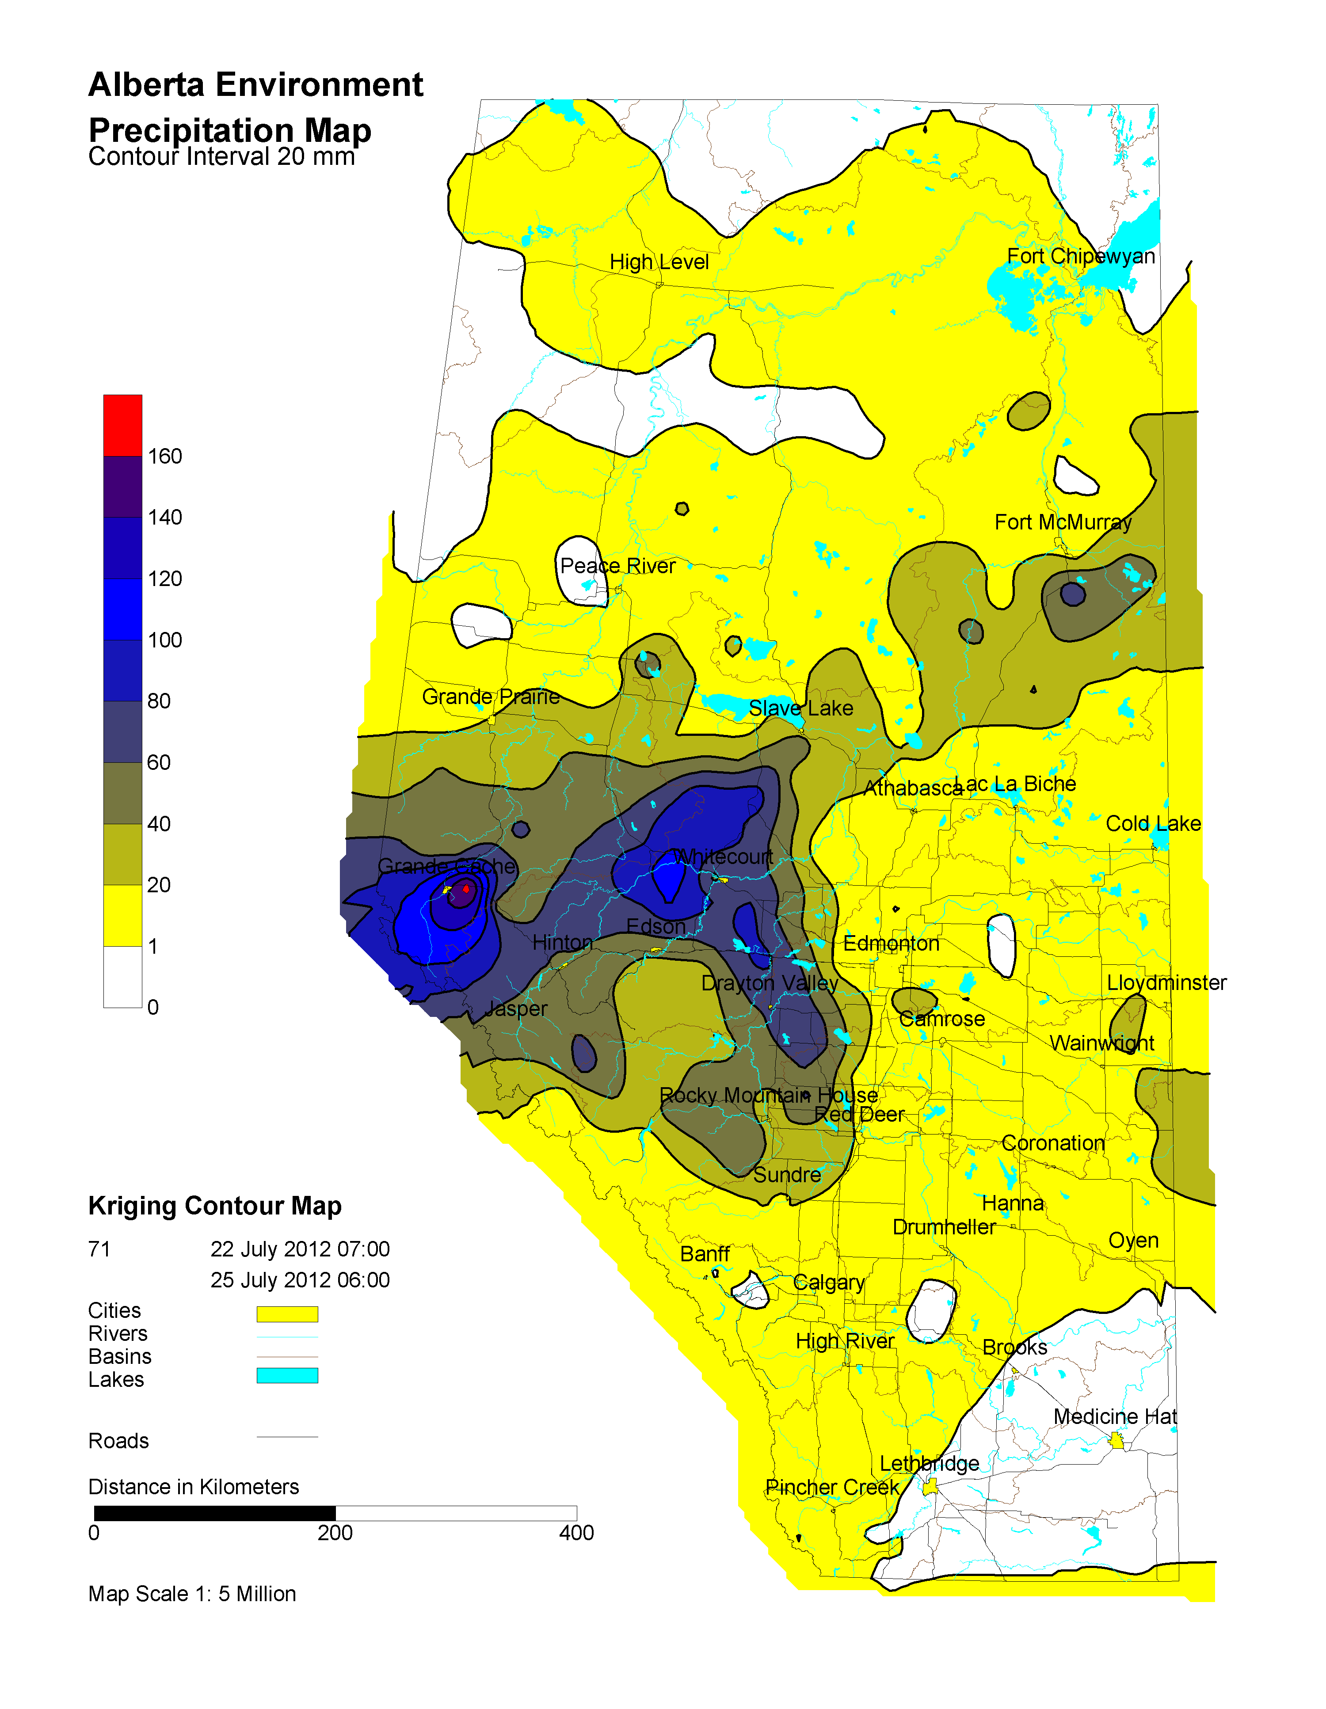
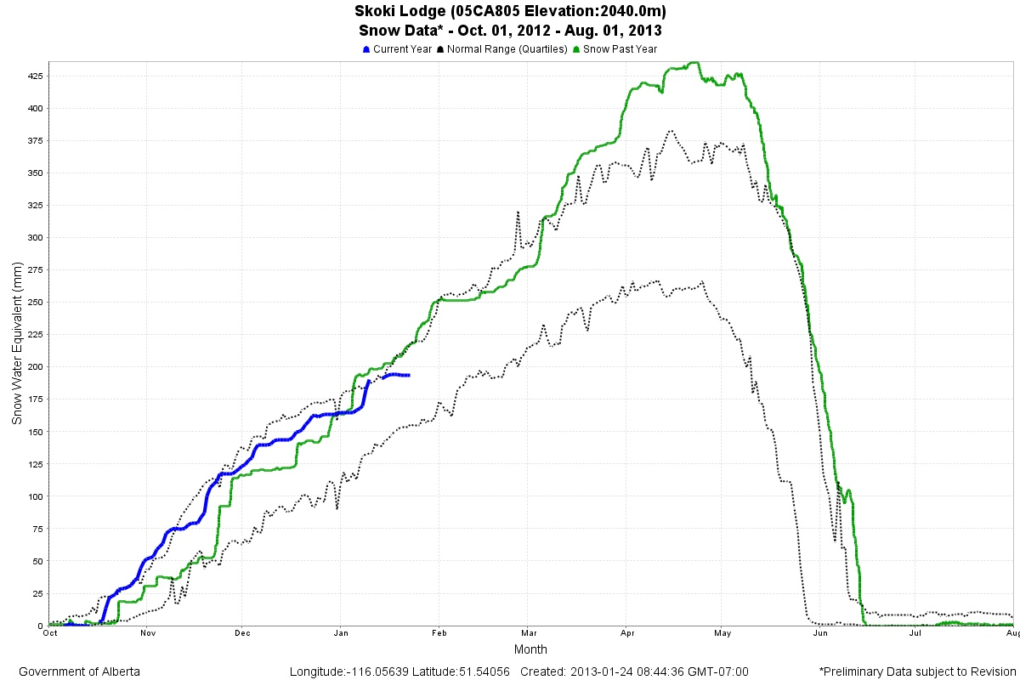
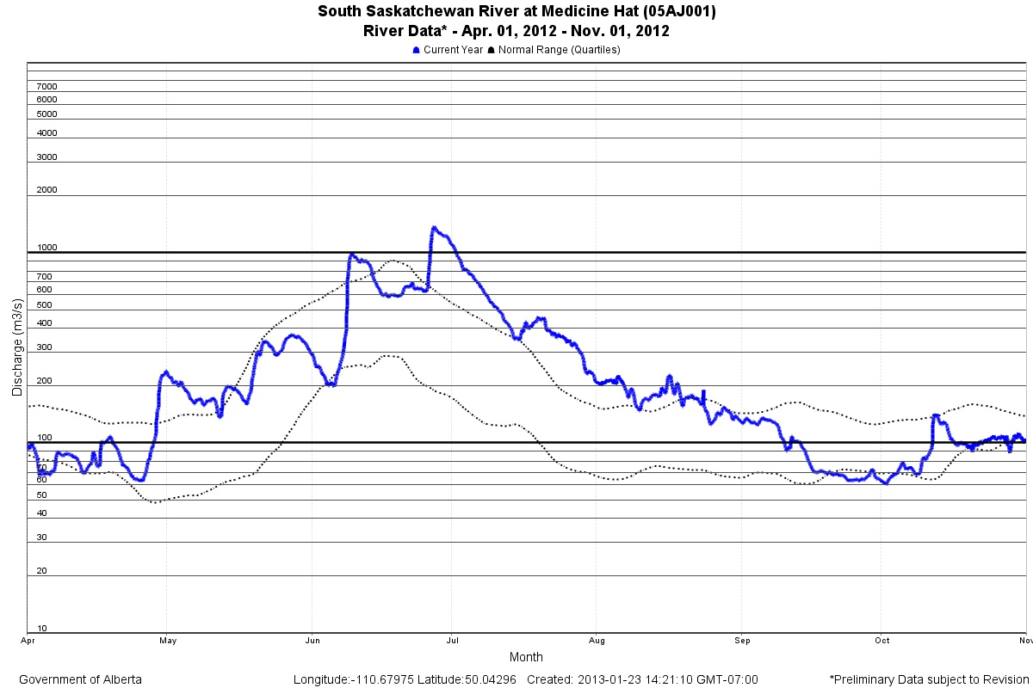
Coordination with Alberta
DATA and INFORMATION
Daily Precipitation Maps
Snow Pillow Data
Real-time Stream Flow Data
Forecaster’s Comments & Advisories
Discussions with Forecasters

Slide 30
Coordination with Water Survey of Canada
Very accommodating to ad hoc requests for metering
Gardiner Dam Spillway Channel
Qu’Appelle at Welby
Good flow of data
Overall, very well served by the WSC in 2011!
Long Creek below Boundary Reservoir, June 22, 2011. Courtesy WSC.

Slide 31
Lessons Learned on the Saskatchewan River System
More communication with both upstream and downstream jurisdictions is needed to improve decision making process and flood responses.
Several seemingly reasonable low risk decisions can have a cumulative effect and get you in a bad situation.
Expect the unexpected.
Conditions can change fast! Lower quartile snowpack to upper quartile in a matter of a couple of months.
For a multi use reservoir such as Lake Diefenbaker, a detailed reservoir operating manual is required to prevent ad hoc decisions where the squeaky wheel all to often gets the grease. Cannot be making policy decisions on the fly during a flood event, a set of rules is needed.

