Slide 1

Flood Forecasting In Manitoba
• • • • • • • • • • • • • • • • • • • • • • • •
Phillip Mutulu, Ph.D.
Director;
Hydrologic Forecasting and Coordination
Manitoba Infrastructure and Transportation
Prairie Hydrology Workshop
Acknowledgements
-Dr Loukili (HFC- MIT)
-Will Kellas (Student, University of Manitoba)
-Dr Seifu Guangul (STANTEC)
Prairie Hydrology Workshop
January 29 - 30, 2013
Notes:
Explain position and role in the flood
The presentation will give an “insiders” look at the 2011 Flood.
By the end of today, I hope I’ve answered these 3 questions.

Slide 2
Overview of Presentation
Hydrologic Forecast Centre Main Responsibilities
Current Forecasting Methodologies
Current Efforts, Developments
Challenges
Future Directions

Slide 3
Hydrologic Forecast Centre Products
Precipitation Maps
Moisture Maps
Snow Depth Maps
Forecast Hydrographs of River Flows/ Levels, Lake Levels
Flood Reports
Weekly Flow Reports
Weekly Lake Level
Wind Alerts on Major Lakes
Land subdivision review information/ flood protection levels etc.

Slide 4
Current Flood Analysis and Modelling Methodologies
(1) Manitoba Antecedent Precipitation Index MANAPI
- Unit Graph + Muskingum routing for major rivers
- Unit Graph + Linear Storage routing (simple numerical schemes,
and Runge Kutta 4th order scheme
- Natural Resources Soil Conservation (NRSCN) for excess rain computation
(2) Analog approach
(3) Regression Based Methodologies

Slide 5
Simplified Schematic of River Flow Forecasting Model
(Event Based Approach)
API CURVE
Unit Graph (Snowmelt or Rain)
Runoff
Winter Precipitation
Sub-Basin
Moisture Index
Channel Routing
Spring to Freeze-up Precipitation
River Watershed

Slide 6
History of Hydrologic Model Development in Manitoba
Model developed started in early seventies, leading to Manitoba
Antecedent Precipitation Index (MANAPI )
Since the MANAPI is used for routine flood forecasting)
Model Evaluation:-
  1985 MANITOBA RIVER FORECAST DEVELOPMENT evaluation project; by Canada – Manitoba Flood Damage Reduction Program Agreement Respecting Flood Forecasting. Evaluated in 1985 against:- HSPF; SSARR, and SLURP
Recommended that:-
  Lumped index models such as MANAPI or improvement thereof continue to be used for river forecasting in Southern Manitoba until more accurate and practical simulation models become available.
2008-2012; Improvement: From Fortran Dos Compiled routing to Excel Macro Based approach; convenient in data transfers, storage and graphics.
Current efforts; MANAPI improvement (In House), HEC-HMS (In House), MIKE-SHE (Consultants), WATFLOOD (Manitoba Hydro);

Slide 7
Modelling Limitations
Accounting explicitly for :-
    depression storages/ Contributing area
    soil moisture distribution
    land use and cover
    physics of snowmelt
    frozen Soils
    two dimensional overbank flows
    runoff from rainstorms
    ice related flooding
    Hysteresis effects like in 2011

Slide 8
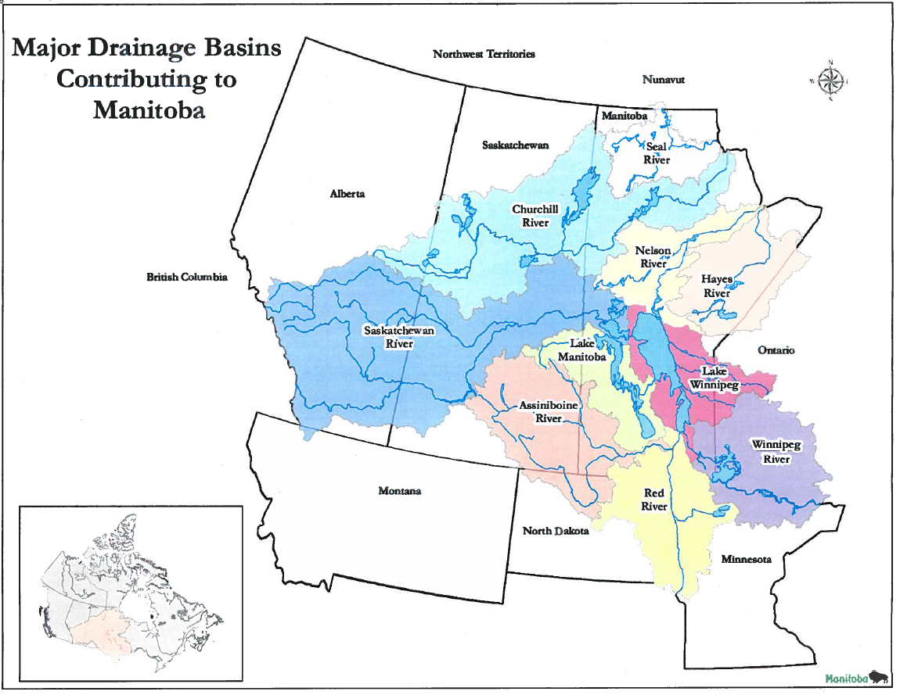
Accurate Forecasts are highly dependent on forecasts from other neighbouring provinces and the US
390,000 km2
160,000 km 2
285,000 km2

Slide 9
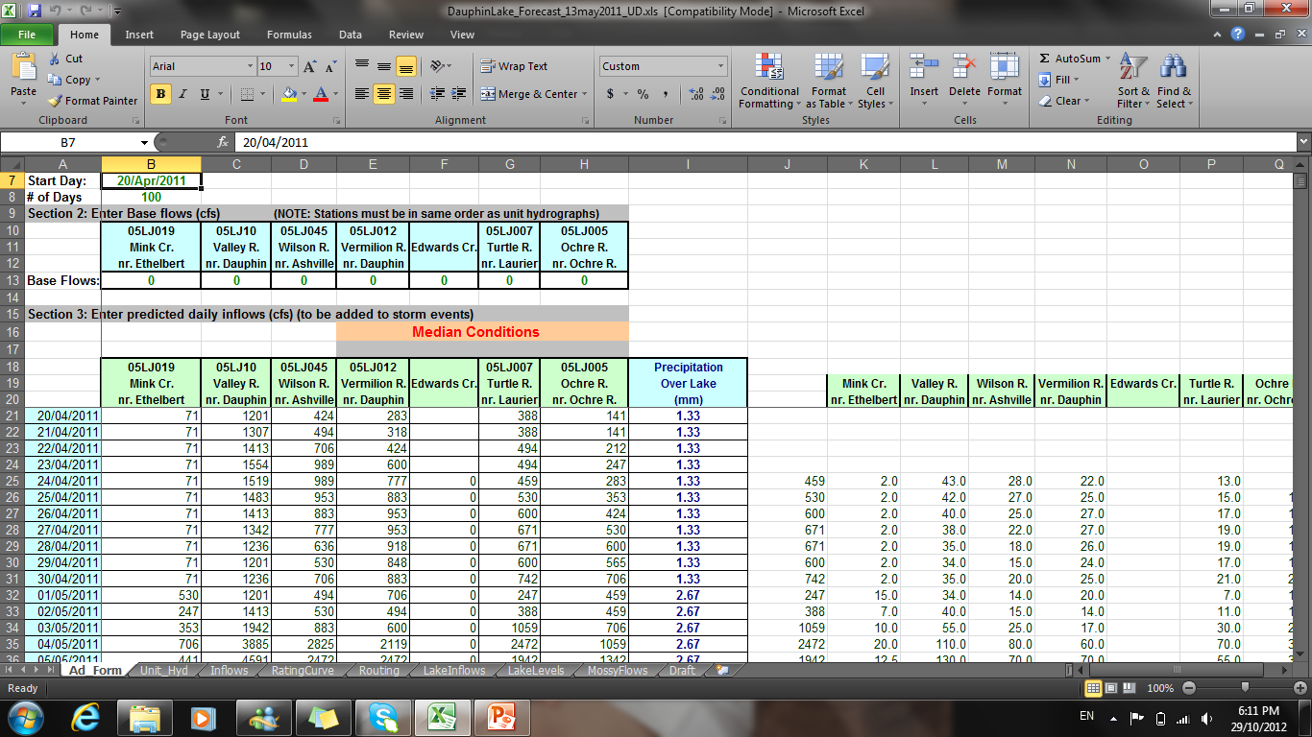

Slide 11
Efforts in Modelling/ Tool Development
Improved mass balance lake inflow-outflow modelling
Revision and delinking of pulse response functions (unit graphs) for snowmelt and rain generated runoffs
Automation and improvement of existing and new methods of data analysis and modelling; exploring event-based Vs continuous simulation models.
Hydrologic modelling; Assiniboine R. including Qu’Appelle Basin
2- Hydrodynamic Modelling for the Assiniboine and
the Red R. Basins

Slide 12
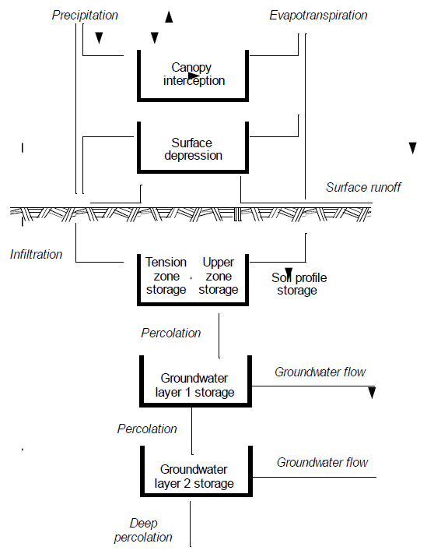

Slide 13
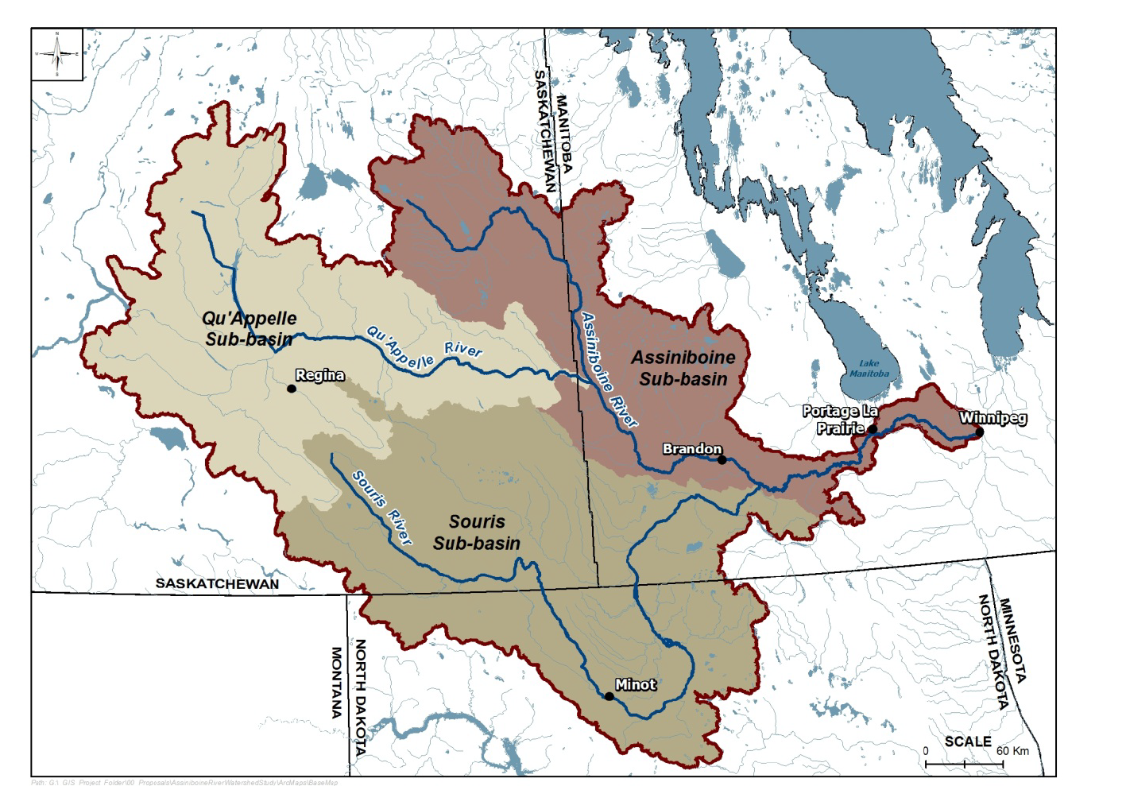
Assiniboine

Slide 14
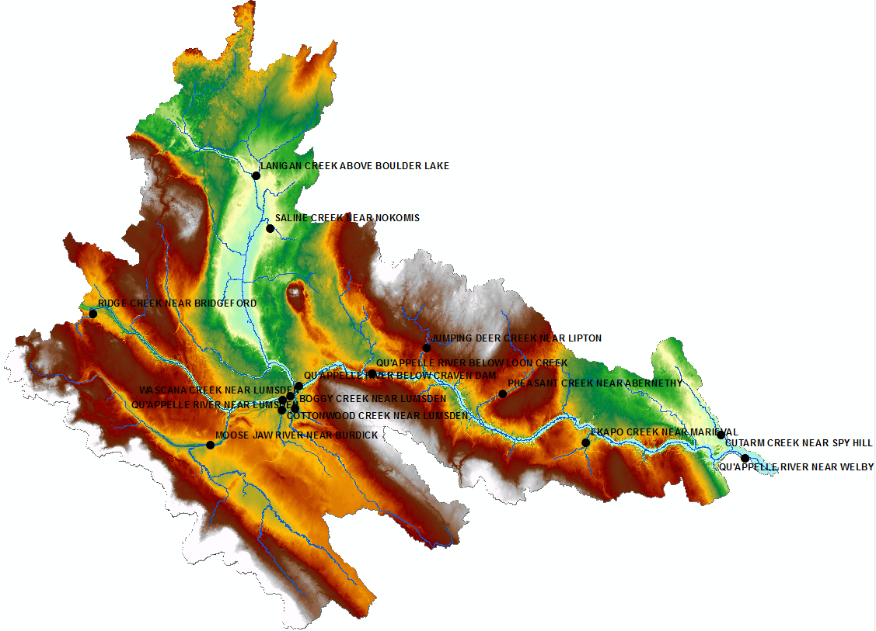
Qu’ Appelle River Basin Modelling:
(semi-continuous)
Previous model, based on SSARR (1975) –
PPWB/WSC study
Current inhouse study based on HEC-HMS, Soil
Moisture Accounting approach for Months of May
to September to account for rainfall-runoff events
Calibration & Validation Phase I completed –
needs improvements
Difficult in implementation of the snow-melt
routine
Challenges in accounting for regulated flows-need to work with Saskatchewan Water Authority

Slide 15
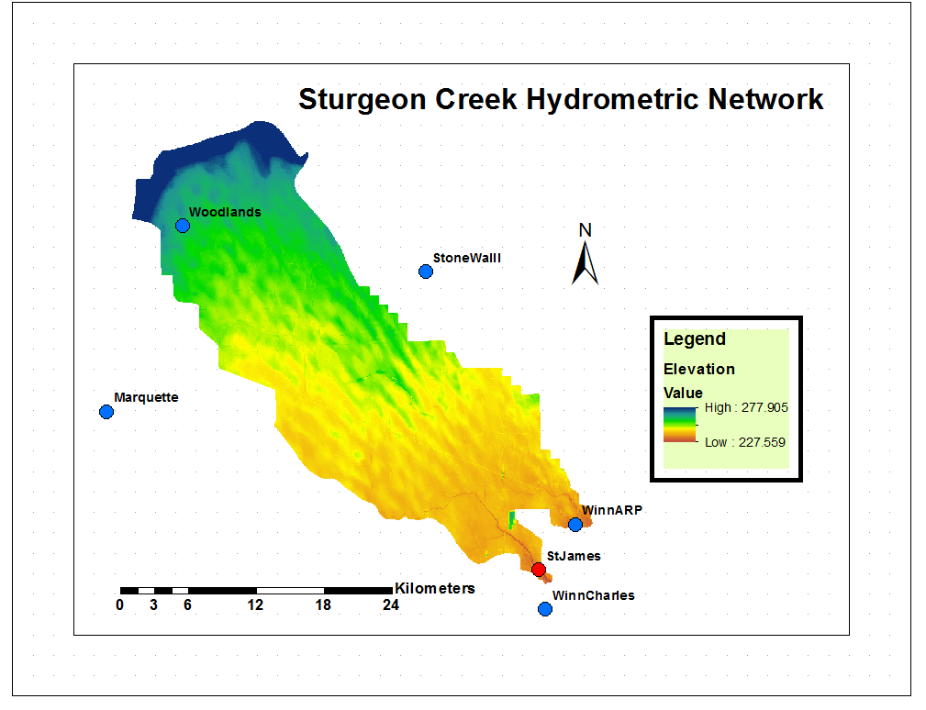
Area = 560 km ²
C2

Slide 16
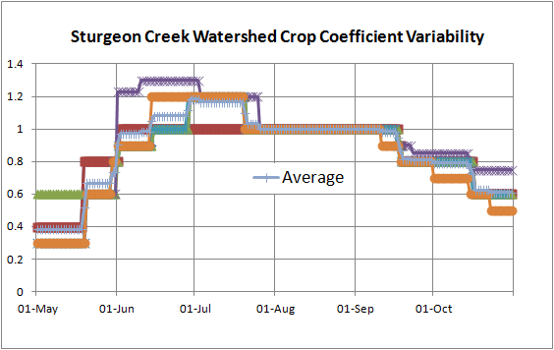
Challenge in Kc Determination.
What are your experiences ?

Slide 17
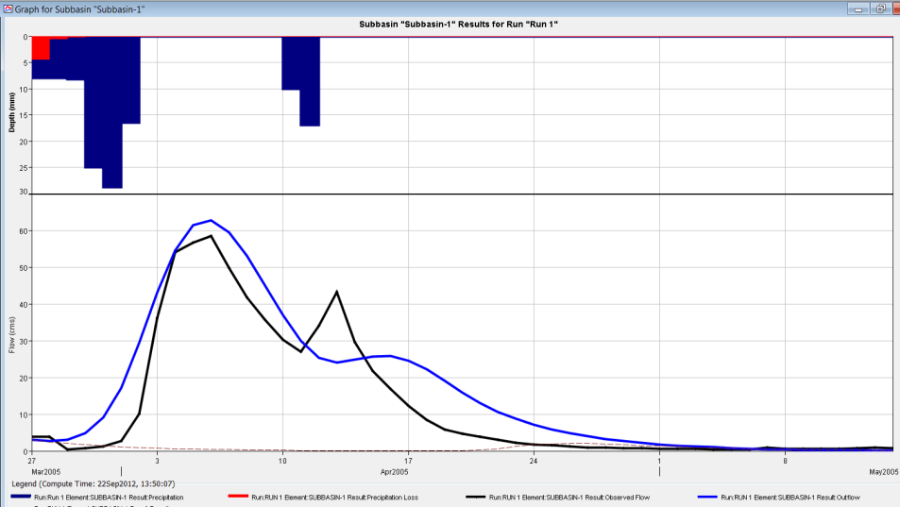
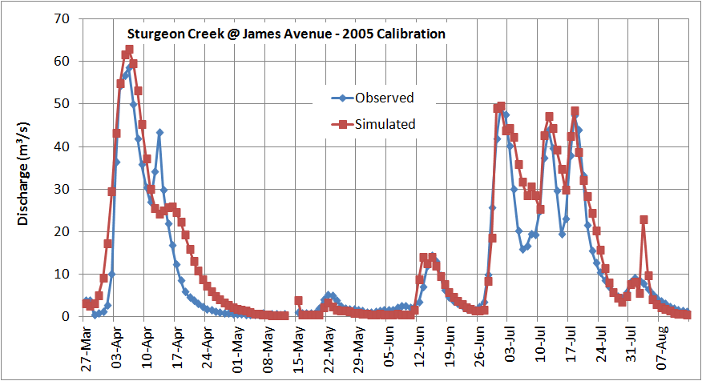
Snowmelt 2005 _ Calibration
Challenges in continuous hydrologic simulation, especially during transition from snow driven events to rainfall driven events
Mean Flow
Simulated = 14.0 m³/s
Observed = 12.0 m³/s

Slide 18
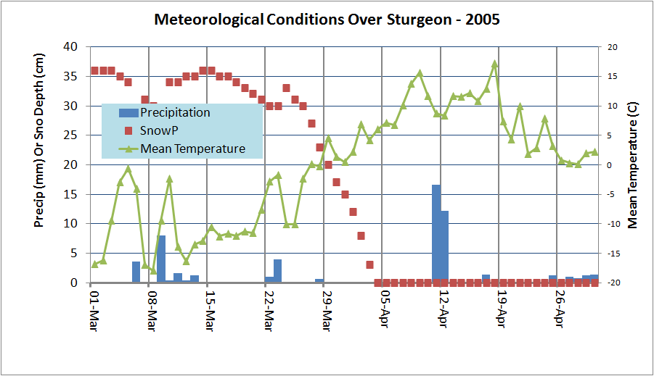
Example:- Problem with Continuous Simulation

Slide 19
Some questions to ponder !
Where do we go from here ?
is more complex hydrologic models the solution ?
is there a single model that works all the time ?
what about data adequacy, data bases and metadata issues
what are the priority areas of research and development ?

Slide 20
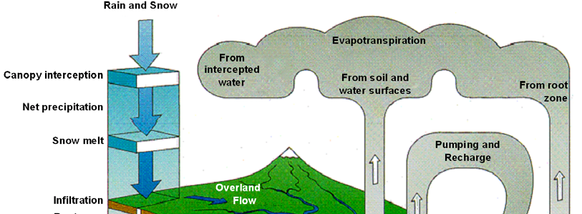
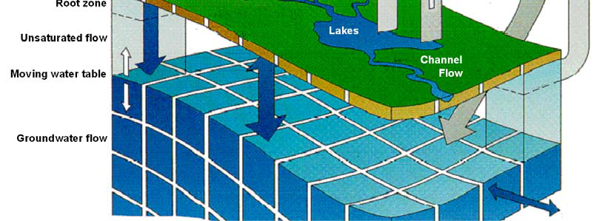
E.g. Continuous Simulation Models: Hydrological Processes in MIKE – SHE

Slide 21
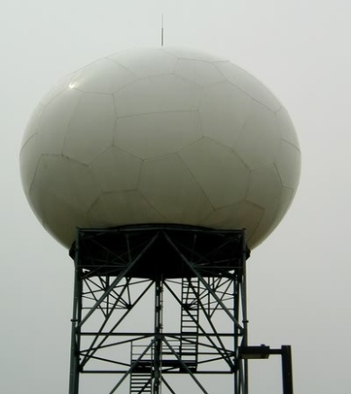
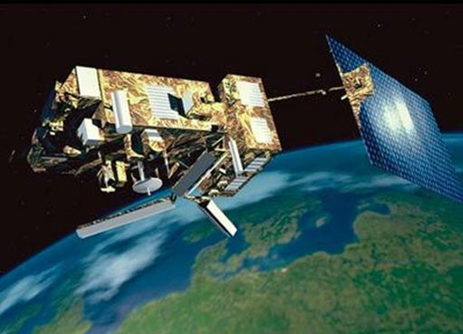
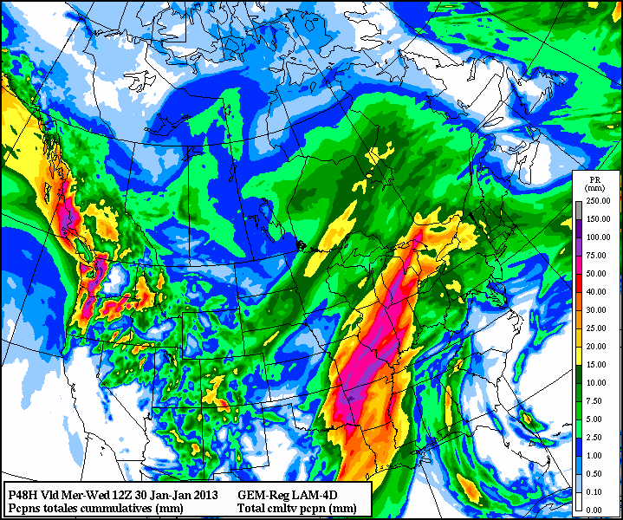
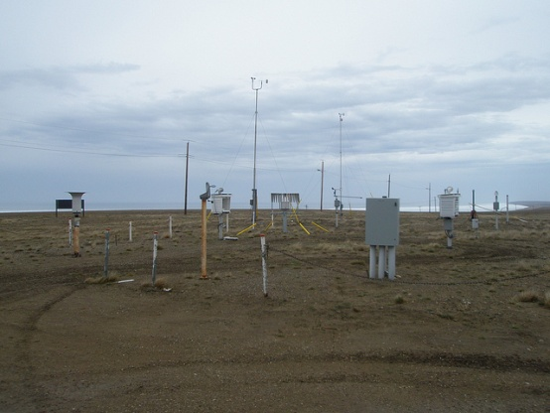
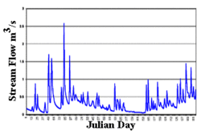
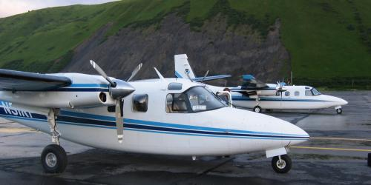
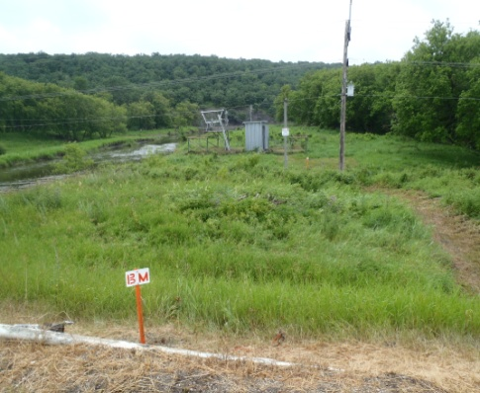
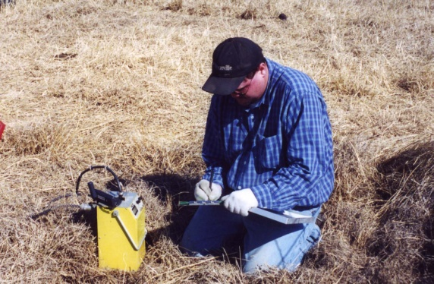
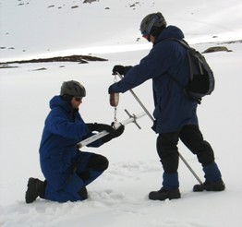
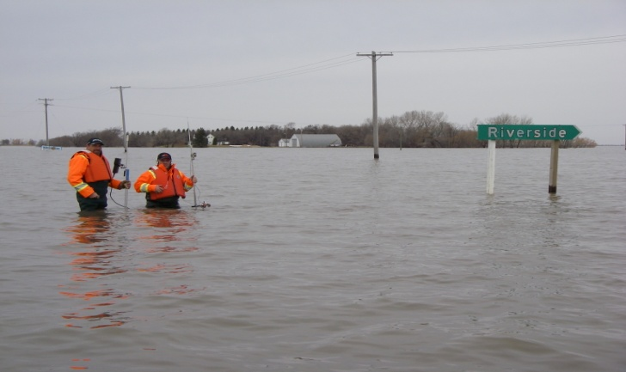
Challenge of multiple sources of data/ databases
Satellite
Weather Radar
Numerical Weather Forecast
Weather Stations
Upstream River flow forecasts
Flood Forecasting Centre
Special Aircraft
Automatic River Gauges
Soil Moisture
Snow Depth
Water Level & Flow Rate

Slide 22
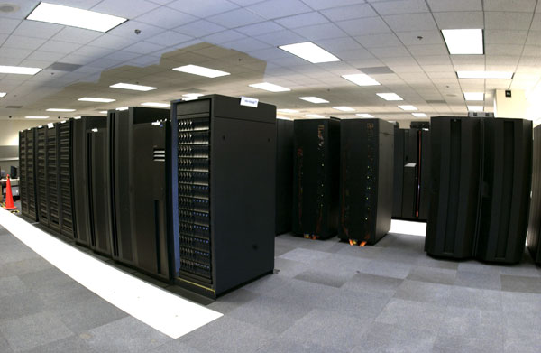
COMPLEX INFRASTRUCTURE
MANITOBA HYDROLOGIC FORECAST CENTRE
INTO THE FUTURE !!

Slide 23
Manitoba Flood Forecasting Platform/
Decision Support System
Hydrometric Data Acquisition system
Pre-processing
Calibration
Data Base Management
System
Flood
Forecast
Models
Radar/ Satellite Data
GIS
Meteo Forecasts/ or
Prepared scenarios
Information
Review Process
Post-processing
Flood maps/ Reports / Web publish
Forecast
Products Consumer

Slide 24
Concluding Remarks/
Future Direction
Automatic ingestion of ensemble weather forecasts and/ or stochastic generated info
Real-Timer data assimilation e.g. soil moisture and precipitation from air-based and other telemetry platforms
Continue model development inter-comparison and testing
Expand and ingest information from Community Collaborative Rain and Snow program CoCoRAHS (New Initiative)
Research and development of soil moisture and ice-jam related flooding modelling
2-D hydrodynamic flood routing
Flood Forecasting Platform System (Dedicated and delinked from Managed Environment)

Slide 25
Soil Moisture Conditions at Freeze-up time in 2010 and 2012

Slide 26
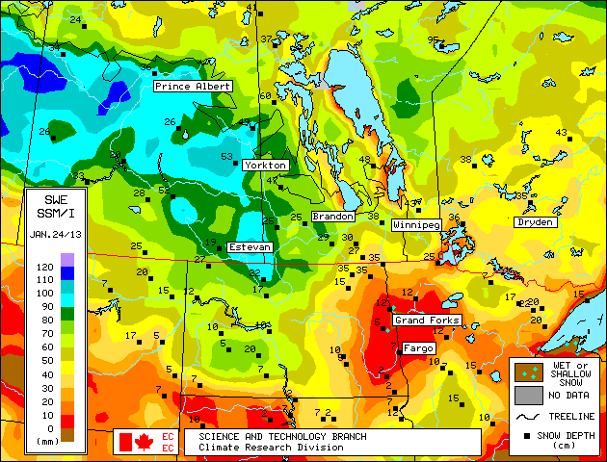
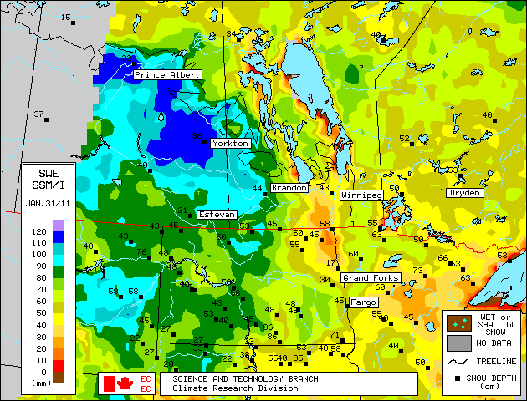
Snow water equivalent in January 24, 2013 and January 2011

Slide 27
End of Presentation
Thank You

