Slide 1
Alberta Tools
ESRD Hydrology Community of Practice
Chiadih Chang
Alberta Environment and Sustainable Resource Development
PPWB Prairie Hydrology Workshop
Winnipeg, January 29-30, 2013

Slide 2
Purposes of the Presentation
Share the information about Alberta tools
Exchange experiences and ideas
Foster collaboration opportunity

Slide 3
Alberta Tools
AB ArcHydro
Alberta Water Allocation Information Toolbox (AWAIT)
SSRB Licence Viewer
Water Allocation Modelling
Tools for SSRB WMP Implementation

Slide 4
Alberta Tools
AB ArcHydro
Alberta Water Allocation Information Toolbox (AWAIT)
SSRB Licence Viewer
Water Allocation Modelling
Tools for SSRB WMP Implementation

Slide 5
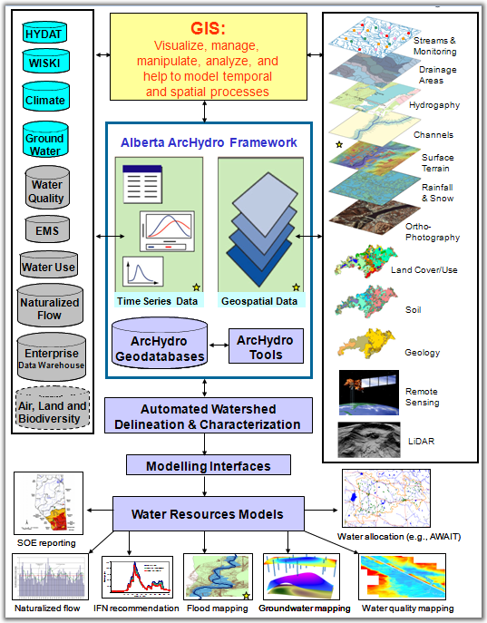
Vision – ArcHydro as a Foundation for Watershed Management in Alberta

Slide 6
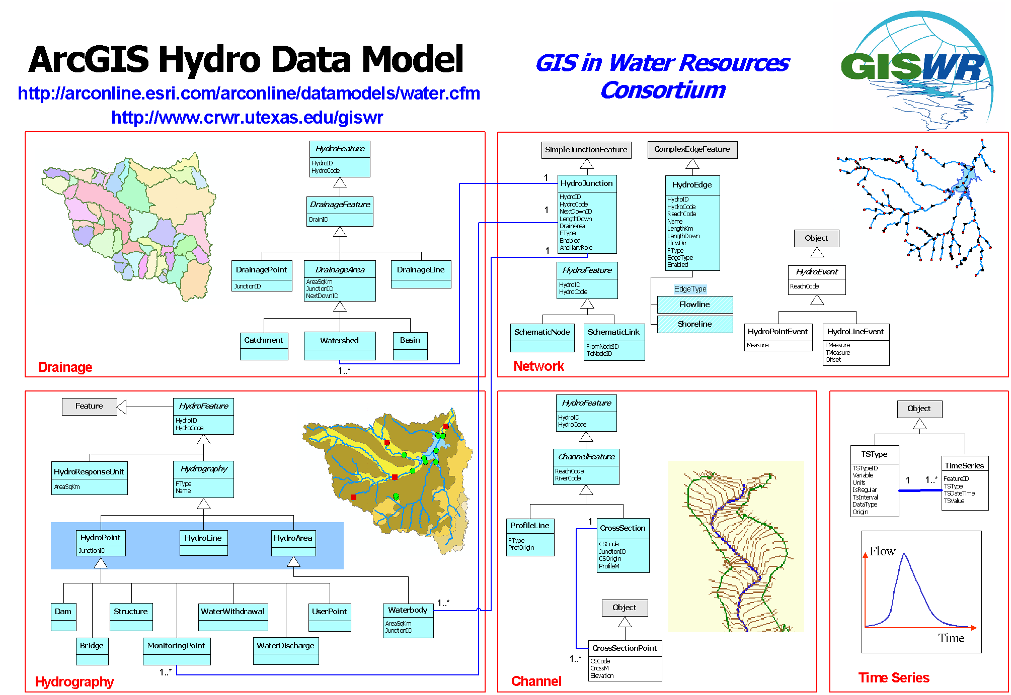

Slide 7
Current Status of Alberta ArcHydro
ArcHydro data are organized into each of the 18 major basins in Alberta
Snow pillow data

Slide 8
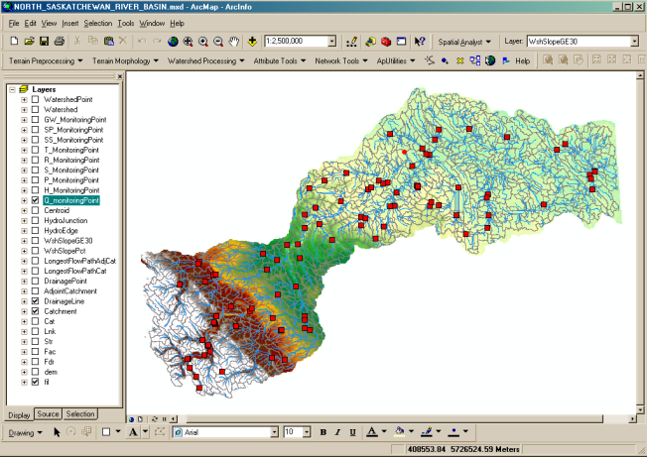
Current Status of Alberta ArcHydro
Each major basin contains:
Raster Data (DEM-related data)
Vector Data (catchments, drainage lines, etc.)
Network Data (geometric network)
Daily Time Series Data (hydro-climate data)
Snow pillow data

Slide 9
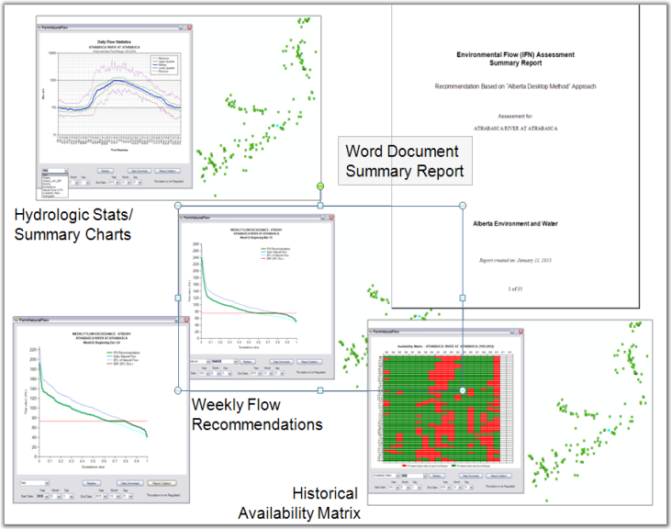
Current Status of Alberta ArcHydro
Tool developments using AB ArcHydro as data framework, e.g., Alberta IFN Desktop Method
Snow pillow data

Slide 10

Benefits of Using ArcHydro
A simple, extensible geodatabase design
Scale-independent
Strong water resources network model
Features integrated through relationships
Supported by customized ArcHydro toolset
Integration of geospatial and temporal water resources information
Simplifying connection to water resources models, e.g., Alberta IFN Desktop Method, MIKE SHE, HEC-GeoRAS, HEC-GeoMHS
Notes:
- Align with Alberta’s “Unleashing Innovation on Water Strategy” Vision (“Today’s Opportunities, Tomorrow’s Promise: A 20-Year Strategic Plan for the new Government of Alberta).
- Generate consistent results when performing queries on EMS records.
- Automate labour intensive processes in dealing with water allocation.
- Ease the use of GIS technology, data, information for water allocation.
- A cost efficient solution to meet our business need.

Slide 11
Alberta Tools
AB ArcHydro
Alberta Water Allocation Information Toolbox (AWAIT)
SSRB Licence Viewer
Water Allocation Modelling
Tools for SSRB WMP Implementation

Slide 12
What Is AWAIT ?
Alberta Water Allocation Information Toolbox (AWAIT) is a user-friendly, GIS-based decision support toolbox to automatically:
  extract
  filter
  query
  display, and
  summarize
water allocation and approval information stored in the Environmental Management System (EMS) of Alberta.

Slide 13
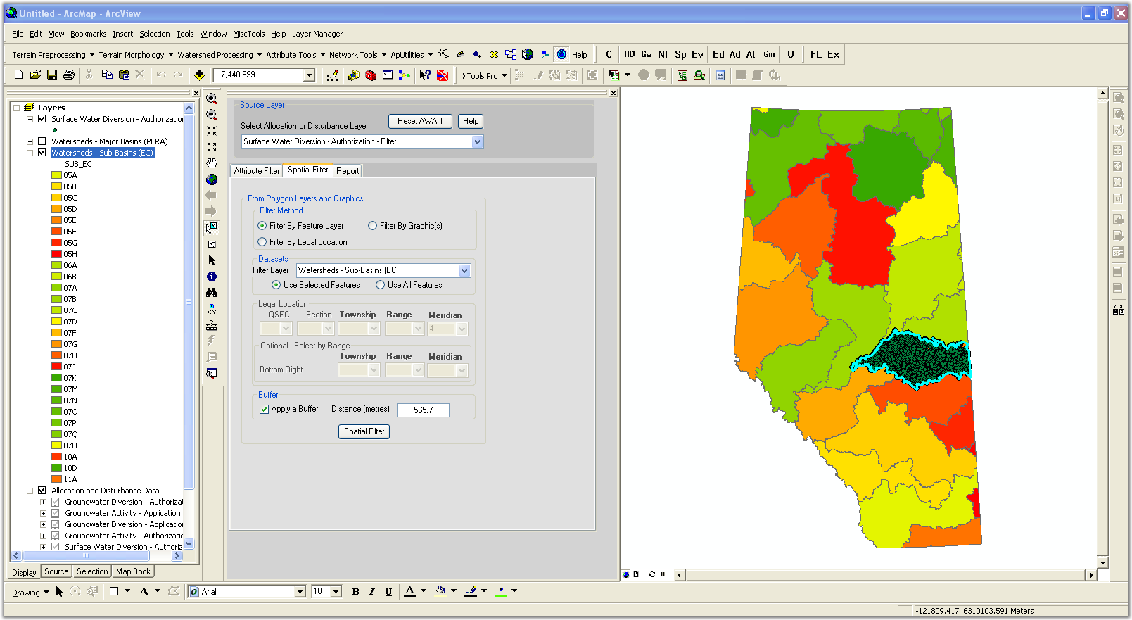
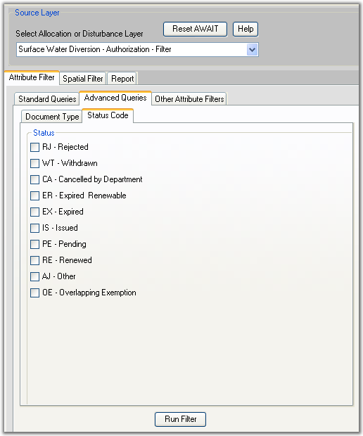
AWAIT Interfaces

Slide 14
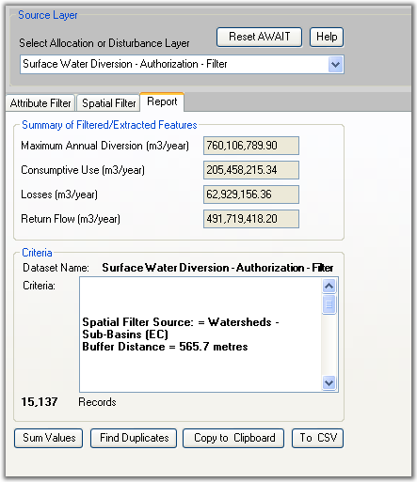
Query Example

Slide 15
Alberta Tools
AB ArcHydro
Alberta Water Allocation Information Toolbox (AWAIT)
SSRB Licence Viewer
Water Allocation Modelling
Tools for SSRB WMP Implementation

Slide 16
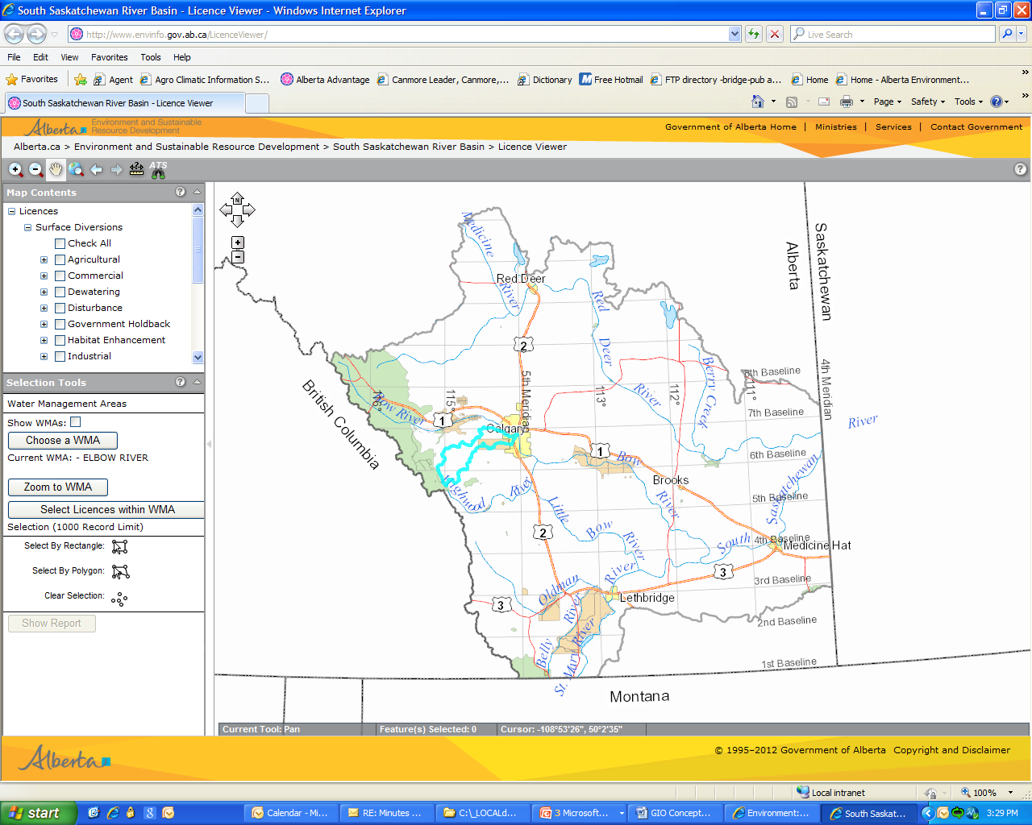
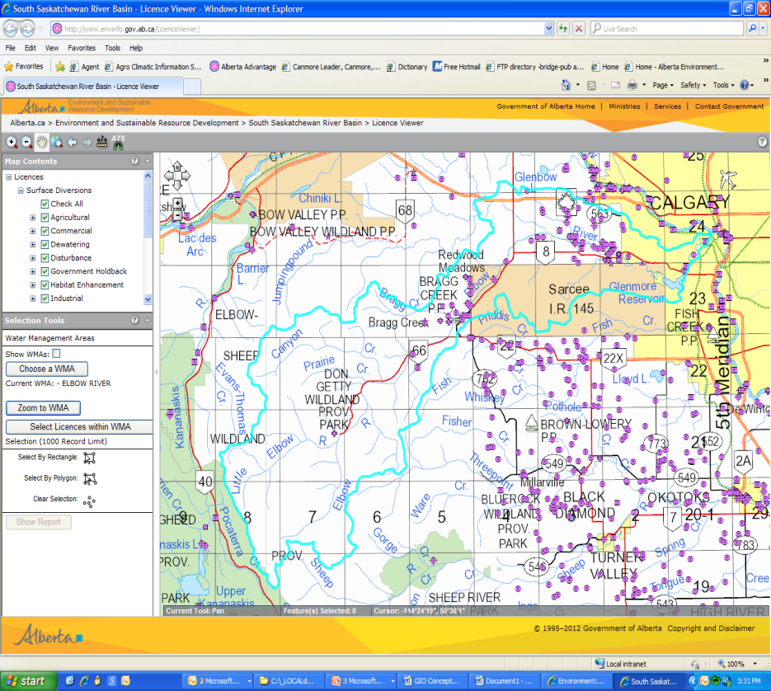
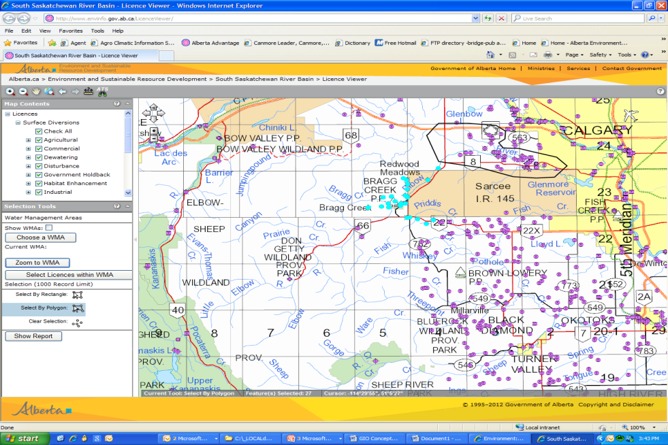
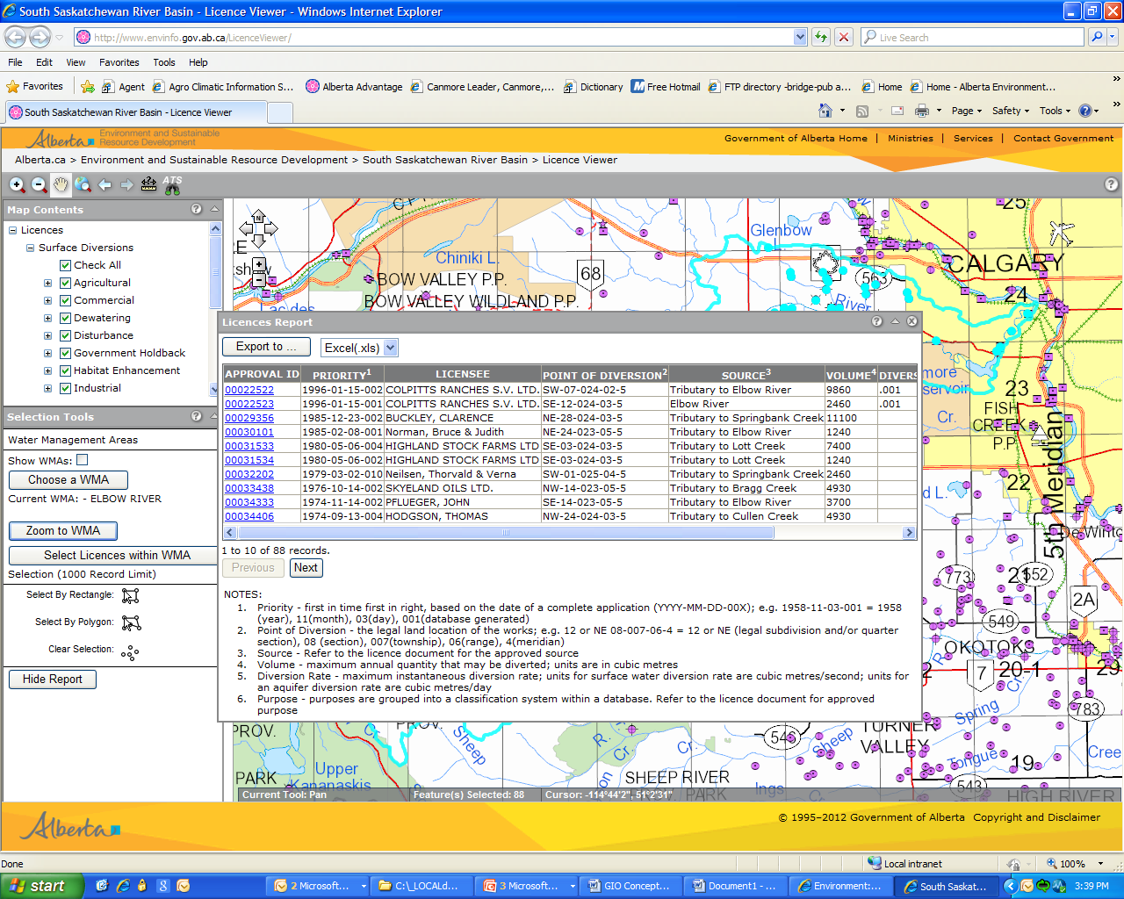
Public SSRB Licence Viewer
Required as part of the SSRB Implementation Plan
http://ssrb.environment.alberta.ca/licence_viewer.html
If desired select a predefined Water Management Area (WMA)
Display all licences spatially on the map, with the ability of selecting the certain activities such as Agriculture, Municipal, etc.
Select by user defined polygon
Export Capabilities and link to the scanned licence document

Slide 17
Alberta Tools
AB ArcHydro
Alberta Water Allocation Information Toolbox (AWAIT)
SSRB Licence Viewer
Water Allocation Modelling
Tools for SSRB WMP Implementation

Slide 18
Water Allocation Modelling
WRMM
  Water Resources Management Model
Wrm-Dss
  Water Resources Management
    Decision Support System
Notes:
WRMM is a water allocation planning tool used by the Alberta Government
Used on an ongoing basis for decision support

Slide 19
Water Allocation Modelling
WRMM (the original)
Owned by Alberta ESRD
Used in Southern Alberta Water Planning
  30 year history
Designed specifically for Alberta (1st in time, 1st in right)
  Water Act
  Instream objectives
  Reservoir operating policy
Runs quickly
Notes:
WRMM has been used:
in all substantial water management planning projects in Southern Alberta
in development of operation plans for our major water infrastructure

Slide 20
Water Allocation Modelling
Wrm-Dss (WRMM version 2)
Enhanced Capacity, Capability, Efficiency, and User Friendliness
More optimal solution than WRMM
No limitation on size of schematic
Uses databases to store model data
  Backwards compatible (can still use text files)
Includes channel routing features
  For daily operational decision support
Notes:
Current status:
Debugging and stress testing of Wrm-Dss code
Migrating our existing WRMM models to work in Wrm-Dss

Slide 21
Water Allocation Modelling
Graphical User Interface for WRM-DSS
Visual model designer
Can use maps or images created in GIS applications for backgrounds
Notes:
Makes model design visual
State of the art industry standard programming
Potential to migrate to the Web
Can be developed independently and in parallel to Wrm-Dss application
No licencing / maintenance fees for dep’t

Slide 22
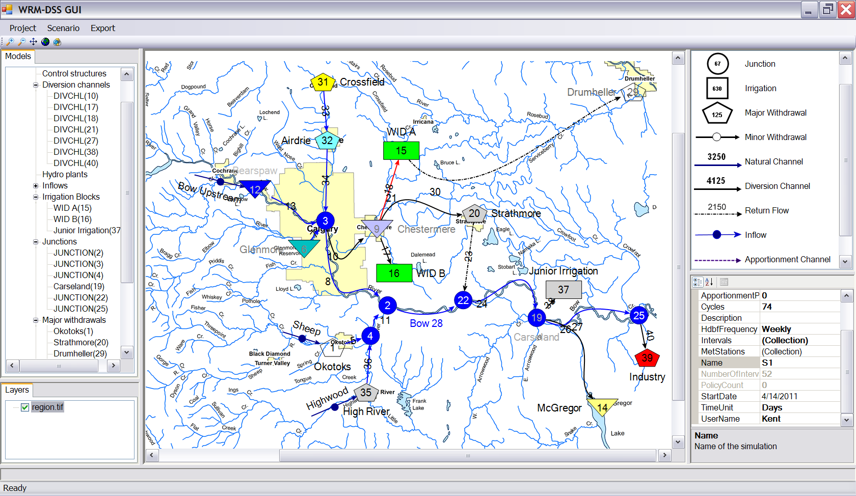
Notes:
GUI replaces the need to edit a text file.

Slide 23
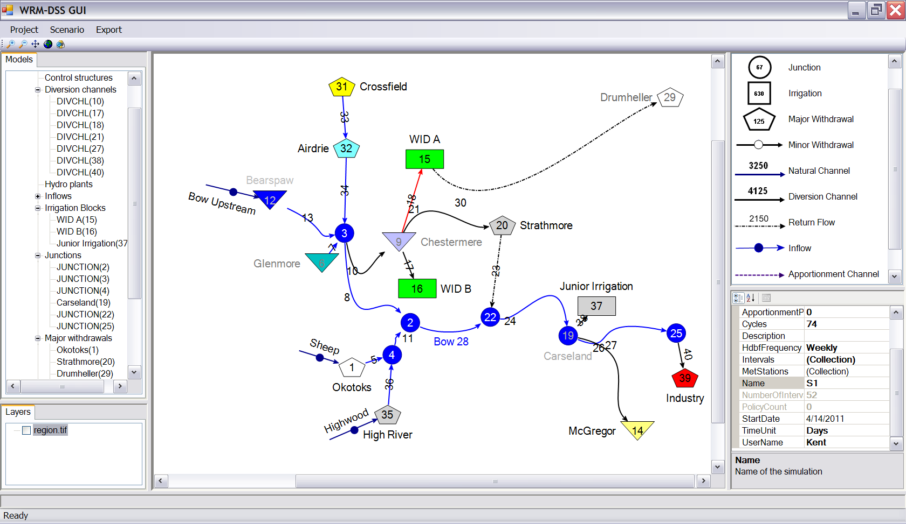
Notes:
Screen shot of GUI utility
Background map can be turned off to have a clear view of schematic.
Components and their labels can be made of any color.
Components are connected to each other. Moving a demand will not break the connection with its channel.

Slide 24
Alberta Tools
AB ArcHydro
Alberta Water Allocation Information Toolbox (AWAIT)
SSRB Licence Viewer
Water Allocation Modelling
Tools for SSRB WMP Implementation

Slide 25
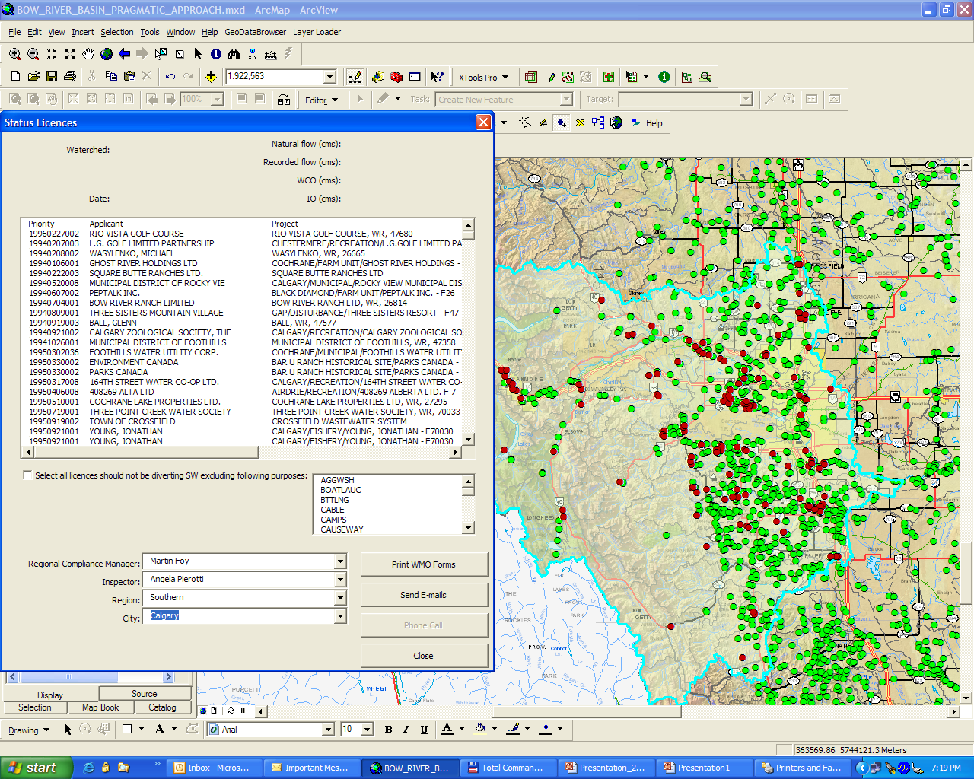
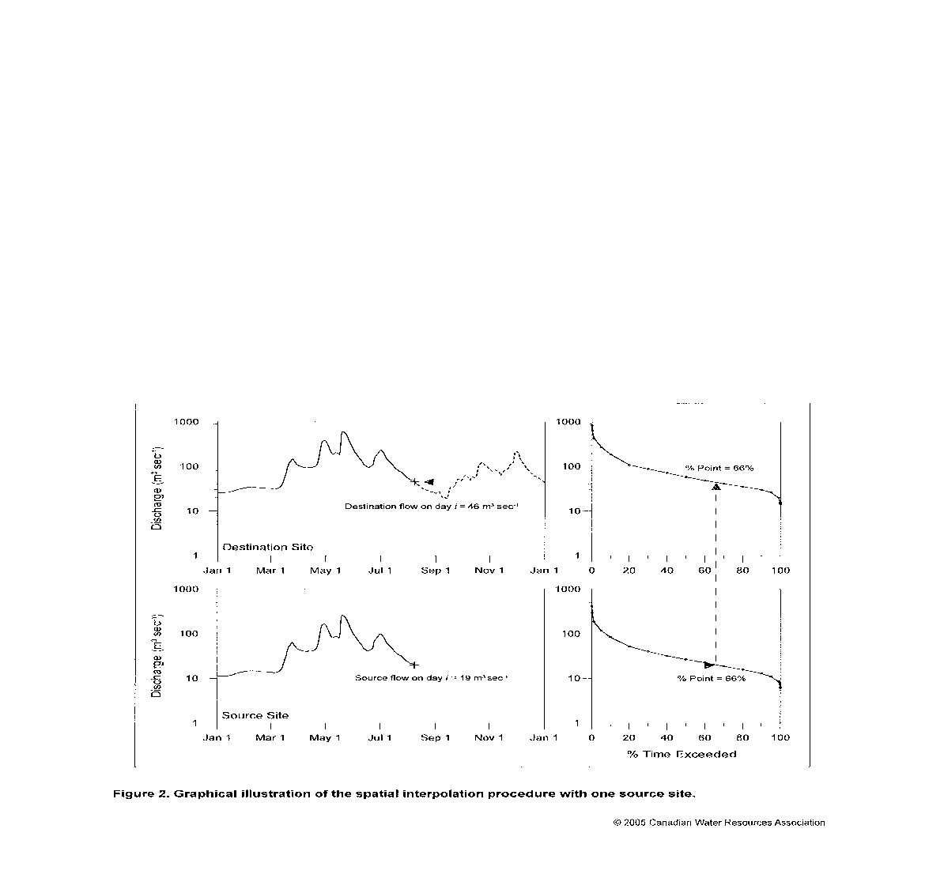
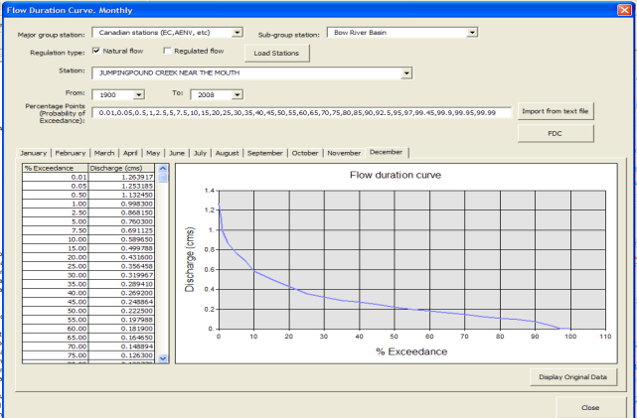
Tools for SSRB WMP Implementation
Requirements for the SSRB WMP Implementation:
Water Conservation Objective (WCO) is based on natural flow and existing In stream Objectives (IO).
  Calculation of natural flows needed on a near – real time basis.
Administration of Priority Call under the Water Act
Water Shortage Management tool (Southern Region Water Shortage Plan)
WCO/IO Performance Assesment Tool
Water Shortage and Priority Call Tool
Pragmatic approach - to calculate Natural Flow (GIS based)
Data Analysis Tool
Notes:
WCOs in Red Deer, Bow, Oldman and South Saskatchewan River sub-basins were established January 2007 in accordance with the recommendations in the SSRB Water Management Plan. The recommended WCOs are tied with natural flows and existing IOs. AENV has limited capacity to compute near real time natural flows at certain locations on main stems of Red Deer, Bow, Oldman and South Saskatchewan Rivers. The capacity needs to be expanded to include more locations in the main stems and also on major tributaries. Besides expanding to include more locations, the existing methodology needs to be reviewed and, if possible, refined. The ultimate goal is that Department should be able to implement the established WCOs in all the identified Water Management Areas (WMAs) and/or reaches and this information is made available to the public. Therefore, an automated system for estimating natural flows in ungauged watersheds and a priority call administration system is proposed to implement the WCOs required under the Water Act.
Water shortage management tool - Ability to delineate a watershed anywhere and identify all licences within the watershed. Provide a list of all licences, compare conditions of licences and determine if withdrawal of water is allowed based on Natural flows and recorded flows at stations. This is basically done at the established Water Management Areas which Have recorded flows.
Priority Administration tool – Search capability of licence in question, Watershed delineation, Identify licences upstream of priority call, sort Junior and Senior licences from the one requesting a priority call, ability to exempt certain purposes, export capability, map creation, produce Water Management Orders to stop diverting, send e-mails, text, or telephone call.
Steps for Pragmatic approach
Estimation of a representative regional non-dimensional FDC
2. Calculation of actual FDC at the required (destination) site
(multiplying the non-dimensional regional curve by an estimate of the long-term mean discharge obtained)
3. Conversion of the actual FDC at a site into a continuous streamflow hydrograph

Slide 26
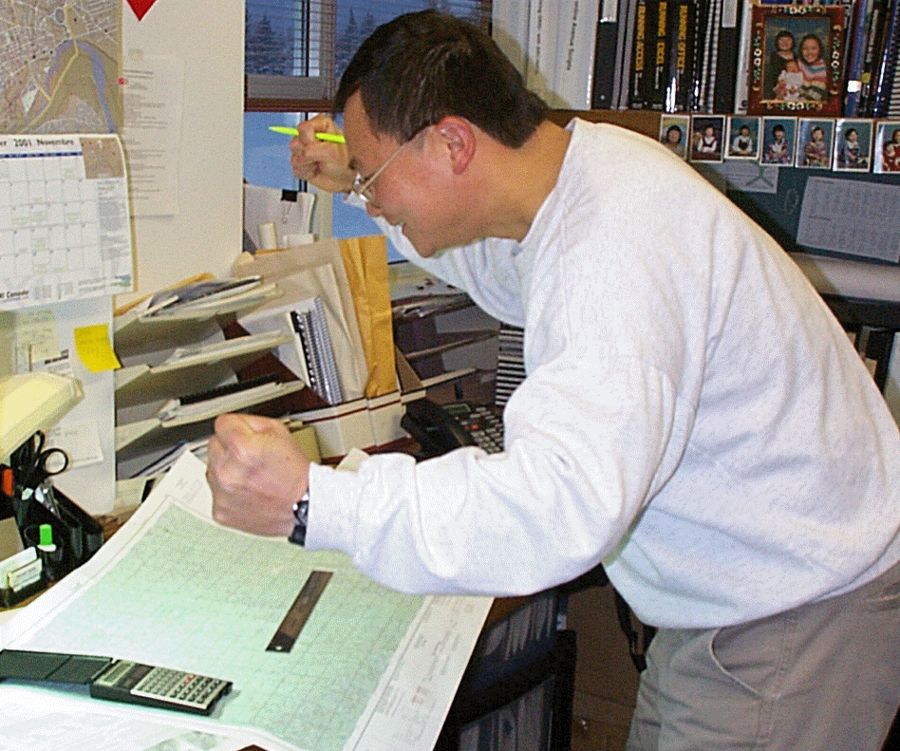

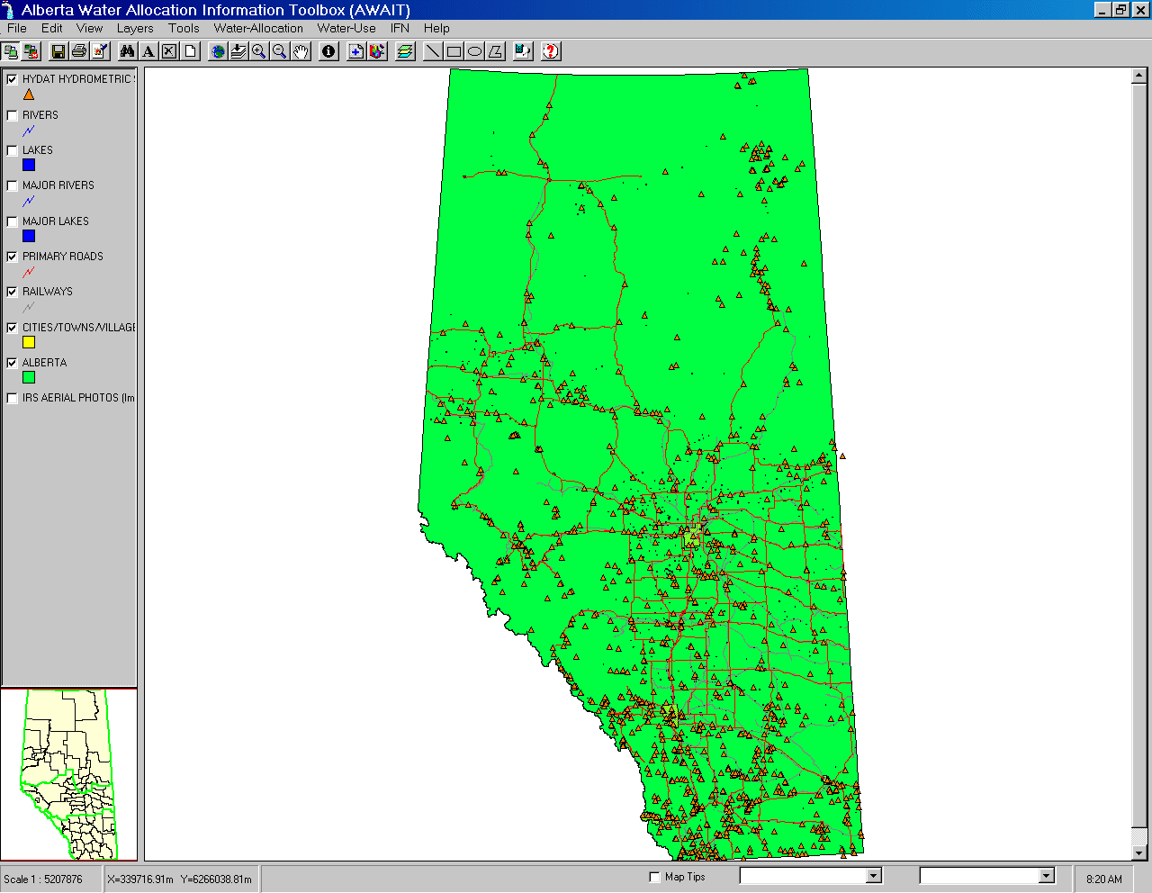
Alberta Tools Making a Difference!
Without Alberta Tools versus With Alberta Tools
Stressful and frustrated staff due to inaccessible data/tools and laborious, inconsistent, time consuming work.
Happy & productive staff who are making meaningful contributions to water/watershed management in Alberta.

Slide 27

Thank You!
Q&A, Comments and Discussions
“Tell me, and I’ll forget.
Show me, and I may not remember.
Involve me, and I'll understand.”
(Anonymous)

