Slide 1
Annual Unit Runoff in Canada Presentation at PPWB Prairie Hydrology Workshop January 29, 2013

Slide 2
Introduction
Annual Unit Runoff (dam³/km²) = Annual Volume of Streamflow (dam³)
Drainage Area (km²)
Applications:
Provide an overview of runoff across Canada
Conduct preliminary project feasibility studies
Determine water availability for project licensing
Size dugouts
Evaluate surface water supply dependability

Slide 3
Background: Prairies
Three prior investigations into unit runoff have been conducted for the Prairie Region by PFRA:
1964 – “The Distribution and Variability of Runoff in Alberta, Saskatchewan and Manitoba” (PPWB Report No. 10)
1978 – “Report on Median Annual Unit Runoff for the Prairie Provinces” (Hydrology Report #92)
1994 – “Annual Unit Runoff on the Canadian Prairies” (Hydrology Report #135)

Slide 4
Background: Canada
Other areas of Canada have more fragmented runoff information available
Some information exists to aid in future work, but current unit runoff has not been previously calculated.
British Columbia | Regional Streamflow reports (1998-2002)
Ontario | OFAT, Great Lakes Study – Hard to find raw data.
Quebec | Referred us to the WSC database
New Brunswick / Nova Scotia / PEI | Some old studies exist; Little current
Newfoundland / Labrador | “The Hydrology of Labrador” contains Mean Monthly Runoff
Yukon/NWT/Nunavut | Limited information available for shorter period off record

Slide 5
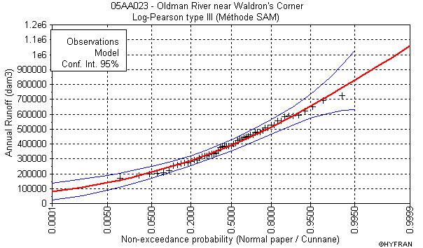
Background: Why Update?
Hydrology is statistical.
As more data is collected from streamflow monitoring stations, it becomes possible to create more accurate models.
Since the 1994 PFRA study, an additional 17 years of data has been collected at many sites.
Updated maps will provide more reliable information to users.
No such maps exist for the rest of Canada.
This project will provide a uniform product based on the largest amount of data available in each region.
Regional trend analysis potential

Slide 6
Methodology: Prairies
Gross Drainage Area (GDA): Total area that contributes runoff to a point under very wet conditions.
Effective Drainage Area (EDA): Area that contributes runoff during a median-sized event (generally less than GDA).
1994 PFRA report established a procedure and set of rules to prepare annual unit runoff maps for the region
EDA of less than 5000 km²
Minimum record of 15 years, extrapolated to 40 years
Natural or naturalized flow
These rules are maintained in the updated study where possible
Period of study extended from 1950-2006 (57 years)

Slide 7
Methodology: Prairies
360 stations selected based on previous rules.
Down from 397 in 1994 study due to less naturalized data available and some stations being discontinued by WSC.
Monthly data pulled from Water Survey of Canada database.
Winter months (Nov-Feb) filled with zero flow values as applicable.
No flow in winter is a reasonable assumption in the Prairies.
Annual flows calculated.
Linear correlation to other stations used to fill missing years of annual data for full study period.

Slide 8
Methodology: Prairies
Frequency analysis for each station to determine annual runoff for seven probabilities of exceedence (POE): 10%, 25%, 50%, 70%, 75%, 80% and 90%.
Divide the annual runoffs by the EDA for each station to generate Annual Unit Runoff for each POE and location.
Create map for each probability of exceedence by applying the AUR for each basin.

Slide 9
Methodology: National
Total of 1184 stations selected
Gross drainage areas used for unit runoff calculations outside of the Prairies (EDA not available)
Same methodology as described for the Prairies used to extend records and calculate runoff values for various POEs: 10%, 25%, 50%, 70%, 75%, 80%, 90%

Slide 10
Median Annual Unit Runoff

Slide 11
Median Annual Unit Runoff

Slide 12
Median Annual Unit Runoff

Slide 13
Final Report
100 copies will be printed and distributed by Gord Bell in Regina (gordon.bell@agr.gc.ca)
PDF copies are available from Anna Cole in Saskatoon (anna.cole@agr.gc.ca) and will hopefully be available on a website at a future date

Slide 14
Thank you!

