Slide 1
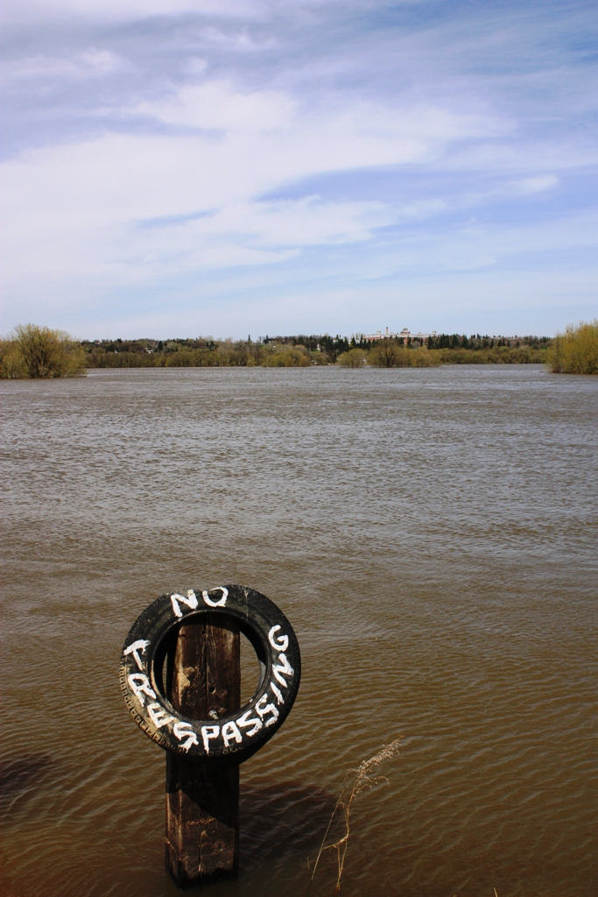
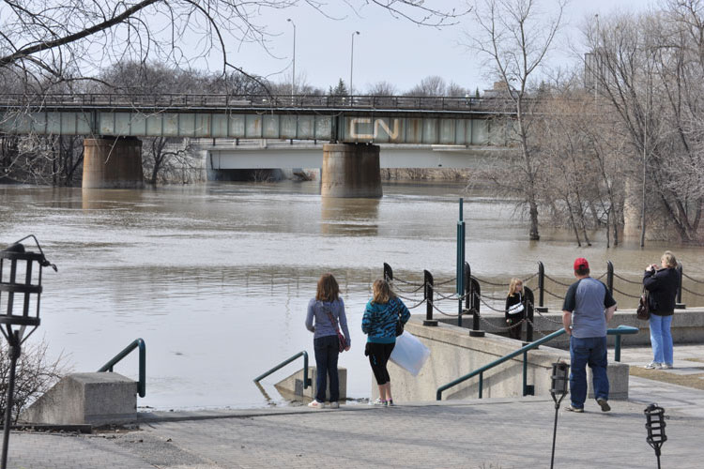
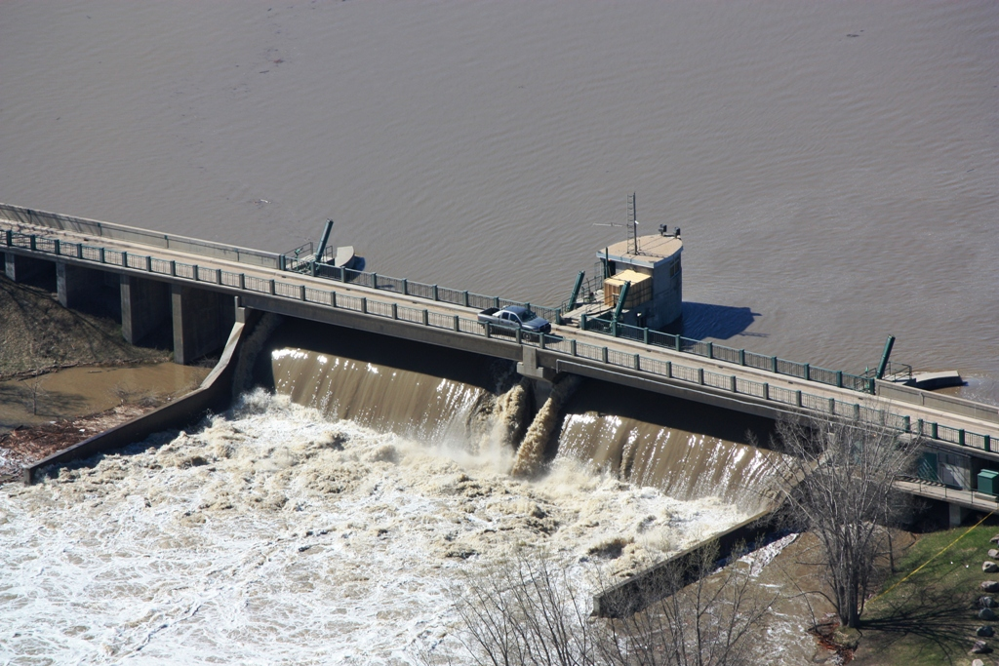
Manitoba’s 2011 Flood
Mark Lee, M.Sc., P.Eng.
Manager, Surface Water Management
Manitoba Conservation and Water Stewardship
January 29th, 2013

Slide 2
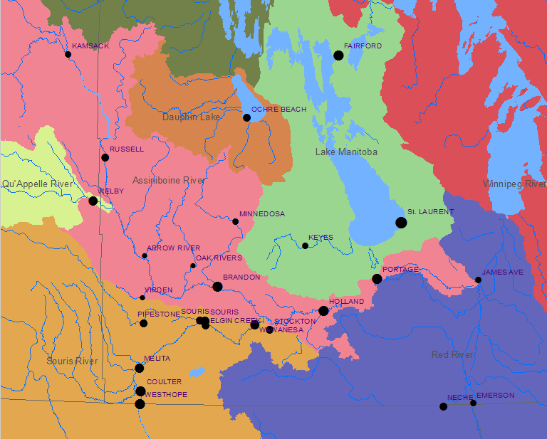
2011 Flood Return Periods
125
250
75
67
400+
140
25
250
220
30
52
145
145
180
22
210
43

Slide 3
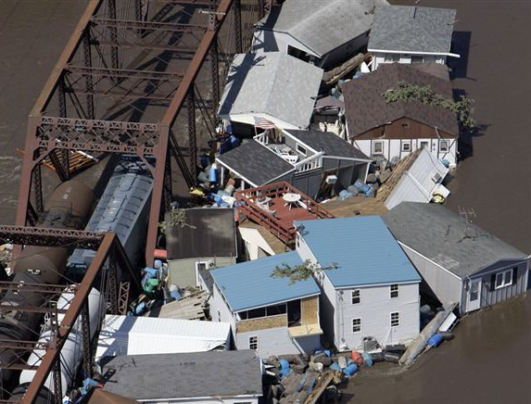

Slide 4
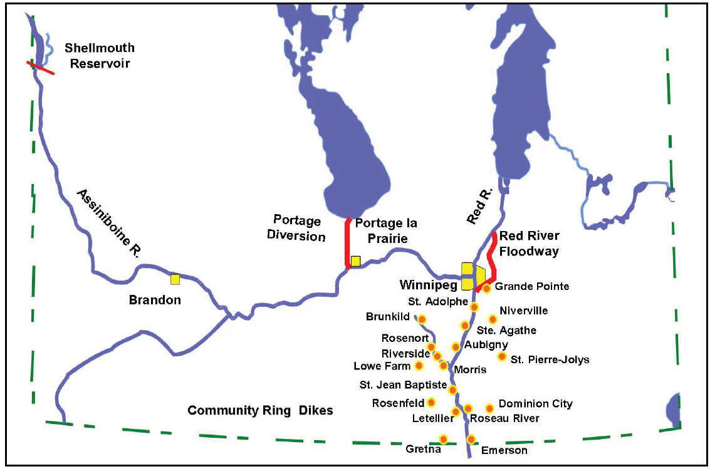
Assiniboine River Dikes

Slide 5
Shellmouth Dam and Reservoir
Dam
Constructed 1964-1972 by PFRA ($10.8 Million)
1.3 km wide
21.3 m high
Spillway – 64 m wide, 170 m long, 16.6 m high
Conduit – 4.6 m in diameter, 204 m long, 6000 cfs capacity
Reservoir
Named “Lake of the Prairies”
390,000 acre-feet of storage
72.4 km long
2.4 km wide

Slide 6
Shellmouth Reservoir Annual Peak Inflows and Outflows

Slide 7
2011 Shellmouth Reservoir Operation

Slide 9
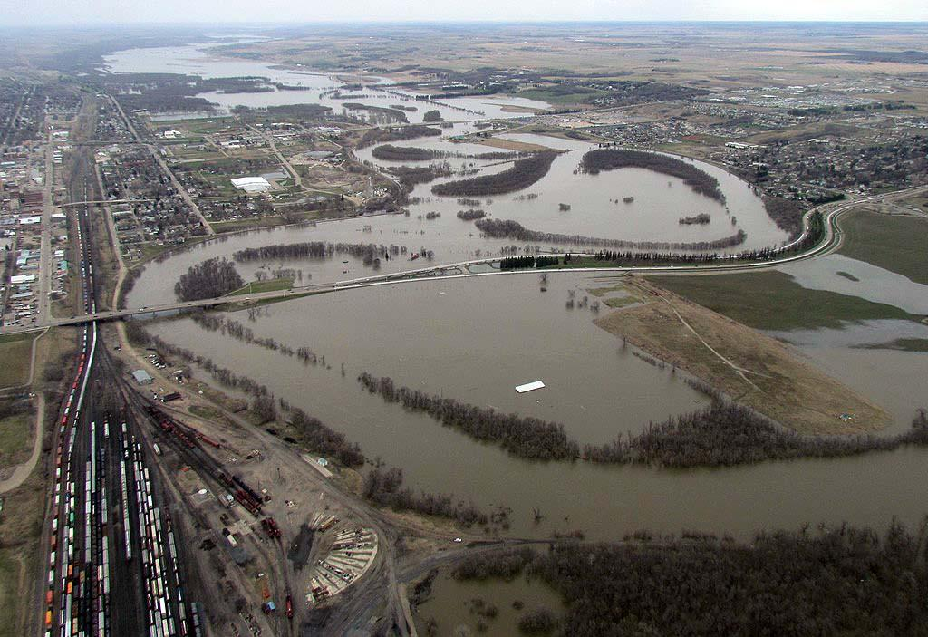
Major flooding within Brandon floodplain
Notes:
There was major flooding in Brandon, resulting in the shut down of the commercial area along 18th street including the Corral Shopping center, and the evacuation of about 900 homes.
This photo is taken looking west at 1st street, with 18th street in the background.

Slide 10
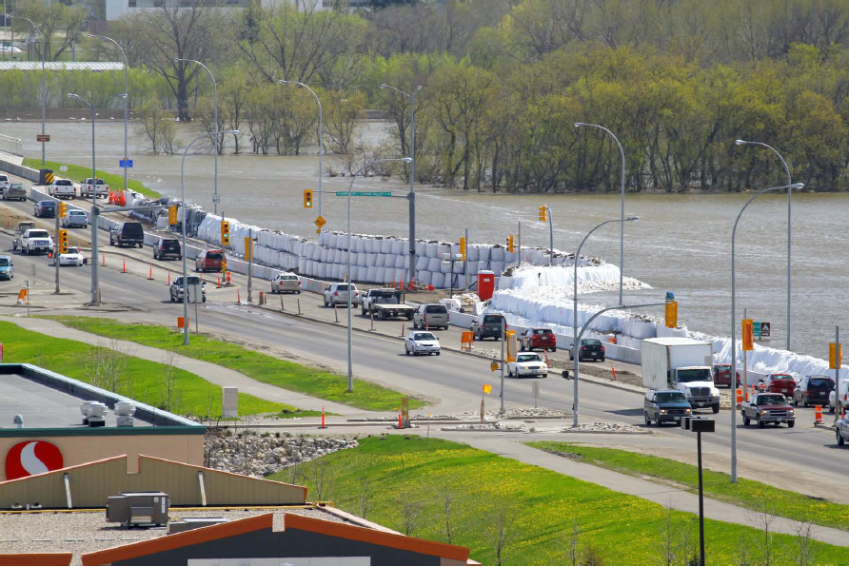
Notes:
A huge sand bagging effort was undertaken to keep 1st and 18th streets open. 1st street was eventually closed, but 18th street was open throughout the entire flood. Super sandbags were stacked 3 high on 18th street.

Slide 11
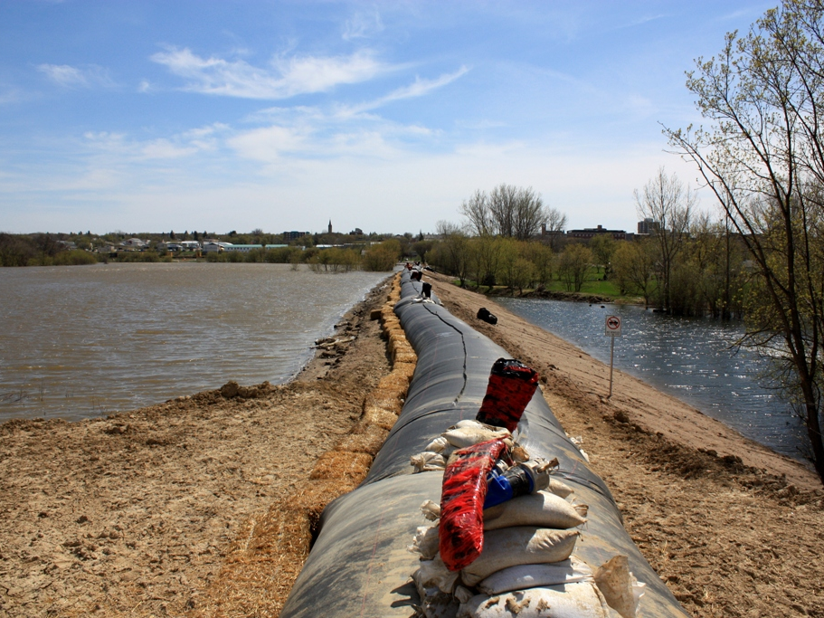
Notes:
Here is a section of earth dike that was raised. Notice the difference in water levels on the two sides on the dike.

Slide 12
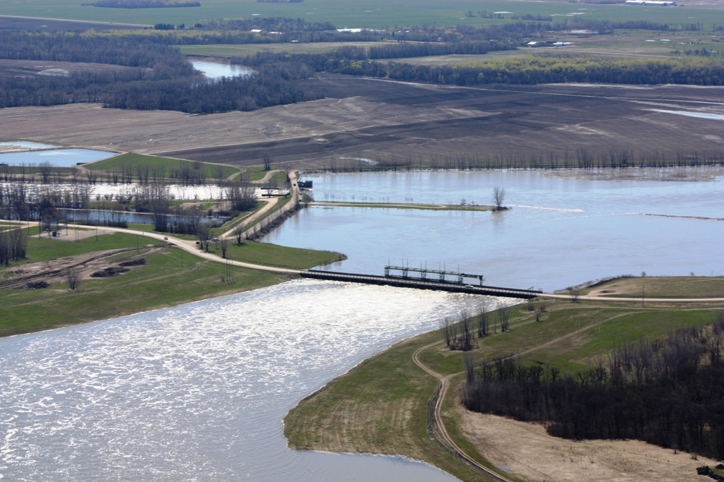
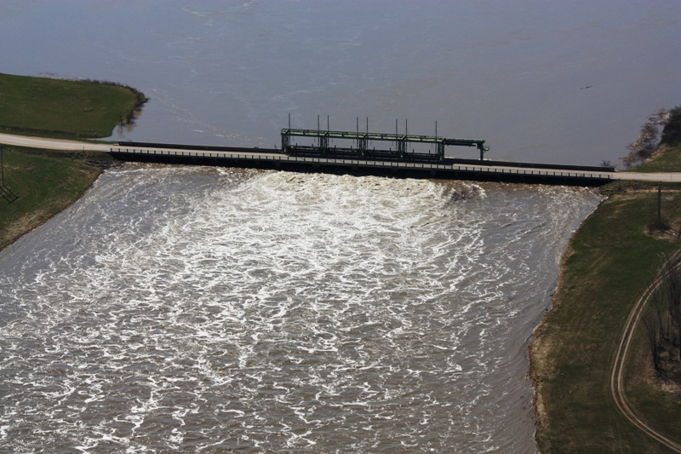

Portage Diversion
Construction finished in 1970 ($20.5 million)
Two control structures:
  Bascule gates control river flow
  Vertical gates control diversion flow
Diversion channel is 29 km long from Portage la Prairie to Lake Manitoba
Diversion design capacity is 25,000 cfs

Slide 13
Assiniboine R.
Portage
Diversion
Design
capacity
25,000 cfs
Capacity:
18,000 cfs
Portage
~38,000 cfs
Winnipeg
Brandon
Red R.
Wawanesa
Souris R.
Forecast:
54,000 normal weather
56,000 unfavourable weather
~15,000 cfs
Notes:
Moving downstream to Portage la Prairie.
The diversion and river had a combined capacity of 43,000 cfs.
With a peak flow forecast of 54,000 to 56,000 cfs forecasted, there was a huge problem of where over 10,000 cfs of flow would go.

Slide 14
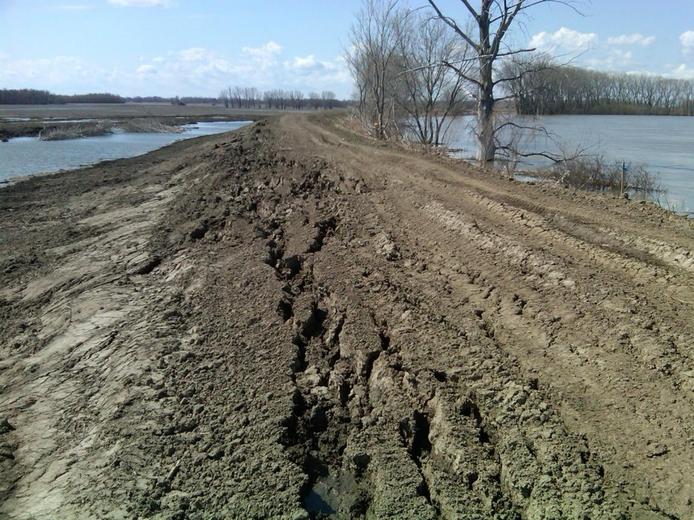
Notes:
The raised Assiniboine dikes were not in good shape. Many areas of the dikes had piping underneath, slippage, or inadequate free board. It was attempted to cautiously increase the flow to 19,000 cfs but within 24 hrs the trouble spots in the dikes were multiplying and the flow was reduced back to 18,000 cfs. To avoid increasing the risk of an uncontrolled breach, the river was held at 18,000 cfs.

Slide 15
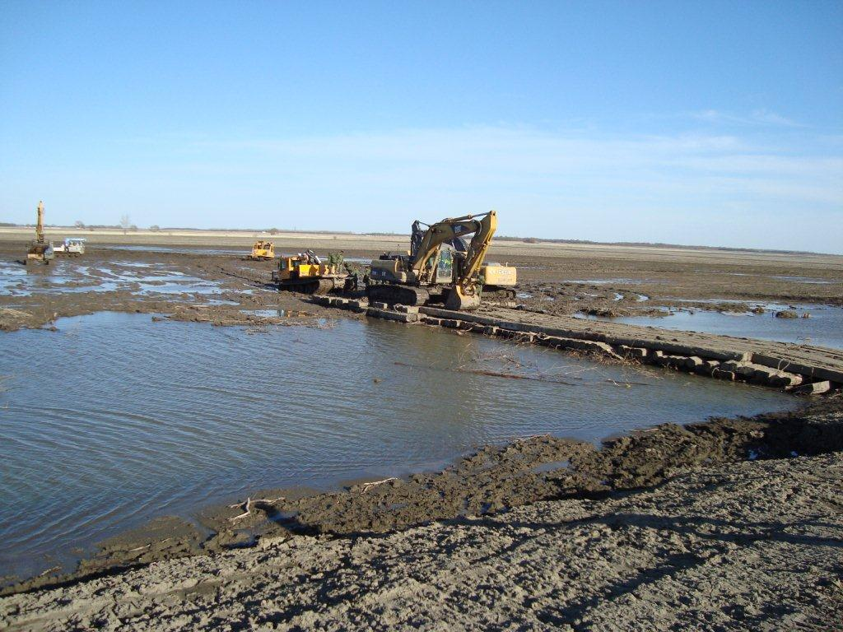
Notes:
Heavy rains left access to the dikes with heavy equipment difficult or impossible.

Slide 16
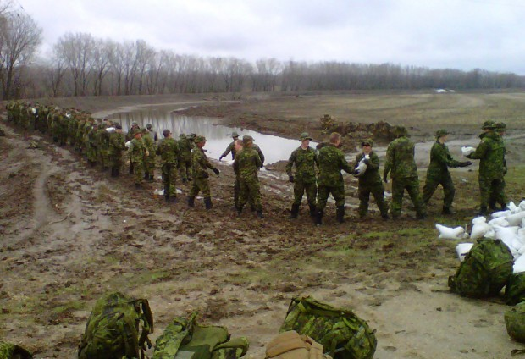
Notes:
Even at 18,000 cfs there were many areas of the dike that needed to be reinforced. Some of the locations were remote and not accessible because of the muddy conditions.
About 1200 military personnel were brought in to reinforce the dikes.

Slide 17
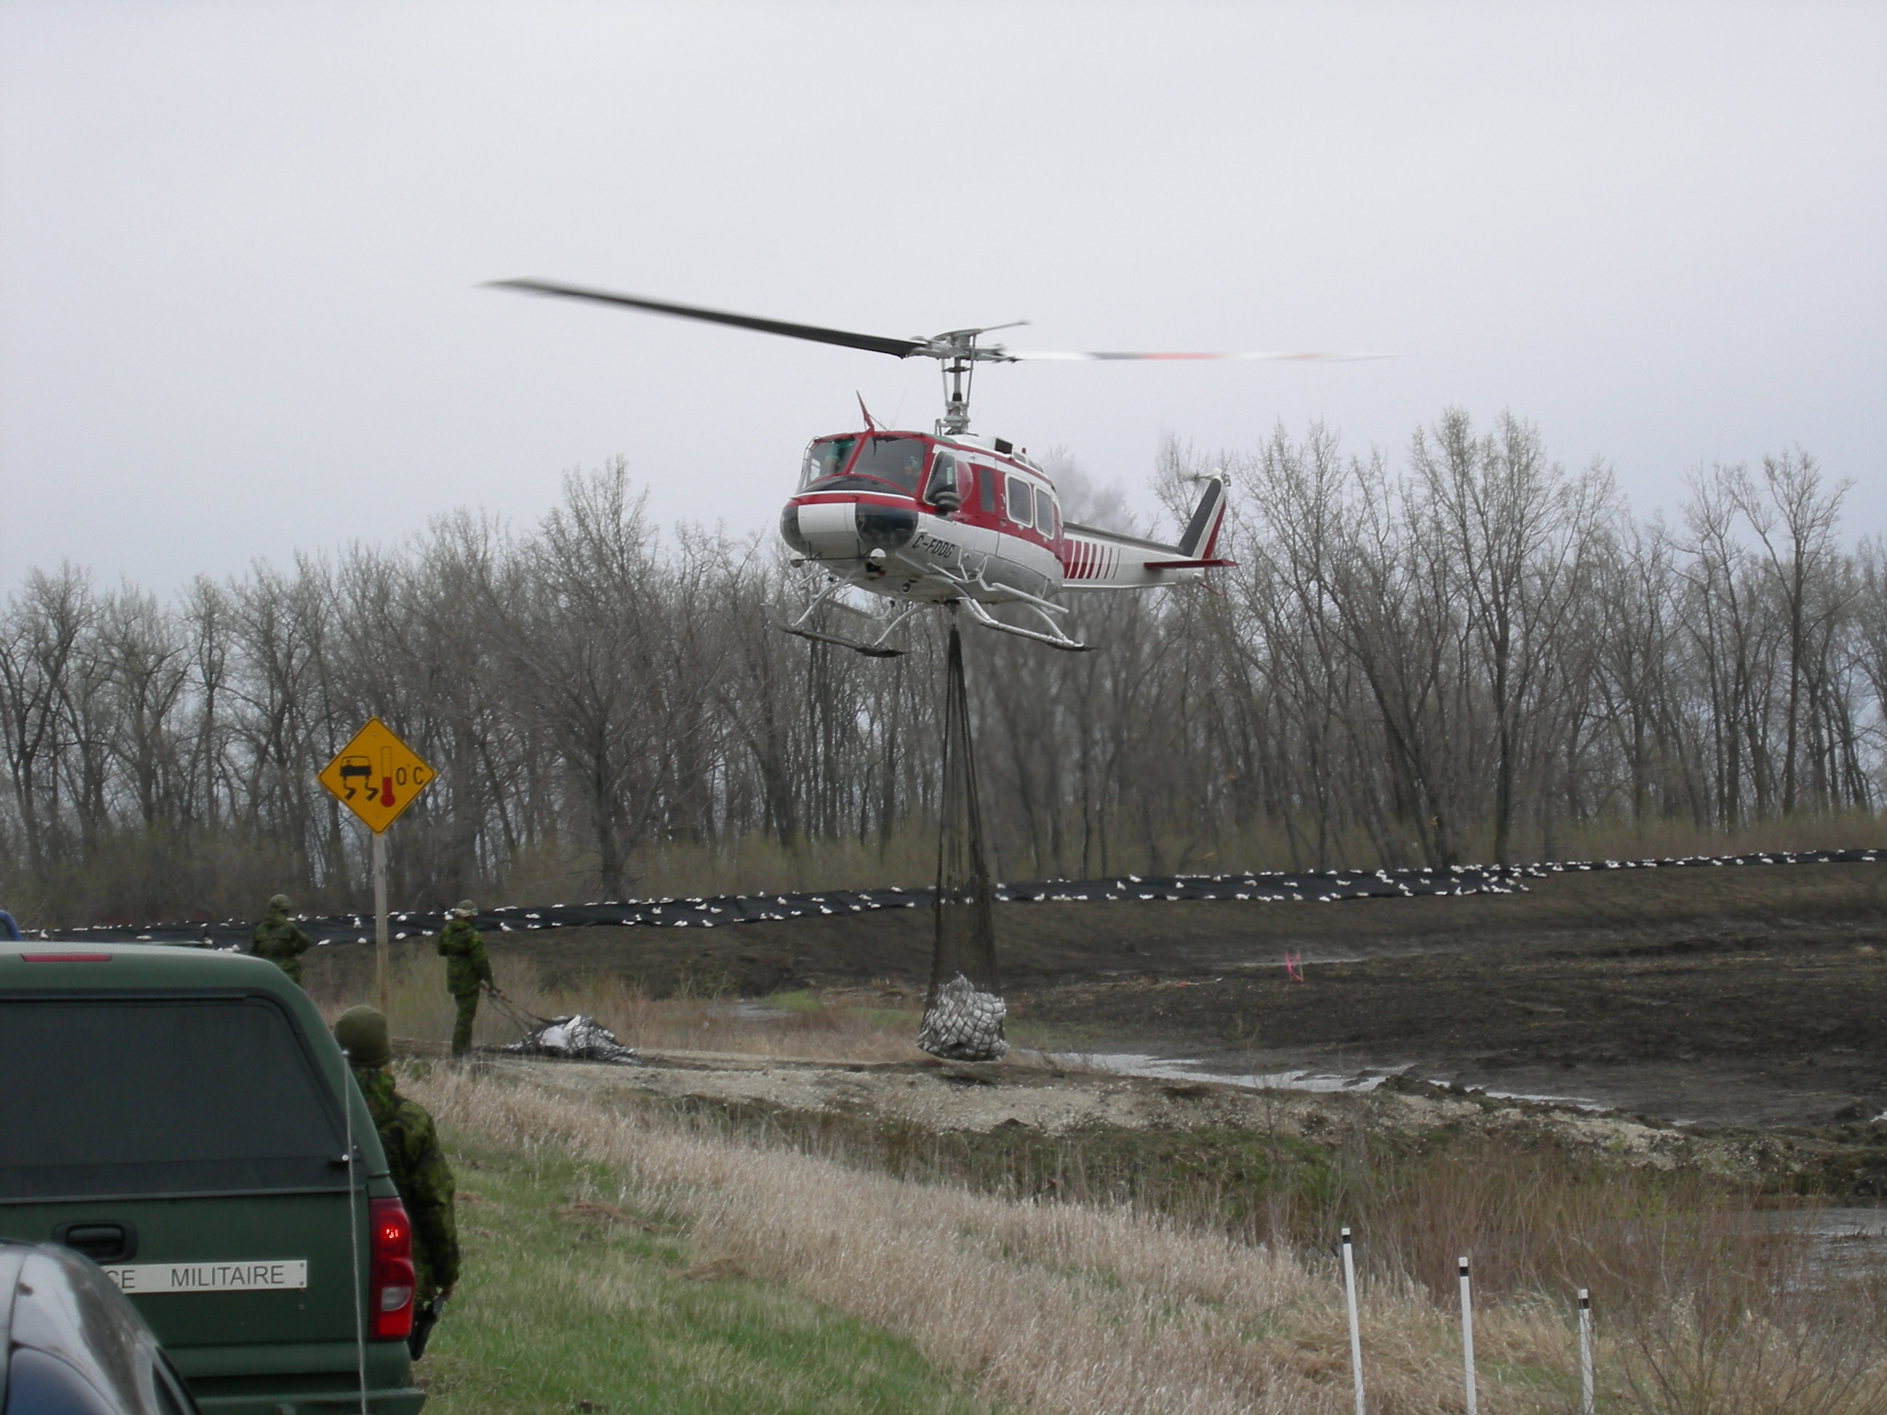
Notes:
Sand Bags were airlifted to the dikes with a fleet of helicopters.

Slide 18
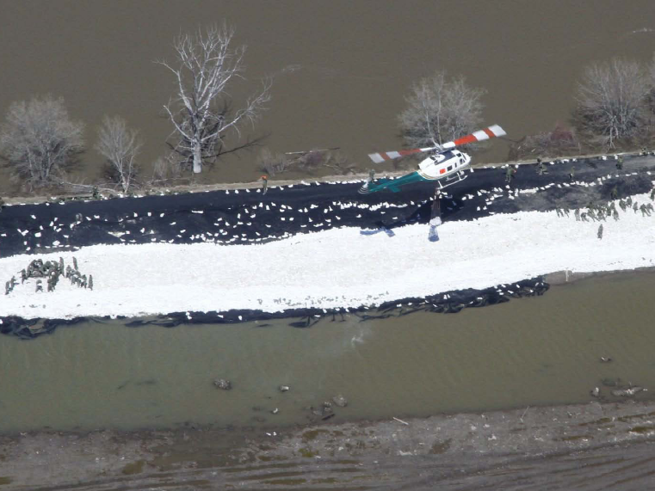
Notes:
Helicopters lifted sand bags to the dikes.

Slide 19
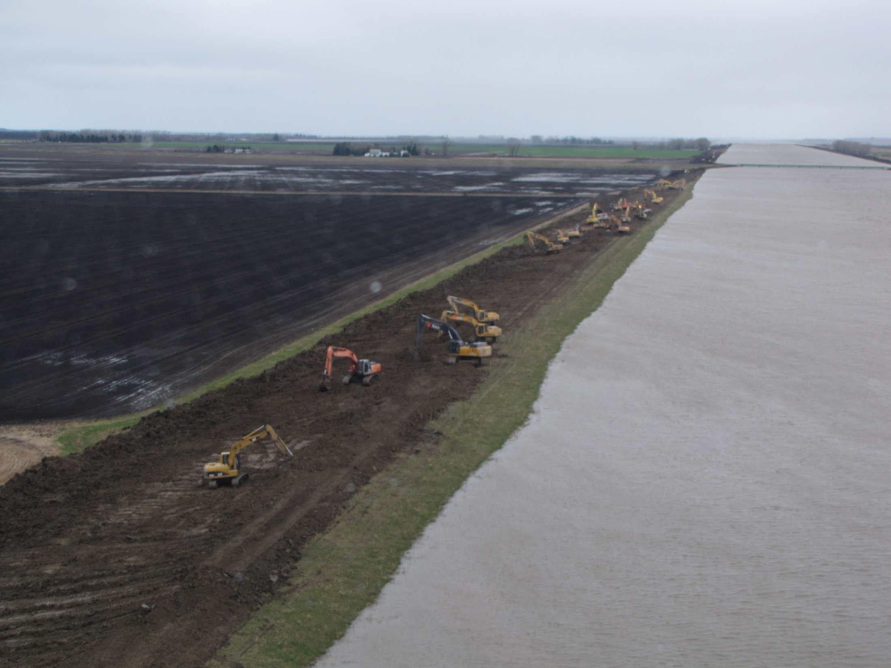

Slide 20
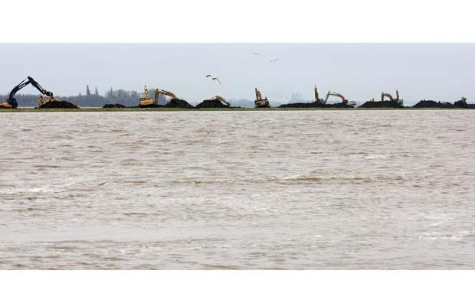
Notes:
With the River capacity limited, a huge effort was taken to increase the capacity of the Portage Diversion.

Slide 21
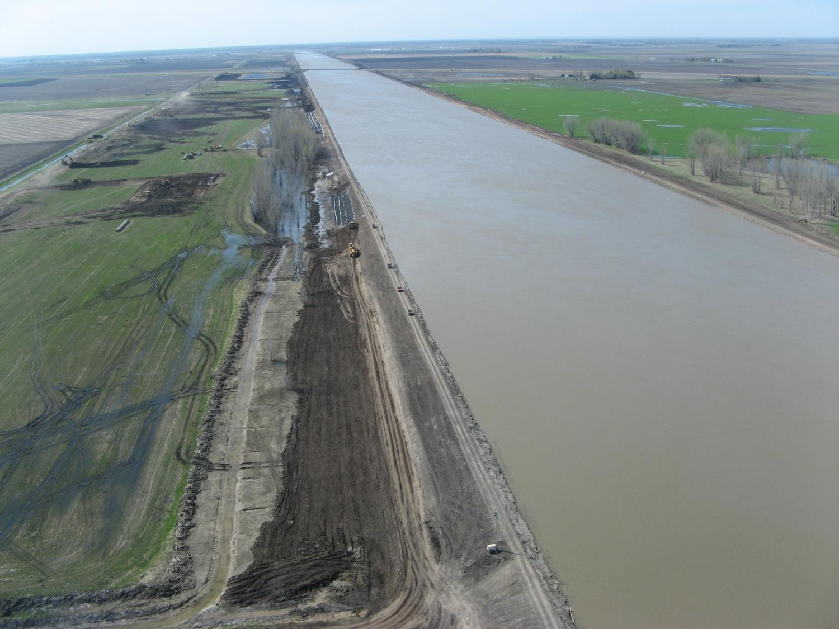
Capacity increased to over 34,000 cfs!
Notes:
The result of the work was that the portage diversion was able to carry 35,000 cfs, more than 10,000 cfs than its design capacity.

Slide 22
Increased to
~34,000 cfs
Assiniboine R.
Portage
Diversion
Design
capacity:
25,000 cfs
Capacity:
18,000 cfs
Portage
~38,000 cfs
Winnipeg
Brandon
Red R.
Hoop and Holler
release
Wawanesa
Souris R.
~15,000 cfs
Notes:
With the diversion now with a capacity of 35,000 cfs, the total capacity of the river and diversion was now 53,000 cfs. Where would the other 1,000 to 3000 cfs go?
It was determined that the best alternative was to make a controlled release point in the dikes at a place called the Hoop and Holler bend.
The decision for an CONTROLLED RELEASE of water from the Hoop and Holler bend was difficult, but necessary as these was a REAL THREAT of an uncontrolled breach along downstream, highly developed, reaches of the Assiniboine River.

Slide 23
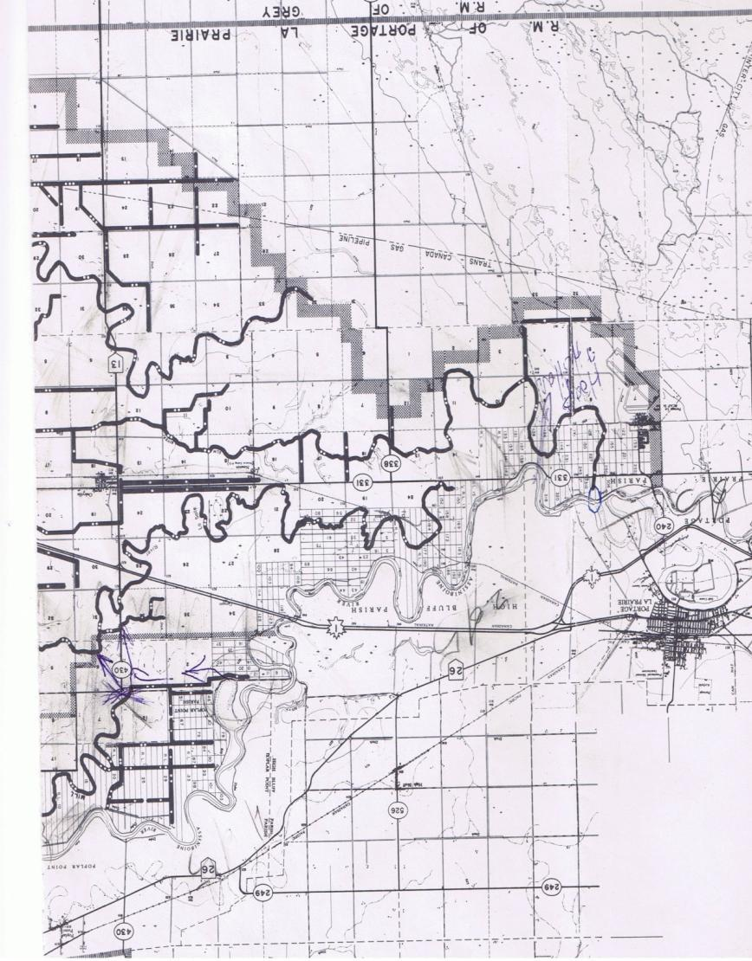
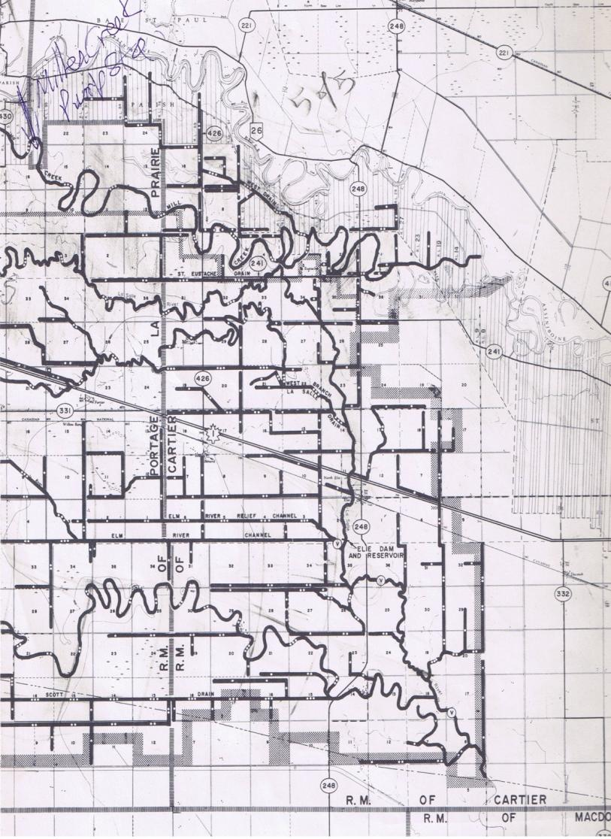
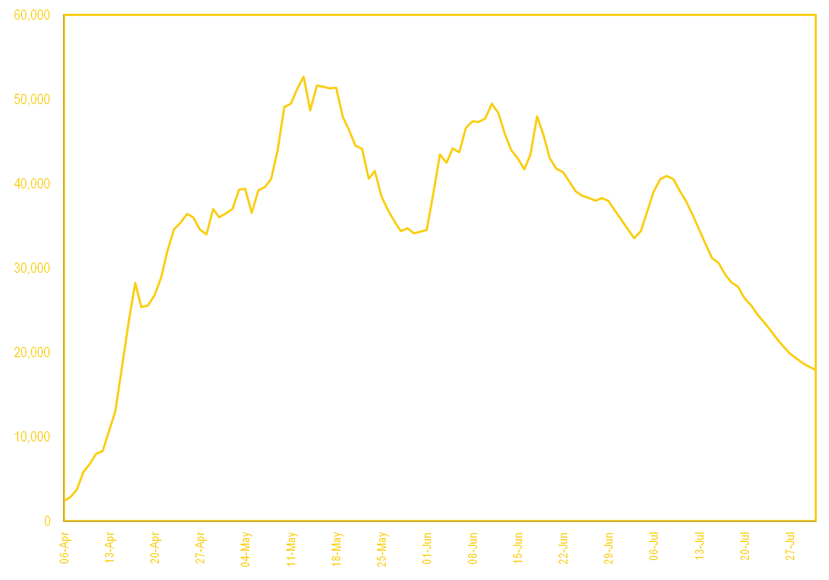
N
Serious Decision Making
Portage
Release Point
Notes:
Water would travel from the Assiniboine River into the Elm river and into the La Salle River further downstream.
Before the Diversion reached a capacity of 35,000 cfs, it was a possibility that up to 6000 cfs would need to be released. A release of a few thousand cfs would have flooded a large area along Elm River Channel.
Elie, Sanford, Starbuck, La Salle, Trans Canada Highway, CN railroad, were all at risk...

Slide 24
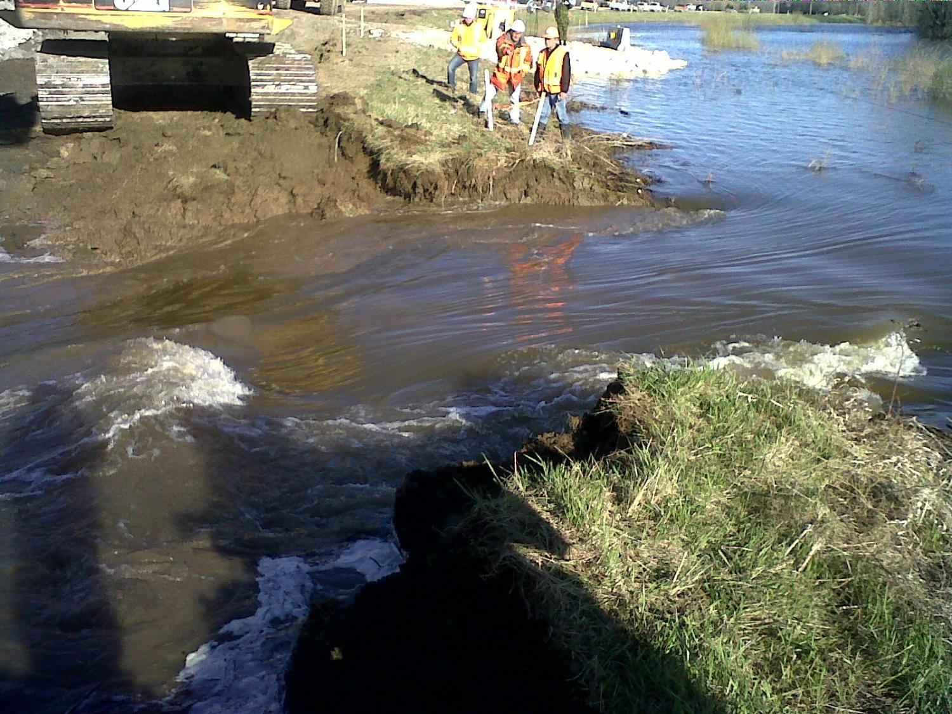
Controlled release of Assiniboine River at Hoop and Holler
May 14 – May 20
Notes:
As flows reached 53,000 cfs, the release was opened the morning of May 14. The release was open until May 20th.
The average release was only about 400 cfs. Good weather as the peak approached Portage a Prairie resulted in the peak flow at Portage la Prairie coming in at just over 53,000 cfs.

Slide 25
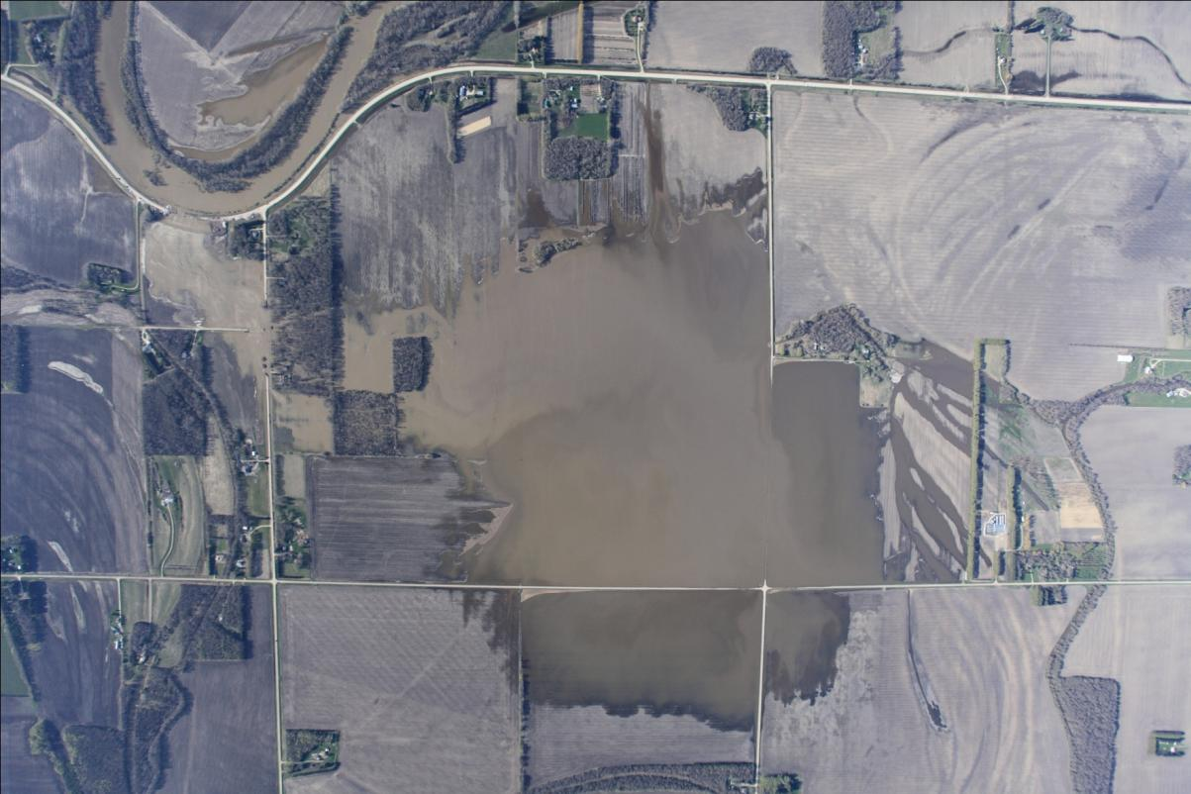
Notes:
The flooded area from the released was much less than expected. In the end, only a few km² of land was flooded.
As bad as the situation along the Assiniboine was, it was only a small amount of precipitation away from being much much worse, as any more flow would have had to go through the controlled release.

Slide 26
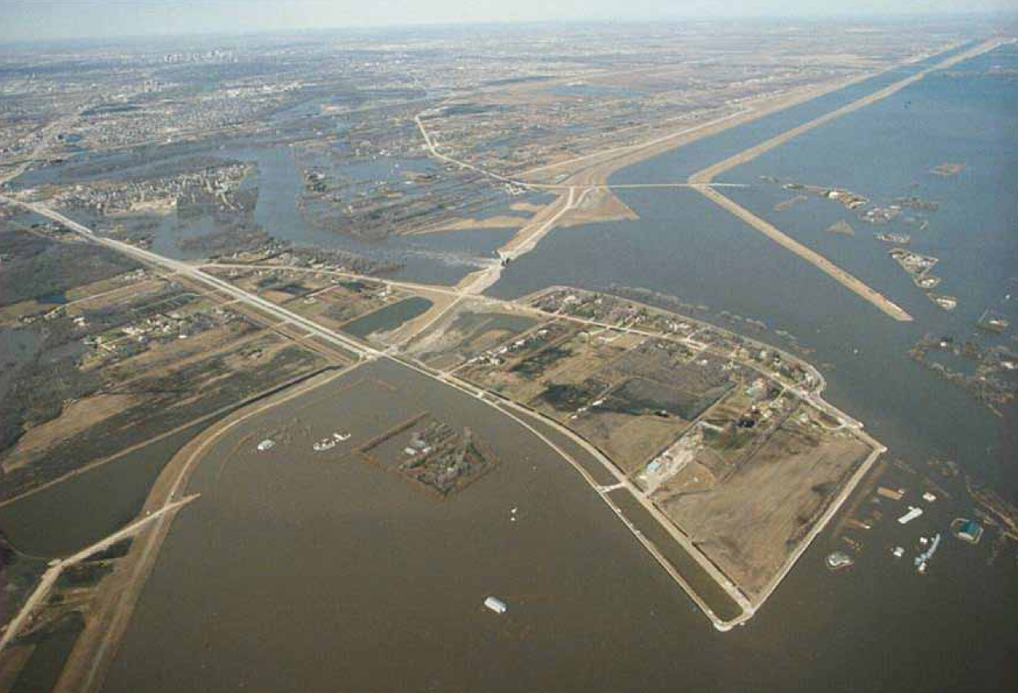
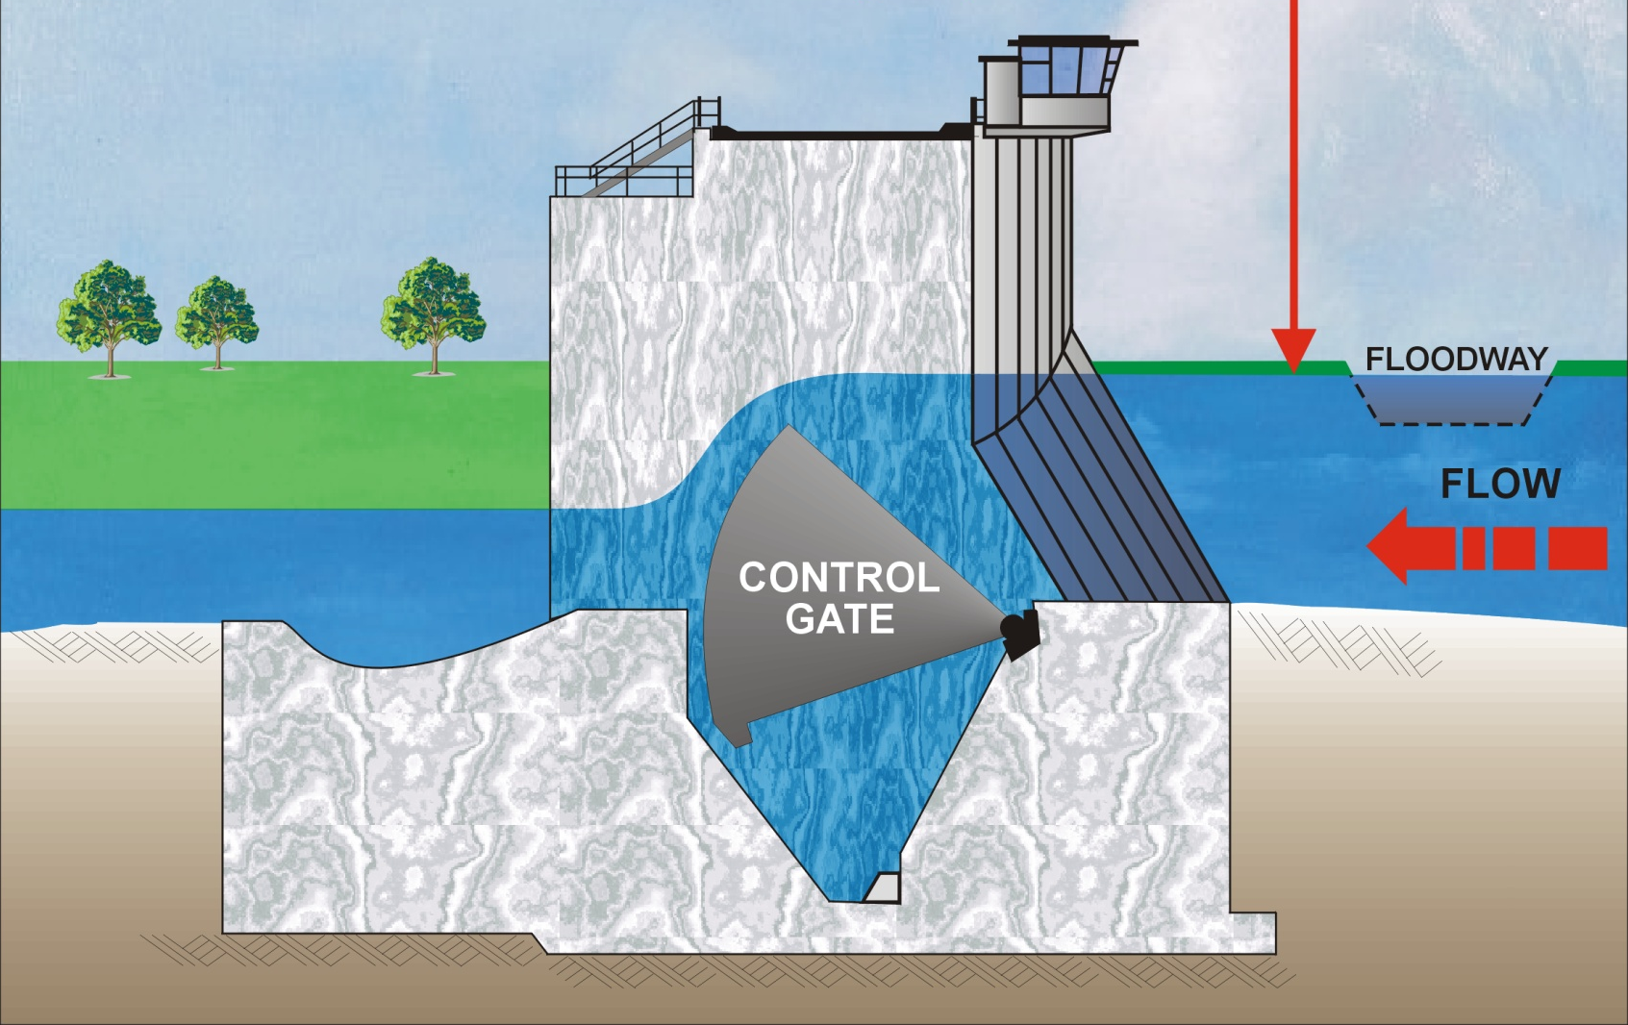
Floodway Operation

Slide 27
1826
1852
1997
2009
1861
2011
1950
1979
1996
2006
With Red River Floodway in operation
Notes:
Even though the flood in Winnipeg was lower than forecasted, it was still the 6th largest in the last 200 years.
It was exceeded only by the three historic floods of the 1800s, 1997 and 2009.
It exceeded the great 1950 flood. Without flood control infrastructure, the damage to Winnipeg would have likely been a few billion dollars.

Slide 28
2011 Winnipeg Water Levels

Slide 29
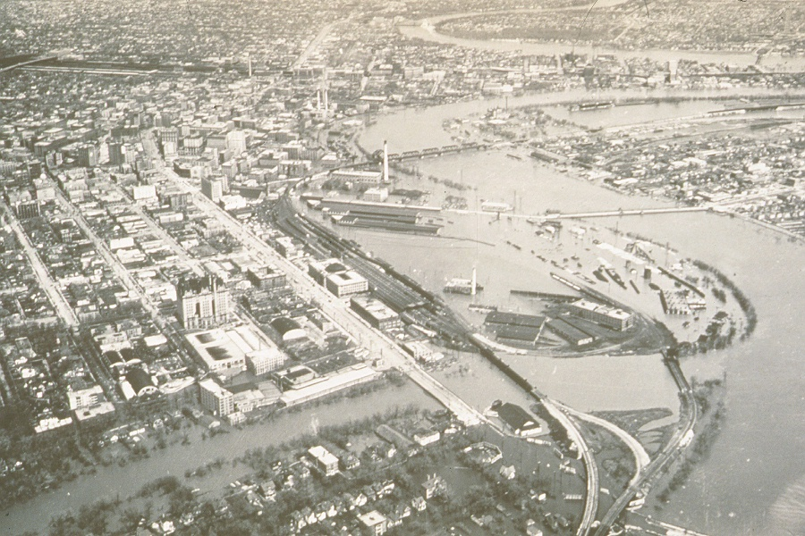
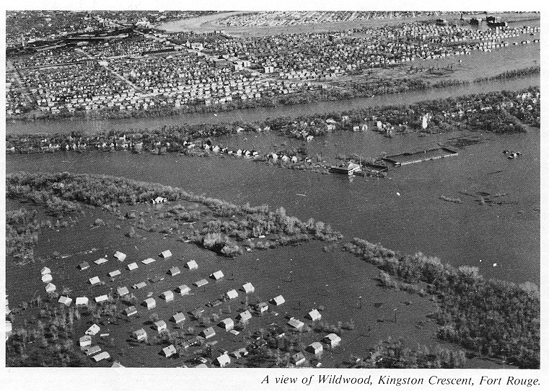
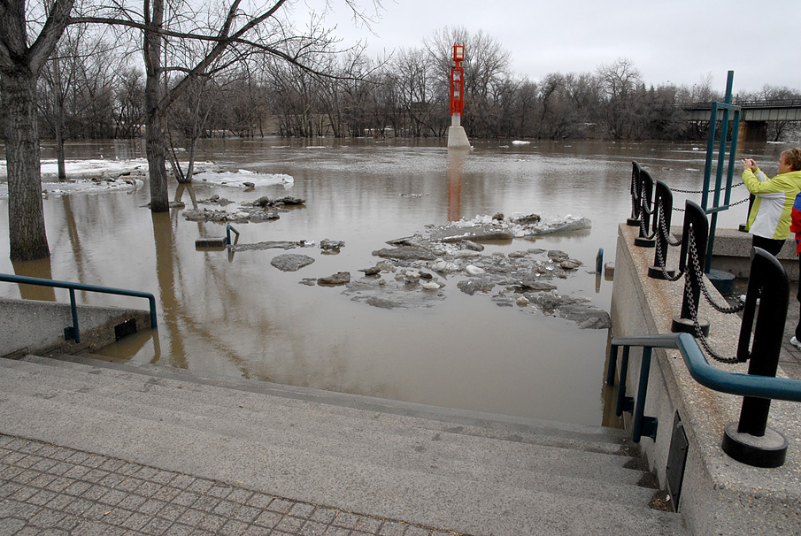
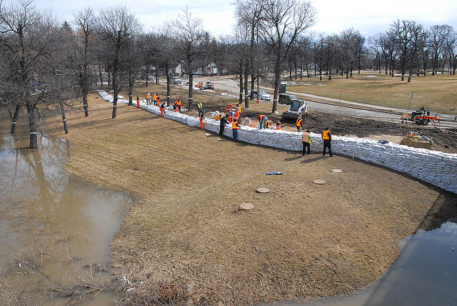

Slide 30
Benefits of Flood Infrastructure
Since 1970, flood infrastructure has prevented $40 billion dollars in damage
2011 flood:
  Flood damages totalled approximately $1 billion
  Without Shellmouth Dam, Portage Diversion, Brandon Dikes, Assiniboine River Dikes, and Red River Floodway, damages are estimated at $6 billion dollars, with $3.7 billion in Winnipeg alone.

Slide 31
Thank You!
Mark Lee, M.Sc., P.Eng.
Manager, Surface Water Management
Water Science and Management Branch
Conservation and Water Stewardship
Box 14, 200 Saulteaux Crescent
Winnipeg, Manitoba R3J 3W3
Ph. (204) 945-5606, Fax (204) 945-7419
E-mail Mark.Lee@gov.mb.ca

