Slide 1
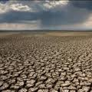
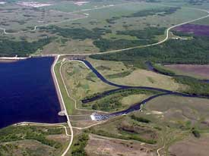
Manitoba Drought Management Strategy
Prepared by:
Abul Kashem, P. Eng.
Surface Water Management Section
Manitoba Conservation and Water Stewardship
PPWB Hydrology Workshop
Winnipeg, January 29-30, 2013

Slide 2
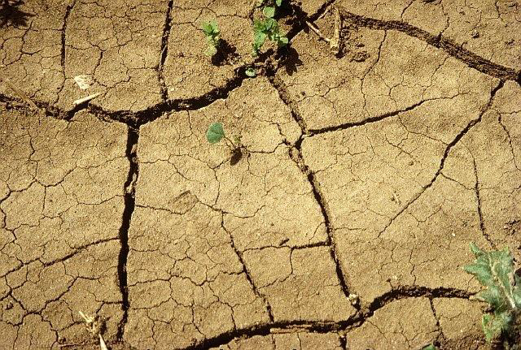
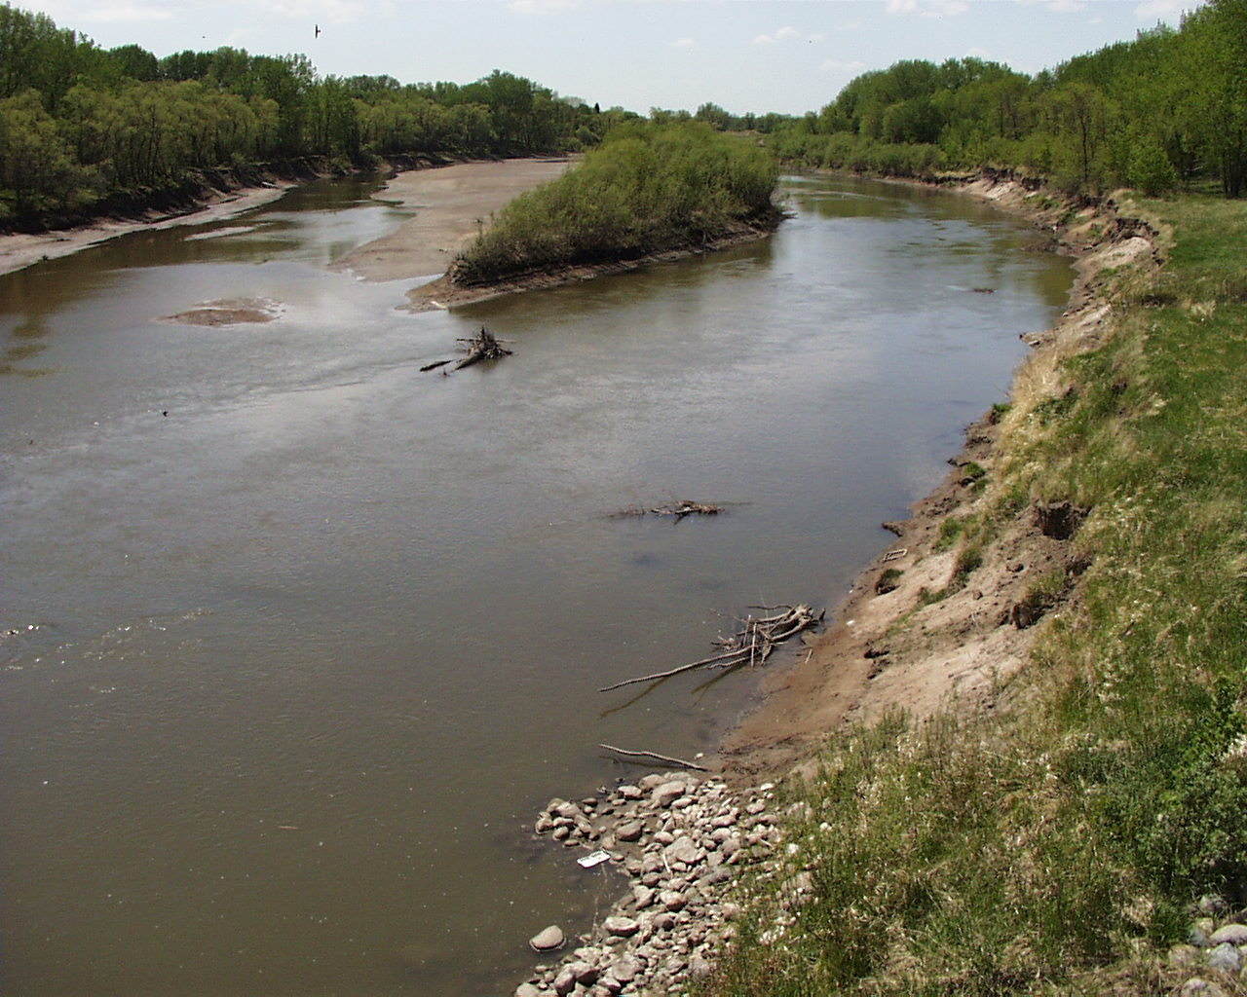
Outline
Context
Defining Drought
Determining Drought
Drought Indicator
Preparedness
Assessment of Drought Stages
Reporting
2

Slide 3
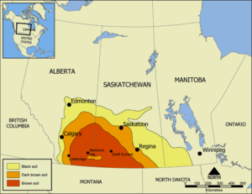
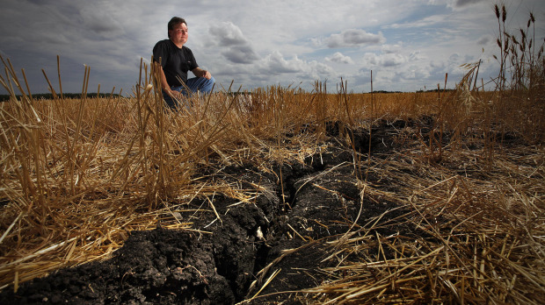
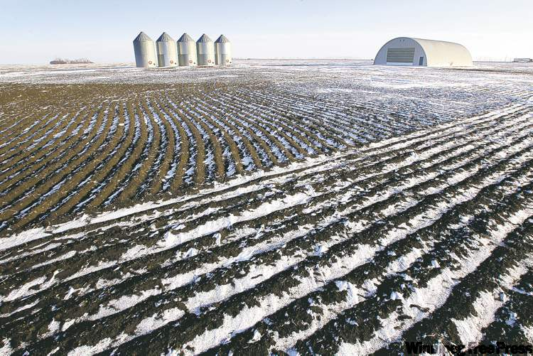
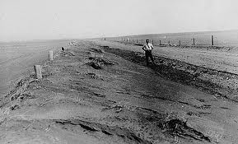
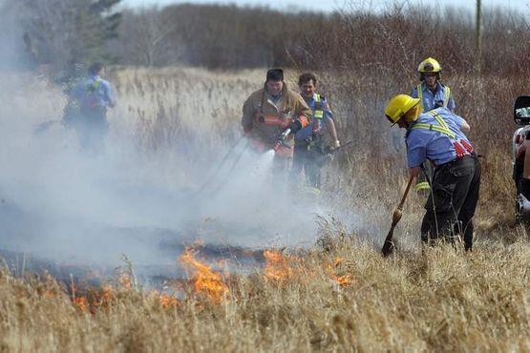
Historical Drought
Palliser Triangle
Aug 2011, near Winnipeg, The Globe and Mail
Red River 1936
Winnipeg Free Press, Jan 25, 2012
Red River 1988
Are we prepared for a prolonged drought?
Are our water supplies sufficient?
How do we know if we are in a drought?
March 2012
3

Slide 4
Red River’s low flows
4

Slide 5
Defining Drought
Drought is a natural hazard caused by a shortage of water resulting in direct impacts on both human and environmental wellbeing, for a given period of time, for any location(s) where natural or managed water systems fail to meet the typical water demand for human and environmental uses
5

Slide 6
Determining Drought
  How do we know if we are experiencing a drought?
  Assess two components:
    Indicators
    Preparedness levels
6

Slide 7
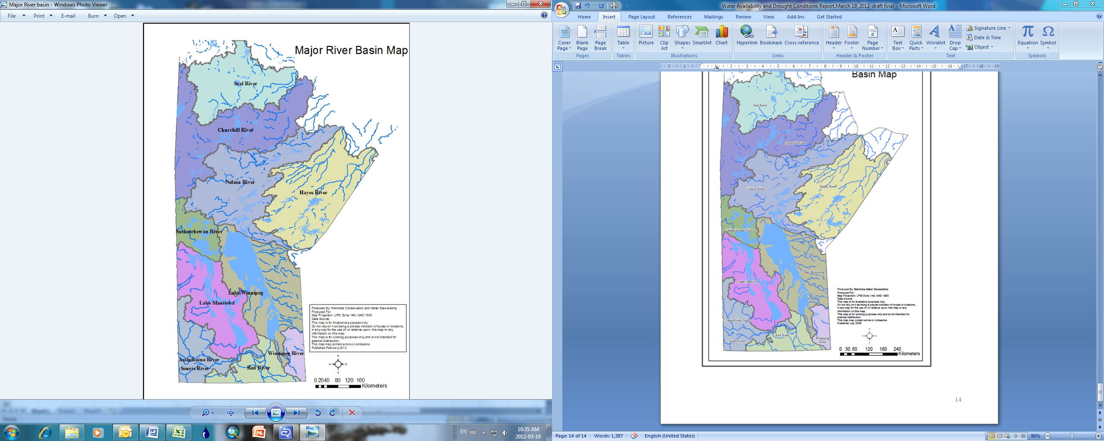
Drought Indicators
  Drought indicators help to determine if the basin conditions are:
    Normal
    Moderately dry
    Severely dry
    Extremely dry
  Developed primary and secondary indicators for Manitoba
    Primary: Precipitation and Streamflow
    Secondary: Groundwater
7

Slide 8
Drought Indicators (Contd..)
  Precipitation Indicators
  Percent of Median
  Precipitation Percentile
  Streamflow Indicator
  Flow Percentile
  Ground Water Indicator
    Ground Water Level Percentile
8

Slide 9
Drought Indicators (Contd..)
 | Indicator Thresholds
 | Percent (%) of Median Precipitation | Precipitation Percentile (Lowest 5th-20th-35th ) | Flow Percentile (Seasonal) (Lowest 10th-20th-35th ) | Ground Water Level Percentile (Lowest 0.10th-5th-25th )
 | Actual precipitation compared to % of median for 1, 3 or 12 months | Most current month precipitation compared to historical lowest percentiles | Most current month streamflow compared to historical lowest percentiles for each season | Most current month streamflow compared to historical lowest percentiles for each season
Normal condition | >80% of median for 3 months | >35th | >35th | >25th
Moderately dry | 60%-80% of median for 3 months or 12 months | 20 -35th | 20 -35th | 5 -25th
Severely dry | 40%-60% of median for 1 month or 3 months | 5 -20th | 10 -20th | 10 -20th
Extremely dry | <40% of median for either 1 month or 3 months | = or <5th | = or <10th | = or <10th
9

Slide 10
Drought Indicators (Contd..)
Moderate- 14%, Severe-6%, and Extreme -1% of time
Moderate- 5%, Severe-6%, and Extreme-1% of time
10

Slide 11
Drought Indicators (Contd..)
Moderate- 10%, Severe-7%, and Extreme -6% of time
Moderate- 10%, Severe-7%, and Severe -6% of time
11

Slide 12
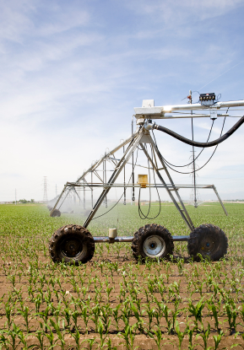
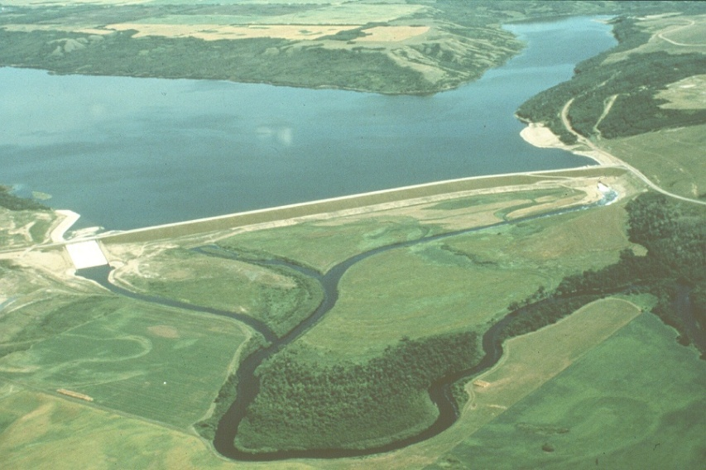
Preparedness
  Assessment of drought stage also requires information on basin’s preparedness level
  Preparedness is the basin’s resiliency to withstand a drought
  Need to assess preparedness across basins – water supply infrastructure, communication, etc.
12

Slide 13
Assessment of Drought Stage
  Drought stages (Normal, Moderate, Severe and Extreme) determined through assessment of drought indicators and preparedness level
Drought Indicator | Preparedness Level
 | None | Low | Medium | High
Normal | Normal | Normal | Normal | Normal
Moderately dry | Moderate | Moderate | Moderate | Normal
Severely dry | Severe | Severe | Severe | Moderate
Extremely dry | Extreme | Extreme | Severe | Moderate
13

Slide 14
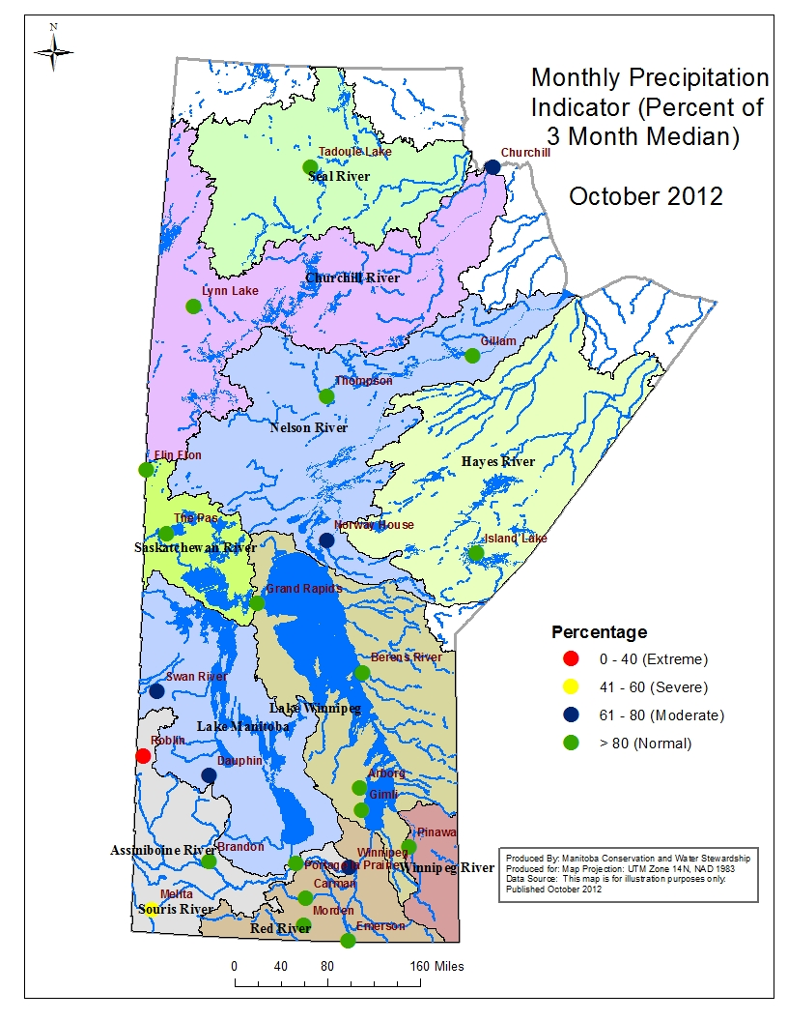
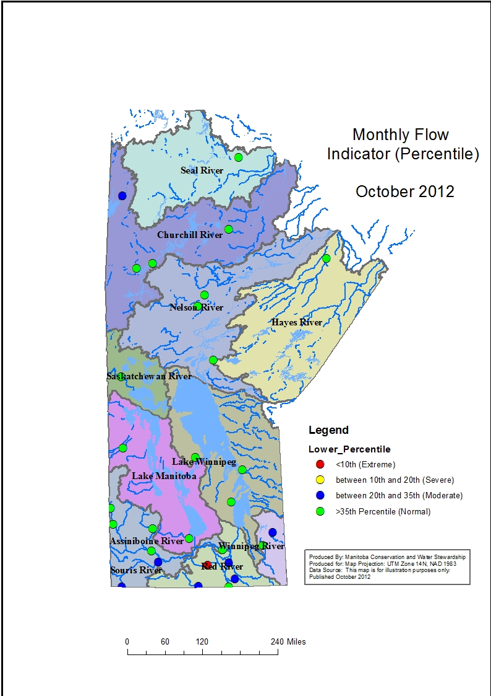
Reporting
Reporting on Water Availability and Drought Conditions
http://www.gov.mb.ca/conservation/waterstewardship/water_info/hydrology/drought.html
14

Slide 15
  Thank you
15

