Slide 1
Lake Flood Protection Level Determination in Manitoba
Bin Luo, PhD, P. Eng
Conservation & Water Stewardship

Slide 2
Content
Background
Technical details
Water level frequency
Wind setup
Wave uprush
Standard
Notes:
General introduction of background lake FPLs
Technical details especially the fields have potential for future exploration
Mention the FPL standard we’re still in debate

Slide 3
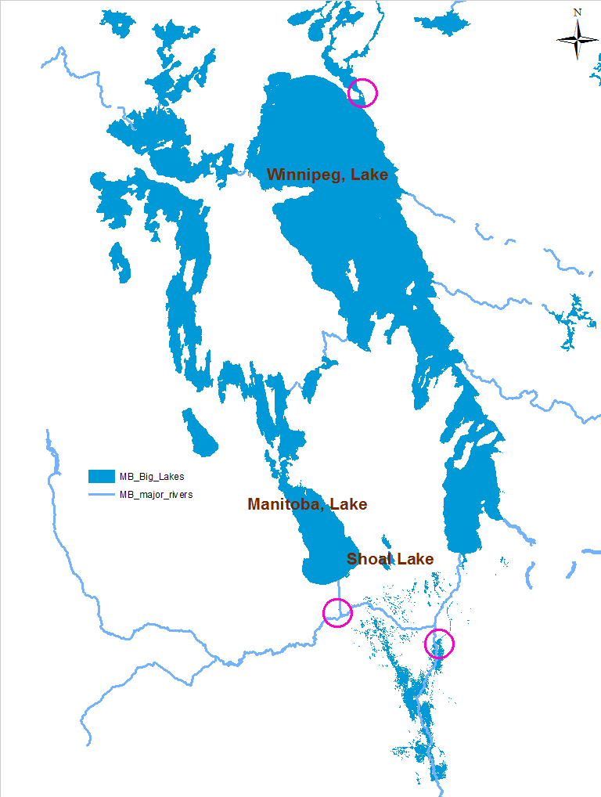
Jenpeg Hydro Dam
A Flood Protection Level is a building level for properties/dikes around a waterbody to mitigate flooding damage
Extreme high water levels in 2011
Regulated by hydraulic structures
Portage Diversion
Red River Floodway

Slide 4
Big Liability
High risk cost to use low FPLs
Most of the existing flood protection levels around the lakes are based on 100-year event
Hundreds of cottages were destroyed along Manitoba lakes due to the May 31, 2011 windstorm during which the water levele have a return period higher than 100 years
Huge infrastructure cost to increase FPLs
Huge cost to construct dikes protecting communities along the lakes
Very expensive to increase the building levels of properties along the lakes

Slide 5
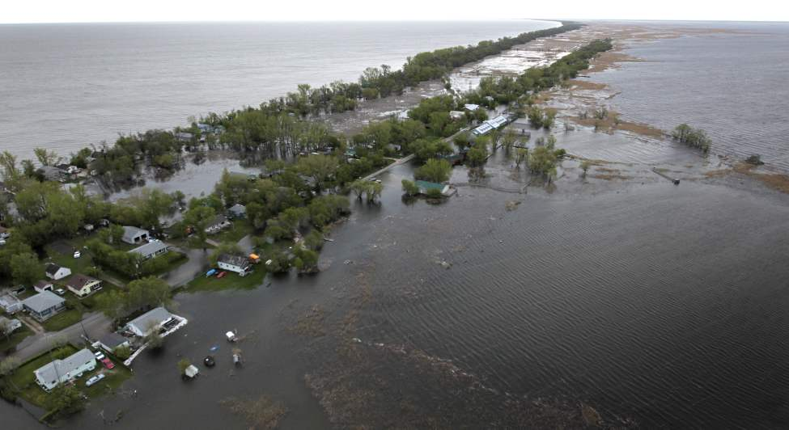

Slide 6
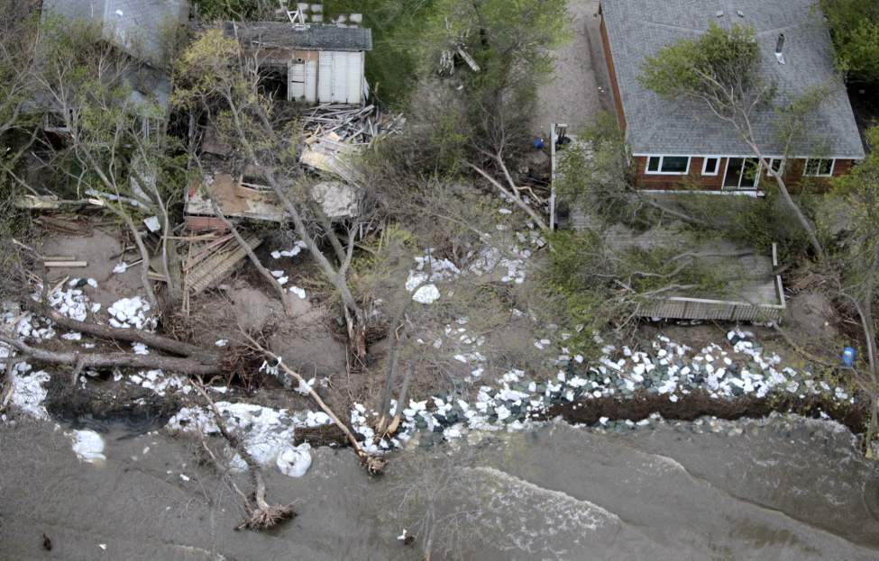

Slide 7
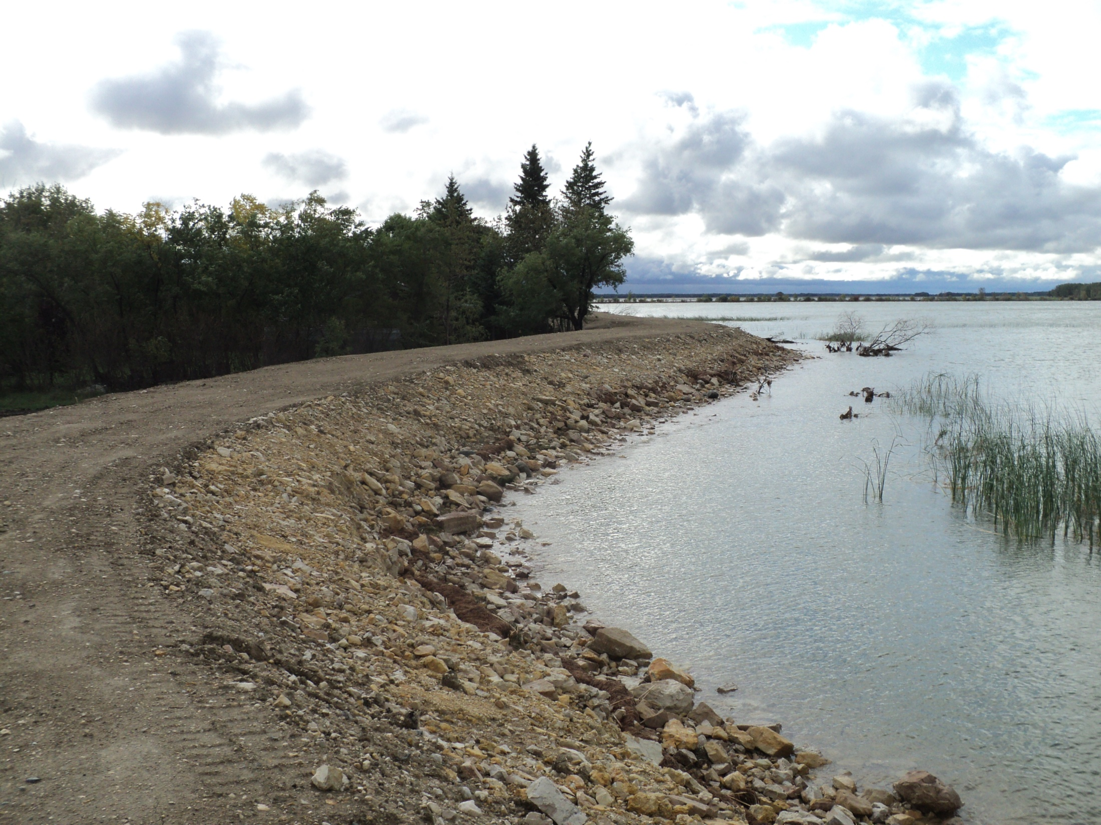

Slide 8
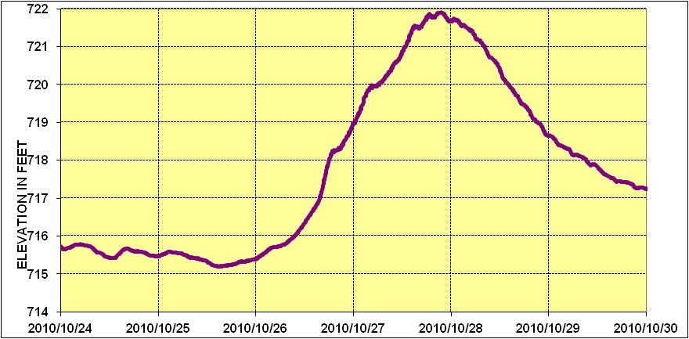
Wind effects
Uprush
Wave Action
Sustained Wind
Setup
Setdown
Crest level
Instantaneous peak level
WEE level
Maximum
setup
Notes:
Still wave levels plus a sustained wind causes setup on the Lake. This further causes wave up-rush on the shoreline. Wind effects can cause Lake St. Martin water levels be 2 to 3 feet above the still water level..

Slide 9
Lake FPL Component
Wind setup
Wave action
WEE Level

Slide 10
Lake FPL Determination
Uncertainty
Wave Theory
Lake Hydrology

Slide 11
Water Level Frequency

Slide 12
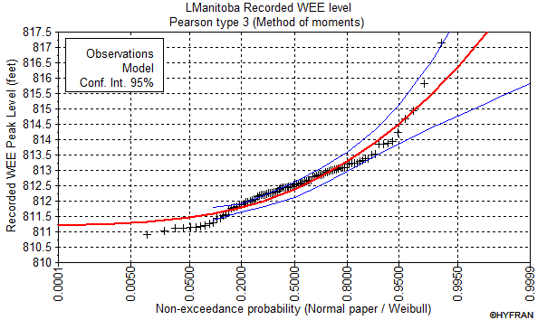
Water Level Frequency (Controlled Water Level)

Slide 13
Wind Setup
Setup ~ F×U²/d
F – fetch length
U – wind speed
d –water depth along fetch

Slide 14
Fetch for Setup Calculation (USACE EM 1110-2-1420)

Slide 15
Effective Fetch For Wave Calculation

Slide 16
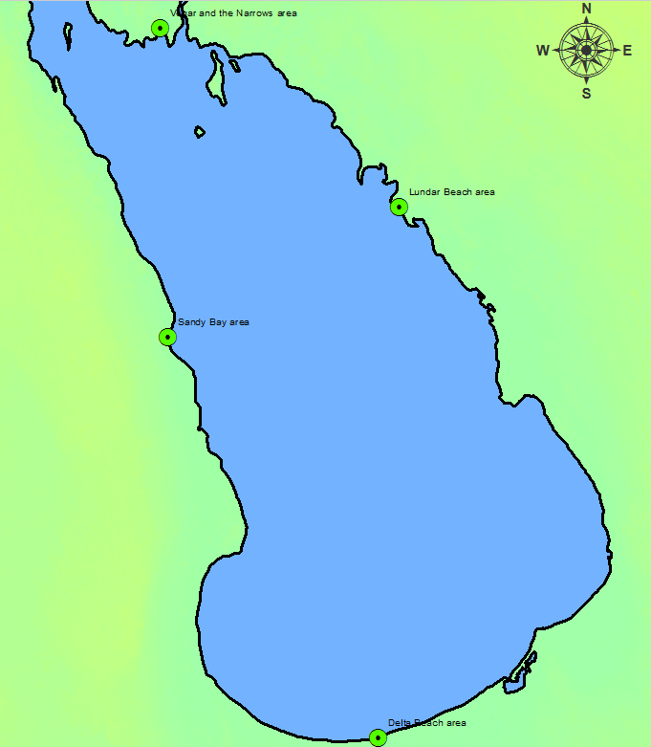
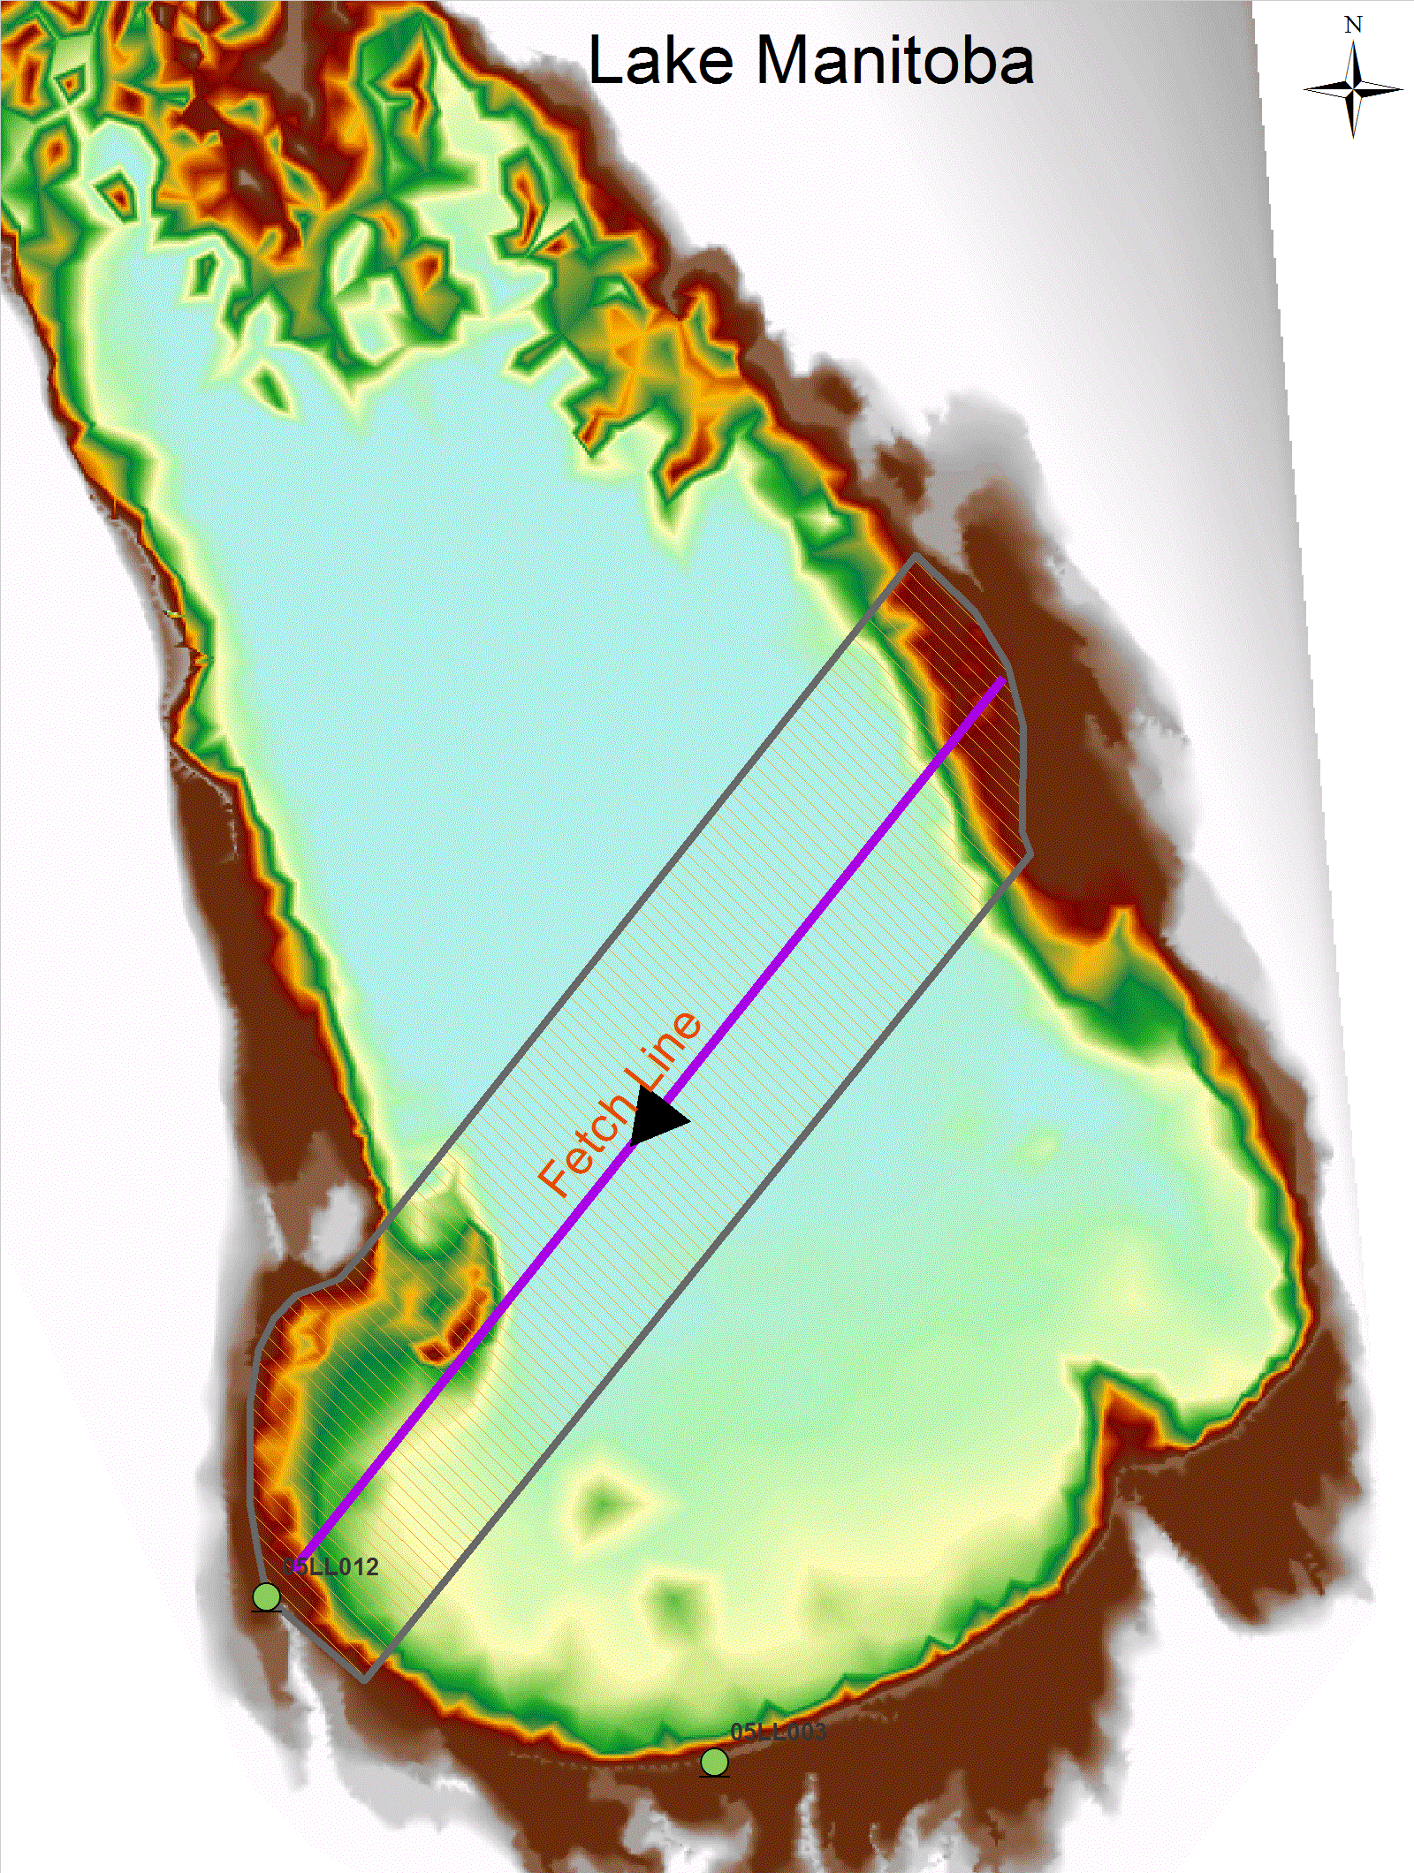

Slide 17
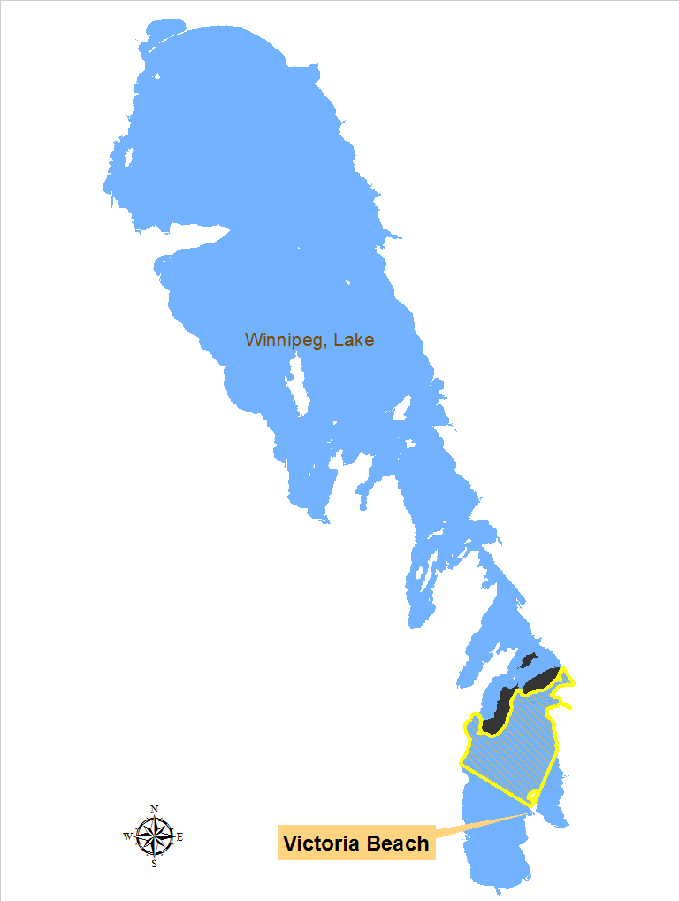
Islands

Slide 18
Wind Duration

Slide 19
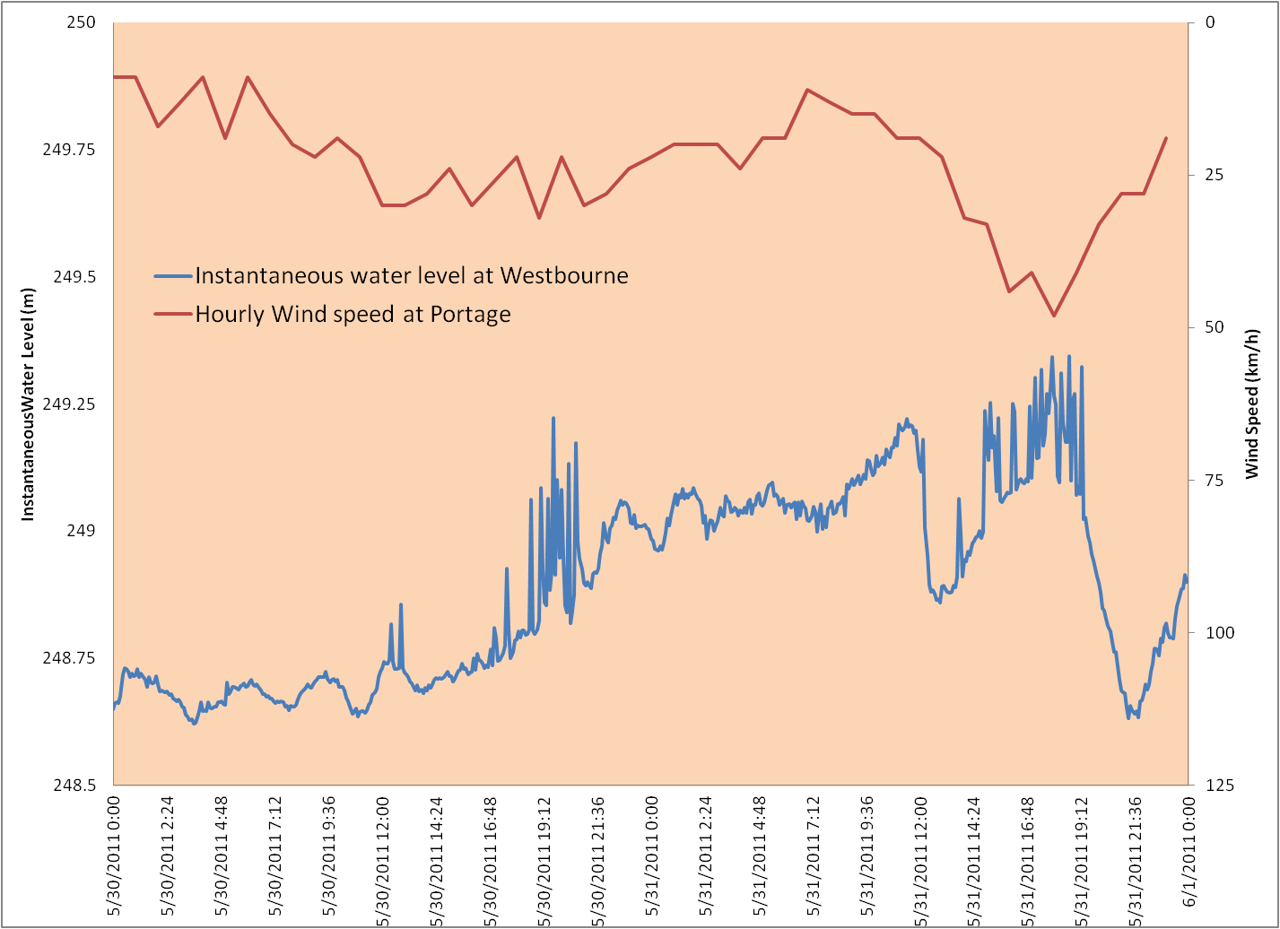
Recorded Data

Slide 20
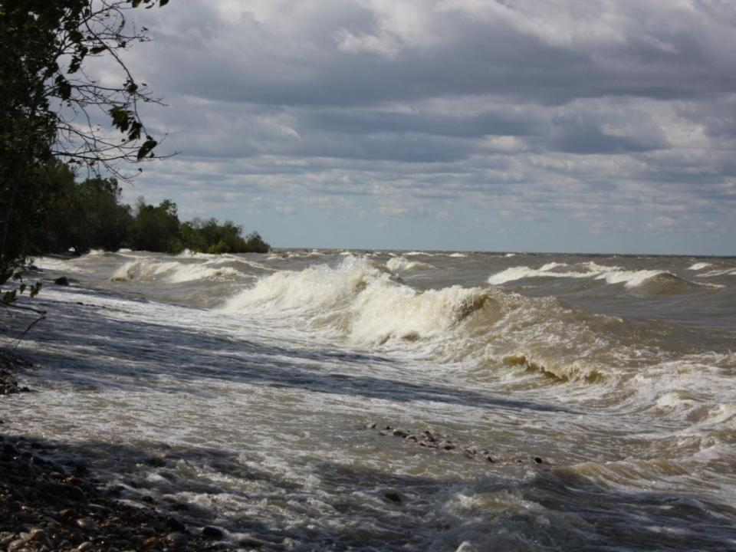

Slide 21
Wave Action
3 ft wave
6 ft
uprush
1.5 ft
1:2 slope
3 ft wave
4 ft
uprush
1.5 ft
1:5 slope
1 ft uprush
1.5 ft
3 ft wave
1:20 slope
Notes:
Different shoreline slopes cause different wave up-rushes.
Flatter the slopes the lesser the up-rush.
3 feet is comprised of wind setup (.08 ft) and wave runup on a 1:10 shoreline based on a 40 mph wind. This may be the origin for requests for flooding rights to 80.0 ft, considering the maximum elevation of Lake St. Martin is about 803. ft.).

Slide 22
Wave Height and Period
Notes:
A wave is classified as a shallow water wave whenever the ratio of the depth (the vertical distance of the still water level from the bottom) to the wave length (the horizontal distance between crests) is less than 0.04. Such waves propagate according to the formula: C = %gd where C is the wave speed, g the acceleration of gravity, and d the depth. Tidal waves are shallow water waves.

Slide 23
Incident Wave Height
Incident Wave
Height

Slide 24
Wave Refraction
A
B

Slide 25
Wave Decay
H_{i}
H_{m}
d_{s}

Slide 26
Wave Decay Factors

Slide 27
Lake Manitoba Wave Decay

Slide 28
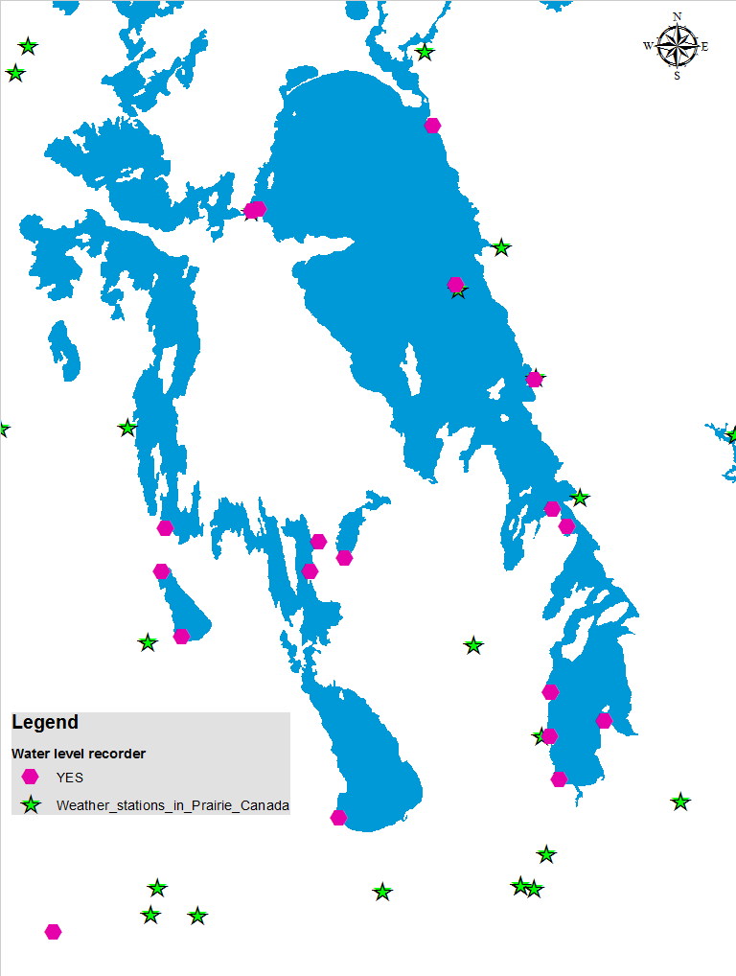
Data Availability

Slide 29
FPL Standard
100-year flood level
Historic flood level
Maximum
Tier-1 city 500-year
Tier-2 city 300-year
Tier-3 city 200-year
Tier-4 city 100-year

Slide 30
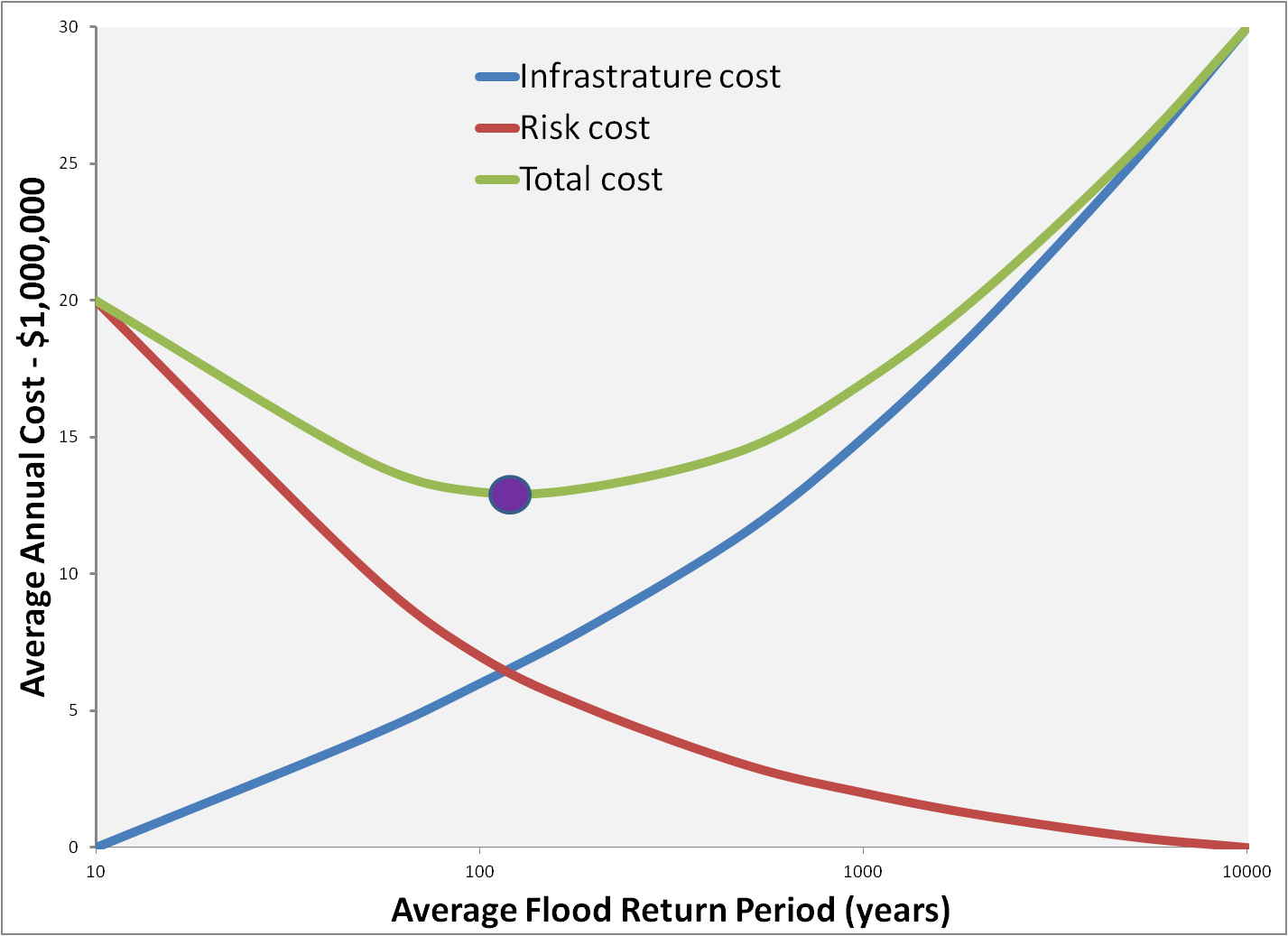
Risk Assessment

Slide 31
Thank You!

